Slide 1
College of Technology Student Success
Kara Harris
Andrew Phillip Payne

Slide 2
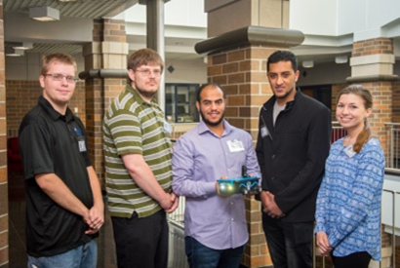
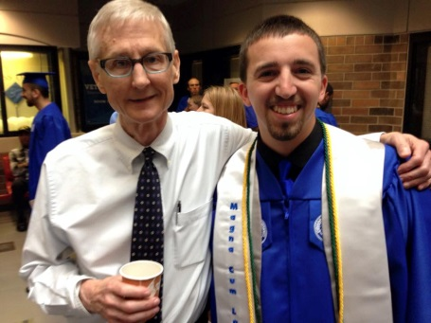
How we “Success”
Many initiatives are organized and executed centrally with departmental direction, support, and input.
We work across campus
Teamwork with a common goal
Departments focus their greatest efforts on creating success in their content areas with support from the college.

Slide 3
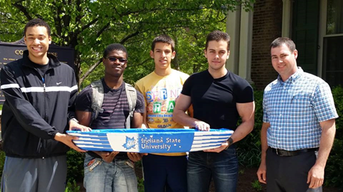
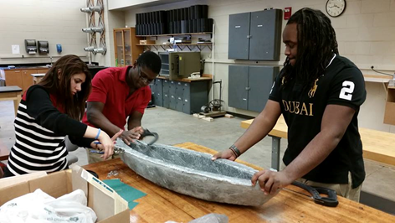
Allocating Success Funding
The College funded two types of initiatives
College-level Pilot
Program Specific Pilot
The College of Technology Student Success Supporters S3’s
Inflatable Architecture Project
All other “Planned” Student Success Initiatives were running simultaneously

Slide 4
College of Technology S³ (Student Success Supporters)
Accomplishments
Conducted 578 audits of student records that were at 75 hours or more
In process of continuing to contact students and advisors regarding audits
In process of mapping and trending audits
Contacting prospective students via call center (different goals)
Transfer student advising
Objectives/Actions Not Achieved
Contacts still in process
Tracking the number of updates that were completed in MySam was not completed, as we still have not found a systematic way doing so at the college-level.

Slide 5
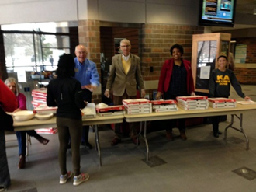
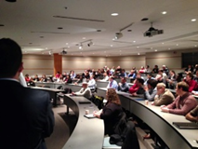
College of Technology S³ (Student Success Supporters)
Collaborations
It is all about collaboration…across departments…colleges…and campus!
It’s in the Details…
Subject-matter knowledge is key
This project was an added on stipend to “stars” in the COT
Not sustainable in it’s current model—faculty burnout

Slide 6
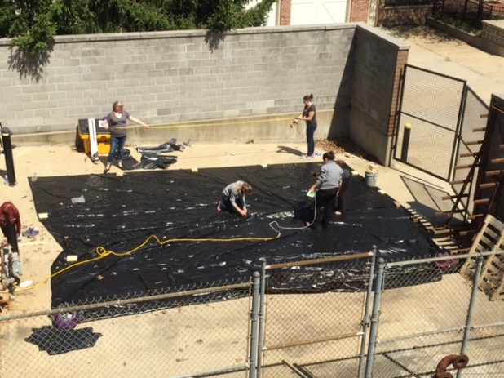
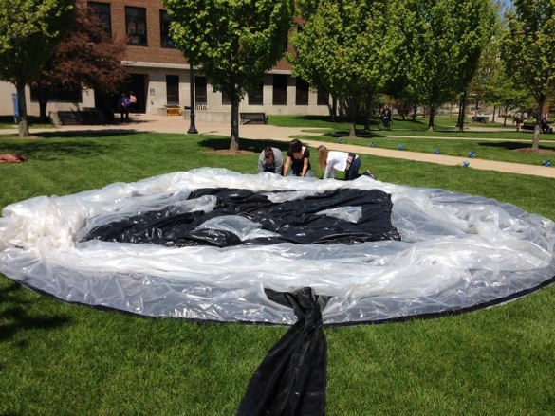
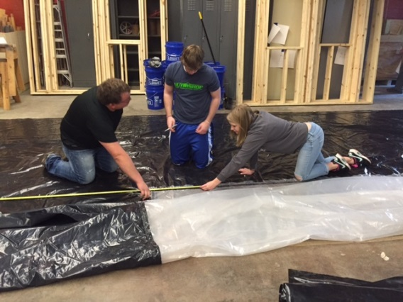
Program Pilot Interior Architecture Design
Accomplishments
Course redevelopment (exercises, grading, final project)
Objectives/Actions Not Achieved
No tailored student survey data collected
Additional public interaction of 3D Architecture would be optimal
Changes to Goals/Action Steps
Increase time given to final project
More public interaction and publicity for students working on final projects

Slide 7
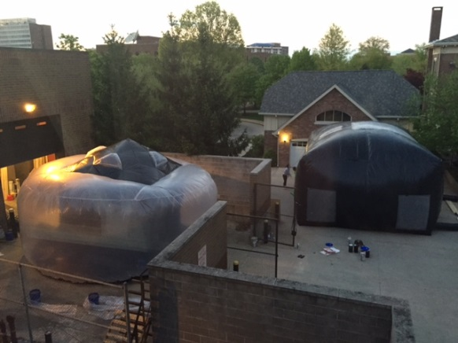
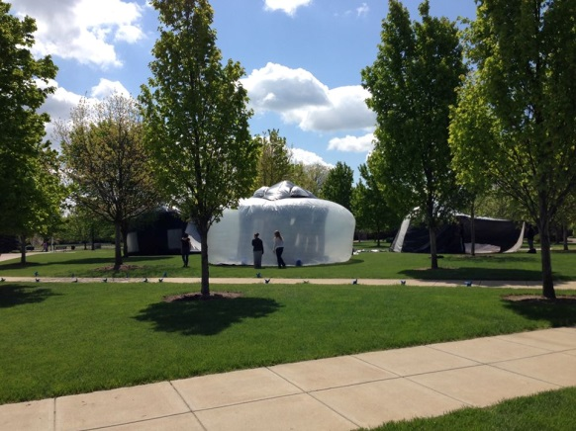
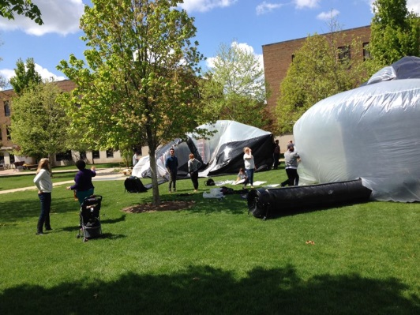
Program Pilot Interior Architecture Design
Collaborations
There are some direct connections between this and Art and Design
Its in the Details…
Retention rates of this course were 53% last spring and increased to 94% this spring
Post course rewrite the estimated budget for consumables will be $ 685.00

Slide 8
Highlights of Success Plans Recruitment Yield
“Shadow Days” hosted by AETM to bring students to the COT for hand-on experiences
Fly-in/Drive-in hosted by Aviation
New Articulations between ATMAE, NKBA, and ACCE accredited AA Degree Programs—BUILT
Continue additional articulation agreements with International Institutions—ECET
Counselor Camp
Fashion Event—HRDPT

Slide 9
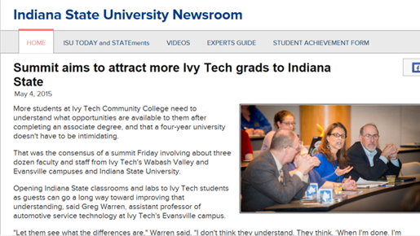
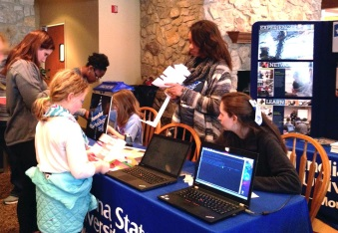
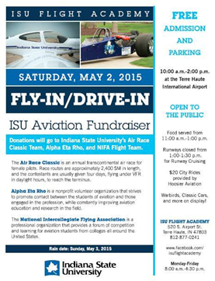
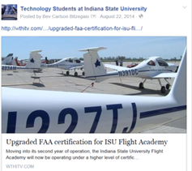
Highlights of Success Plans Recruitment Yield
COT Day—hosted by the college with admissions
Call Center Nights
Faculty one-on-one at NSO
Technology Summit
Social Media

Slide 10
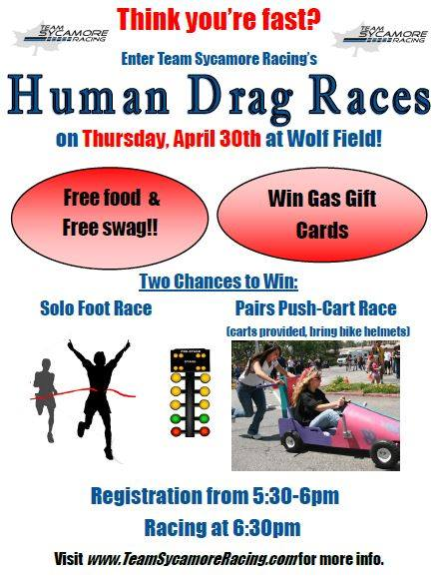
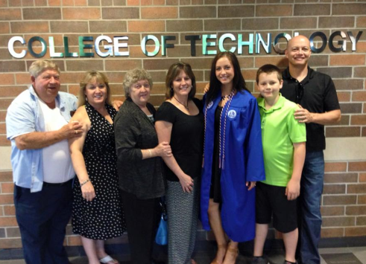
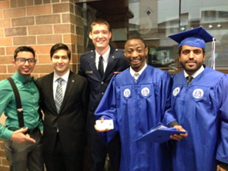
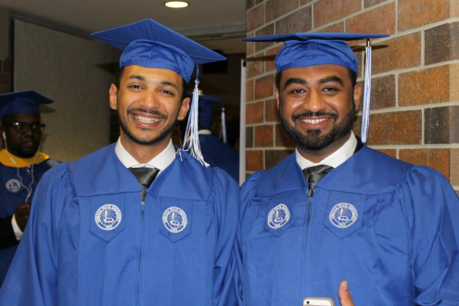
Highlights of Success Plans Retention
Flexible (evening and weekend) advising during priority registration
COT Tutoring, Math & Writing Center, etc.
Supplemental Instructors
Tech Fest
Academic Success Program
Networking/Retention Events—Monthly

Slide 11
Highlights of Success Plans Retention
Themed Housing
Communication Plan with “At-Risk” Students
Participation in International Orientation
Host Counseling 135 Classes in the COT
Host events with Career Center

