Slide 1
2014-15 CNHHS Student Success Initiatives
Jack Turman, Jr., Ph.D.
Dean
College of Nursing, Health and Human Services
Indiana State University

Slide 2
College Based Initiatives
Two Main Goals
Address Student Success Metrics
Student Leadership Development

Slide 3
Health and Social Wellness Living Learning Community
Student Success Target: Improve freshman experience, improve freshman retention
Prompt: Need for ‘student community’, Map Works data (students living in community)
Homesick (51.5%), test anxiety (39.6%), Struggling in one course (41.6%)
More than 550 individual students attended the events.
Faculty and staff also attended the events and engaged with students.

Slide 4
Health and Social Wellness Living Learning Community
Student Recruitment
Six CNHHS students were hired to recruit students, promote College programs and majors, and work with the Living Learning Community committee. (Student Leadership Development)

Slide 5
Health and Social Wellness Living Learning Community
Social Programming
Spring 2015 Welcome Back
This event showcased took place in Hines and Sandison residential halls. CNHHS Departments and Student Organizations were represented.
Monthly Dine with a Prof
Each month at least two faculty from the College had dinner in the Lincoln dining hall with CNHHS students.
Game Nights
Bingo, Pintrest, End of Semester Social

Slide 6
Health and Social Wellness Living Learning Community
Tutors in residential halls
Tutoring services were provided in Sandison Hall. Tutors were available to all students on the subjects in ATTR, BIO, CHEM, NURS, PE, and Statistics.

Slide 7
Health and Social Wellness Living Learning Community
Professional development workshops
Social networking
Test anxiety
Financial Aid planning
Summer jobs to contribute to your future and image
Social Media and YOU
These workshops were open to ALL students enrolled in the College of Nursing, Health, and Human Services. Presenter / facilitators were primarily Indiana State University faculty / staff. Light snacks and refreshment were provided.

Slide 8
Student-Centered Recruitment
Student Success Target: Improve admit to enroll yield
Prompt: Feedback from dean’s council that recruitment was not personalized, not college focused
Dean’s student advisory council working with associate dean of student and community relations and admissions office developed event (Student Leadership Development)

Slide 9
Student-Centered Recruitment Event
Developed market materials and campaign
Sent invitations to over 300 students admitted to the University with a high school GPA of 3.0 or above and who lived within a 100 mile radius of ISU
7 students and their families/significant others – 15 total in attendance
All responses were positive; plan to host the event again next year with an earlier date in the academic year

Slide 10
CNHHS Professional Advising Center
Student Success Target: Improve sophomore-senior retention, improve 4-year graduation rate
Prompt: Provide organized, daily service for students, intrusive follow-up
Hiring 2 professional advisors
Begin summer 2015
Advise students transitioning from university college (exception – nursing students)

Slide 11
CNHHS DEPARTMENTAL EXAMPLES Focused Effort is Prioritized

Slide 12
Dept. of Advanced Practice Nursing
Meeting the nurse practitioner needs of Indiana:
Award of $4000 Hoosiers First Grant from School of Graduate and Professional Studies use of funds for recruitment opportunities: Indianapolis, Vincennes, Anderson University, Terre Haute, and Jasper
Increased social media marketing
Exceed Indiana student applicants goal of 55% actual Fall 15 56% previous year Fall 14 goal of 50%

Slide 13
Dept. of Baccalaureate Nursing
Strengthen the well-qualified applicant pool of traditional and transfer students for both the traditional and accelerated second degree tracks by 2% annually
We exceeded our goal for qualified applicants for the Traditional track student for Fall 2014 and Spring 2015

Slide 14
Dept. of Applied Health Sciences
Improve department retention:
Department faculty have offered various workshops for students on topics such as: time management; communicating with professors and other professionals; skills needed for the workforce.
The department has increased the availability of prerequisite courses so that students have more flexibility in course enrollment. More courses are offered every semester instead of every other semester.
Every faculty member is practicing an open door policy, and all maintained at least six hours of “office hours” per week.
Department faculty continue to intrusively advise
Notes:
students actively by: sending an initial email to all students requesting an advisement appointment; posting advisement appointments on office doors or through electronic scheduling systems; encouraging juniors and seniors to meet for advisement even though a PIN is not required.

Slide 15
Dept. of Baccalaureate Nursing Completion
Improve recruitment to promote retention/completion
GPA increase to 2.75 from 2.5 implemented to increase higher qualified applicant pool
Vigo County RN to BS Scholarship implemented Fall 2014 resulting in an increase of RN applications and admissions of 14%
Increased marketing campaign and recruitment by use of Talisma software. 6+ recruitment fairs attended Fall 2014 to present (focused on IN recruitment)

Slide 16
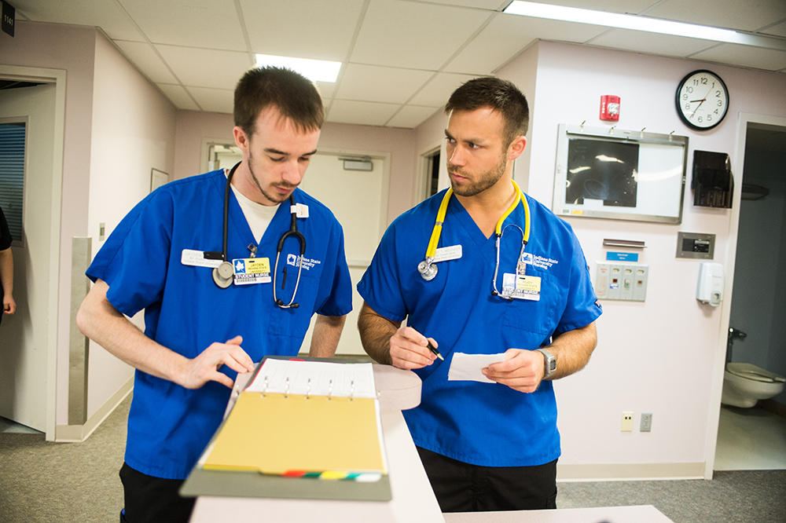
Thank You

