Slide 1
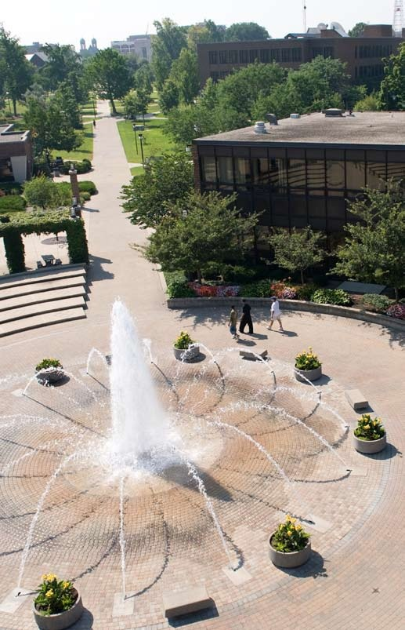
The Pathway to Success
Goal 3 – Initiative 3
Enhance the visibility of
ISU in Indianapolis

Slide 2
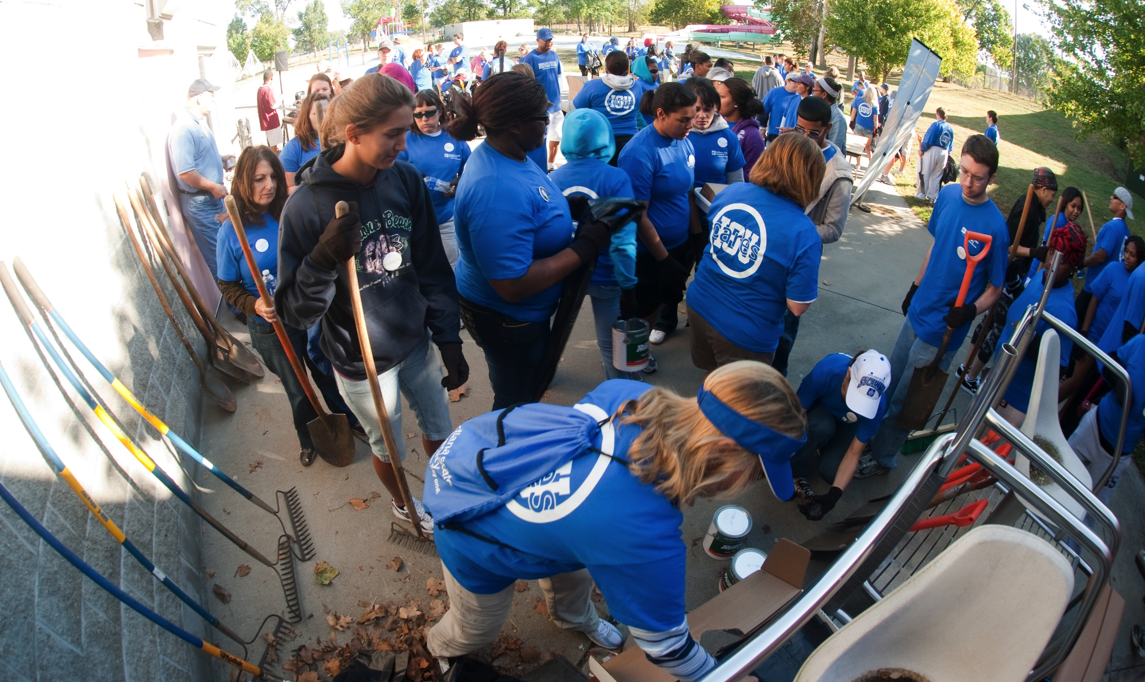
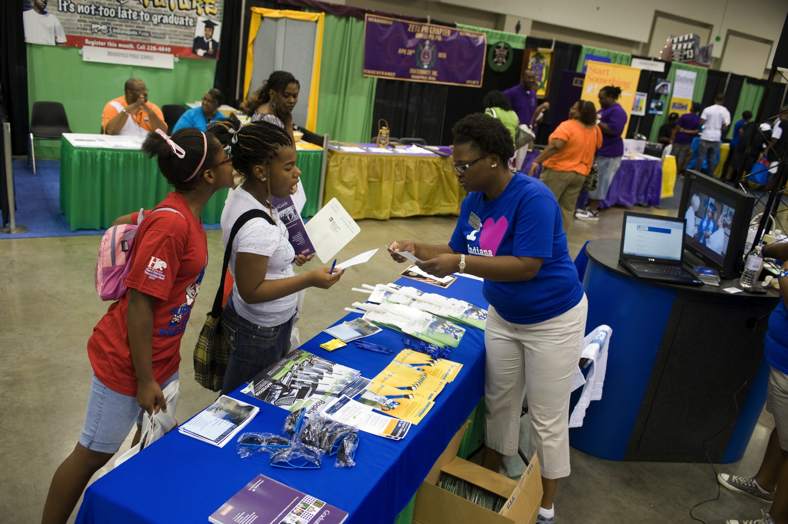
The Pathway to Success
Introduction and Purpose
As the political, financial, and geographic center of Indiana, having a presence and a high level of visibility in Indianapolis is important for ISU.
Initial Purposes
Consolidate operations
Launch academic program offerings
Increase media hits and general awareness
Provide easy access to ISU in Indy for students and community members

Slide 3
The Pathway to Success
Methods
Develop an Indianapolis upcoming events mailer and update corresponding website.
Plan the Indianapolis Day of Service.
Coordinate ISU’s participation in the Special Olympics Indiana annual recognition and awards dinner.
Secure sponsorship and coordinate ISU’s representation at Indiana Black Expo’s Summer Celebration 2012.
Place advertisement in the Indianapolis Star promoting the Professional MBA program.
Secure sponsorship and coordinate involvement in Fiesta Indianapolis.
Identify two potential alternative locations for Indiana State University to have a physical presence in Indianapolis.

Slide 4
The Pathway to Success
Benchmarks
Number of students enrolled in Professional MBA program
Fall 2010 – n/a
Fall 2011 – 12 (one cohort)
Fall 2012 – 32 (two cohorts)
Fall 2013 – 40 (two cohorts)
Fall 2014 – 45 (two cohorts)
Number of Indianapolis media hits in previous calendar year
Fall 2010 – 166
Fall 2011 – 194
Fall 2012 – 200
Fall 2013 – 205
Fall 2014 – 210
Number of students participating in Indianapolis Day of Service
Fall 2010 – 48
Fall 2011 – 55 (Spring 2012)
Fall 2012 – 60
Fall 2013 – 65
Fall 2013 – 70
Number of alumni/friends participating in Indianapolis Day of Service
Fall 2010 – 8
Fall 2011 – 20 (Spring 2012)
Fall 2012 – 30
Fall 2013 – 40
Fall 2014 – 50

Slide 5
The Pathway to Success
Discussion
ProMBA received approval. Initial enrollment numbers were lower than desired. Additional marketing efforts underway.
University coordinated presence at three well-attended 2011 events in Indianapolis – well attended activities and university was recognized through signage and promotional materials.
An Indianapolis mailer was sent fall 2010 semester; not prepared this year to date; awaiting announcement of 2012 Indy Day of Service details. The Indy website needs updating.
Discussions about space in Indianapolis are currently on hold.
Other strategies for enhancing visibility in Indianapolis, specifically an expanded marketing campaign, are underway.

Slide 6
The Pathway to Success
Summary
Initiative has had modest progress.
Participation in Indianapolis events and coordination of activities has been a strong point (Black Expo, Fiesta Indianapolis, Special Olympics, Indy Day of Service).
Discussions regarding new physical space remain on hold.
Media hits continue to increase from 166 in 2009; 194 in 2010; and 184 through mid-October 2011.
Development of a new influencer marketing campaign targeted at alumni, political, business, and opinion leaders (RFP currently out) will have an impact on this effort.

