Slide 1
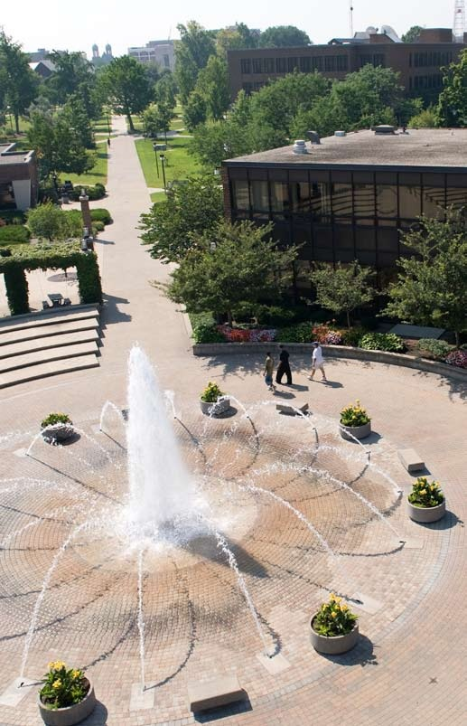
The Pathway to Success
Goal 2 – Initiative 2a
Climate Action Plan

Slide 2
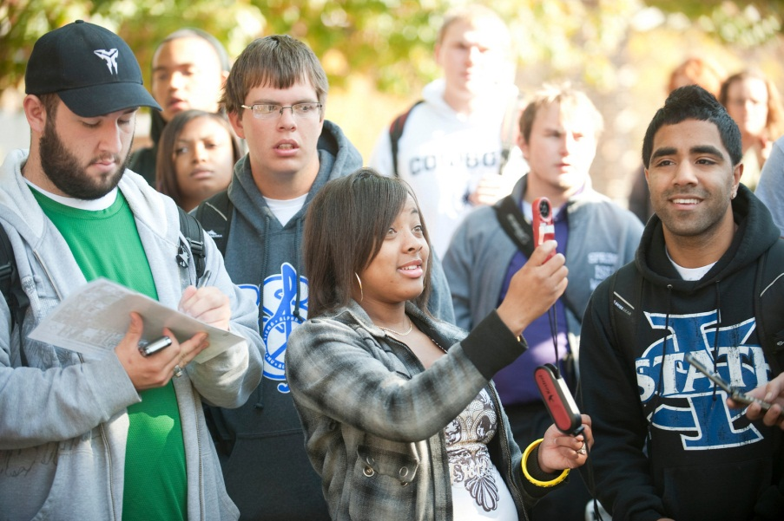
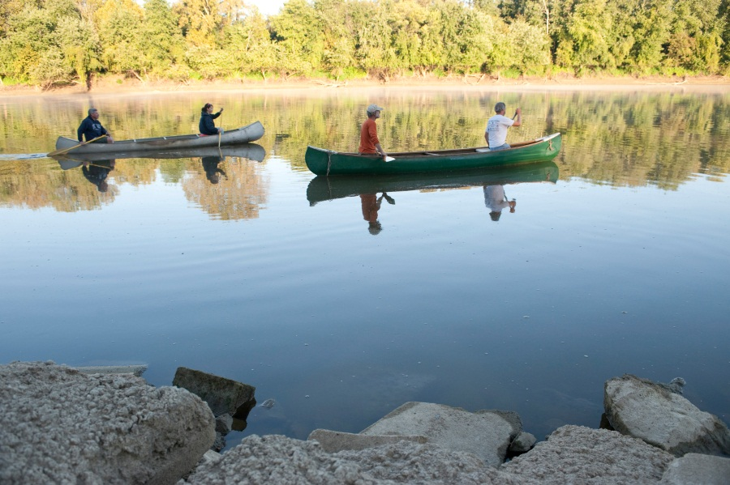
The Pathway to Success
Introduction & Purpose
Over 60 faculty, staff, and students worked on the Climate Action Plan at ISU
Signed on to the American Colleges and Universities President’s Climate Commitment in 2007
Committed to reaching carbon neutrality by 2050
Working sustainability into the ISU curriculum
Saving the University money

Slide 3
The Pathway to Success
Methods
Make ISU a carbon neutral campus by 2050 through conservation and facilities improvements.
Create a sustainability plan for the Wabash Valley by working with government officials and private industry during the Green Town conference during Nov. 16-17, 2011.
Bring more alternative energy sources to campus with wind and solar installations.
Integrate sustainability into the curriculum.
Present findings of our sustainability efforts at national conferences.
Increase student enthusiasm toward green issues with our Compete for the Green and Earth Day events.

Slide 4
The Pathway to Success
Benchmarks
A Table of your benchmark sheet here please …

Slide 5
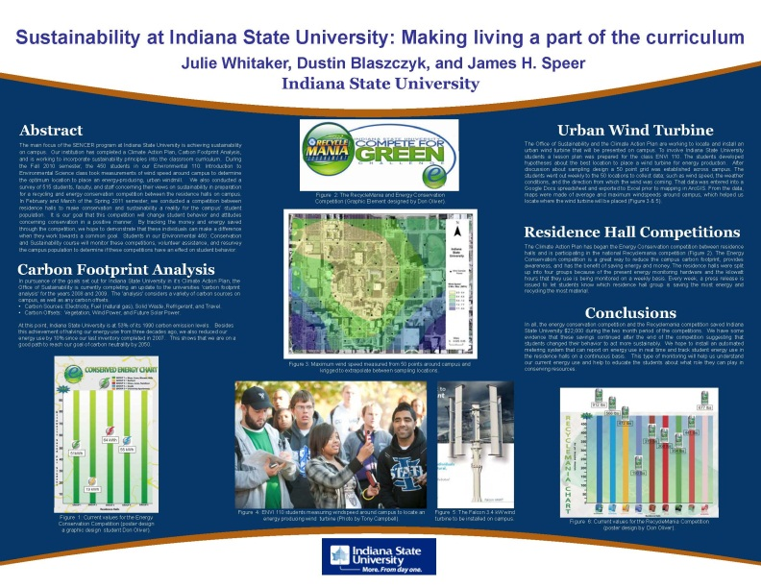
The Pathway to Success
Discussion
Our Climate Action Plan Student Leadership Team has been working to promote ISU's sustainability initiative since the summer of 2010.
We have reduce ISU's carbon emissions by 10% since our last carbon footprint analysis that was completed two years ago.
ISU is currently emits about half of the carbon that we emitted in 1990.
Compete for the Green competition between residence halls (Energy Conservation Competition and the national Recyclemania competition) saved $22,000.
Two oral presentations on sustainability
Two poster presentations on sustainability
Invited to present at Madonna University, Mi
Working with the Indiana Green Campus Network

Slide 6
The Pathway to Success
Summary
The CAP has brought together sustainability efforts on campus and increased awareness of sustainability.
Lead to the Unbounded Possibilities Initiative proposal for the Institute for Community Sustainability.
Thousands of students have experienced sustainability projects at ISU through classes in multiple disciplines.
Moving forward, we would like to increase collaboration with other sustainable institutions in the Wabash Valley to create a sustainability plan for our community which in turn will increase the number of significant experiential learning opportunities for ISU students.

