Slide 1
The Pathway to Success
Goal 6 – Initiative 4
Expand the Diversity Found in the Composition of the Faculty and Staff

Slide 2
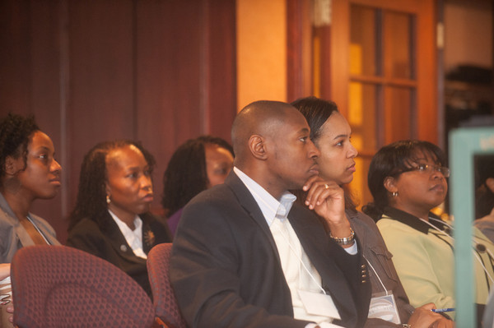
The Pathway to Success
Introduction & Purpose
The purpose of Goal 6, Initiative 4 is the following:
Accelerate hiring of AA faculty so that by 2014, the gap between this group and the percent of AA’s in the student body is narrowed by 50%.
Accelerate recruitment of minorities and women in executive and professional staff positions so that the gap in composition of these employee groups and the diversity of the student body is narrowed by 50%.

Slide 3
The Pathway to Success
Methods
Ongoing articulation of its importance by senior leadership.
Exploration of demographic and retention data for informing efforts and
conducting a study of faculty hiring processes.
Charging key offices and personnel with leadership and support of
coordinated campus-wide recruitment and hiring efforts (e.g., Academic
Affairs, Office of Diversity, Affirmative Action, Human Resources).
Help the campus enhance skills and insights for building deep pools of
diverse candidates (e.g., search leadership workshops, process partners,
robust resources for finding diverse candidates).
Initiate an opportunity hires program as well as mechanism to bring a
critical mass of minority candidates to campus on one day (Scholar
Collaboration & Prospective Faculty Day).

Slide 4
The Pathway to Success
Benchmarks
Goal | Initiative | Impact/Importance to Goal(s) | Fall 2010 | Fall 2011 | Fall 2012 | Fall 2013 | Fall 2014
1 | 1-9 | Our increasing faculty diversity is benefiting our minority and majority students. | L | H | H | H | H
5 | 2 | Alumni have been involved in the diversifying the faculty initiative. | H | H | H | H | H
6 | 1 | 50% increase in AA faculty fall 2011 contributes positively to quality of life as does other diverse hiring (28% of all hires in 2010-11). | L | H | H | H | H
Initiative Benchmarks | Fall 2010 | Fall 2011 | Fall 2012 | Fall 2013 | Fall 2014
African American Faculty – Tenured | 8 | 8
African American Faculty – Tenure Track | 2 | 5
African American Faculty – FT, not on TT | 1 | 2
% Af Am faculty/% Af Am students | 2.5%/13% | 3.4%/14.3% |  |  | 7%/12%
US Minority Exec | 8 | 8 | 10 | 11 | 12
US Minority Other Professional | 39 | 31 | 54 | 60 | 66
% women in exec positions/% female students | 34%/54% | 33%/55% |  |  | 54%/54%

Slide 5
The Pathway to Success
Discussion
Faculty side:
Robust website & search leadership workshops
Search process partners assigned to searches
Expanded and coordinated national advertising campaign
Mechanism through ATS for opportunity hire candidates to apply
Scholar Collaboration and Prospective Faculty Day
Outcomes: 75 OH candidates (45 AA); 20 minority participants in
SCD; 15 minority hires (28% of all 2010-11 hires; 5AA)
Staff side:
Have already met 2014 minority executives proportion goal.
Executive women & minority other prof.’s - data trending down.
Other Activities:
Diversity Research and Teaching Symposium, new staff orientation
program & diversity training module, Sycamore Safe Zone program

Slide 6
The Pathway to Success
Summary
Goal 6, Initiative 4 successful, but more work needed:
AA faculty hiring needs to accelerate (10 this year
puts us on target).
Retention is key (one plan: Early Career Program (yr
1-3, not just new faculty).
Visiting Scholars Program
Need interventions to reverse declines on staff side.
Need to explore gender disparities between
associate and full professor.
Reminder: Diversity is everyone’s job!

