Slide 1
The Pathway to Success
Goal 6 – Initiative 2
Enhance the Development of Faculty

Slide 2
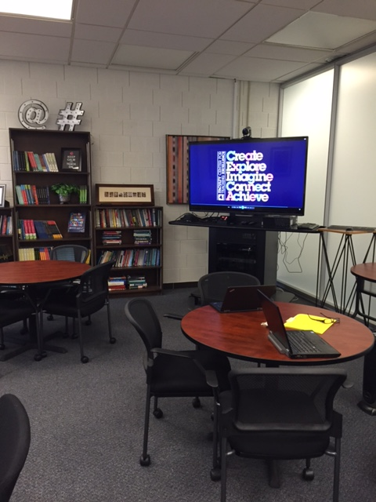
Overview of Accomplishments
Faculty Center for Teaching Excellence (AY 2013-14)
- Established the environment (furniture, technology).
- Faculty team attended Ken Bain Best Teacher’s Institute.
- Mornings in May.
- Faculty Development Programming
- Sessions for spring 2014: 17
- Total session attendees: 308
- Average number of visitors per session: 18
- Number of colleges/offices/units represented: 14
New Faculty Orientation (Fall 2014)
- 55 new and reappointed faculty attended.
- Involvement from all divisions continues to increase.
- Student success message is consistent, loud, and clear.

Slide 3
Benchmark Table

Slide 4
Baseline Recommendation
Faculty Center for Teaching Excellence
Funding for a faculty team to attend a higher education teaching conference each year.
Funding for the implementation of a yearly teaching/learning forum on campus.
New Faculty Orientation
Stipends are not fully covered.
Funding for events comes from Quality of Life initiative . . . . Should this be the case?

Slide 5
Missed Opportunities
New Faculty Orientation
To do more in spring semester of Year 1 for new faculty.
To bridge more completely to FCTE.
To help with workload management for new faculty.
To make sessions more interactive.
To increase engagement of new faculty with each other in each session.

Slide 6
New Points of Emphasis
Faculty Center for Teaching Excellence
Collaboration with other local institutions.
More shared programming with other campus units.
New Faculty Orientation
Spring electives add variety and increase involvement of other areas.
Shorter schedule in fall to reduce workload.
Increased interaction and active learning.
More active participation by faculty leaders such as Susan Powers and Beth Whitaker.

Slide 7
Opportunities for Collaborations
Faculty Center for Teaching Excellence
Extended Learning Center for Community Engagement
Office of Student Success Extended Learning
Individual Colleges Individual Departments
Cunningham Memorial Library
New Faculty Orientation
College of Graduate and Professional Studies
Library
Deans/Associate Deans/Chairs
Faculty Senate

Slide 8
Foreseeable Roadblocks
Faculty Center for Teaching Excellence
Must plan for increased funding as more faculty take advantage of Center resources and programs
Bandwidth and backup concerns regarding single staff member (director)
Faculty Center for Teaching Excellence / New Faculty Orientation
Bandwidth constraints now and increasingly in future create necessity:
- to demonstrate in a real way the value of professional development for faculty (i.e. are the proper incentives in place?)
- to demonstrate an awareness of workload considerations with content and practices for scheduling development events

Slide 9
Looking Ahead - Recommendations
Faculty Center for Teaching Excellence
Continue to expand the inclusion of Faculty Fellows
Institutionalize attending a national teaching conference with an ISU faculty team
Create a yearly forum on teaching and learning
New Faculty Orientation
Continue efforts to take input from new faculty to improve the program
Continue to change program to react to environment and faculty input
Ensure the program has continuity throughout the first year to create a linkage to faculty development offered by FCTE from there forward

Slide 10
Questions?
Enhance the Development of Faculty
Dr. Beth Whitaker
Beth.Whitaker@indstate.edu
Dr. Lisa Spence
Lisa.spence@indstate.edu

