Slide 1
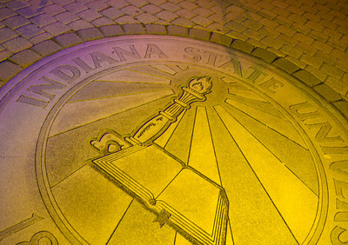
The Pathway to Success
Goal 5 – Initiative 2
Strengthen Engagement of Alumni in the Life of the University

Slide 2
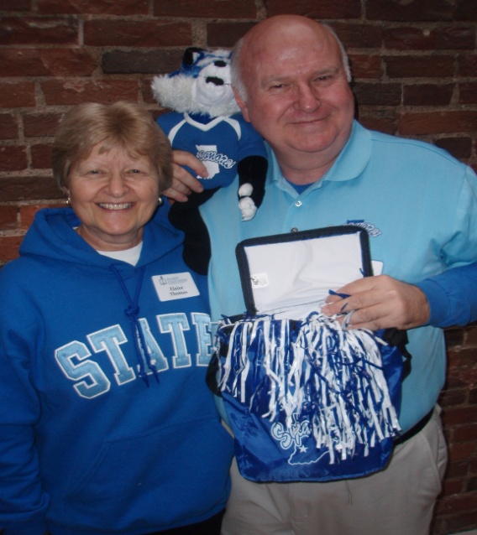
The Pathway to Success
Introduction & Purpose
The ISU Alumni Association:
Central organization
connecting all alumni to
the University.
Raise awareness
“Friend raising” to
Fundraising

Slide 3
The Pathway to Success
Methods

Slide 4
The Pathway to Success
Benchmarks
Categories of Engagement Fall 2010 Fall 2011
Donor Affinity 696 1056
License Plate Affinity 919 172
Volunteer Affinity 171 170
Membership Affinity 96,210 96,110
Event Affinity 83 787
Social Network Affinity NDA 1767
**E-Communication Affinity NDA 101
Affinity Programs 1200 648
*Total number of “engaged” alumni 159 1722
*Alumni engaged in three or more of the above categories
** New measurement of engagement

Slide 5
The Pathway to Success
Discussion
Assertive Alumni Board
Committees formed
Measure engagement level
Raisers Edge software
Grow Regional Alumni Associations
Construction of Alumni/Conference
Center

Slide 6
The Pathway to Success
Summary
Alumni Association board members actively
engaged in the strategic planning process
Continue to develop the Engagement Model
Continue to grow and develop Regional
Alumni Associations
Construction of Alumni/Conference Center

