Slide 1
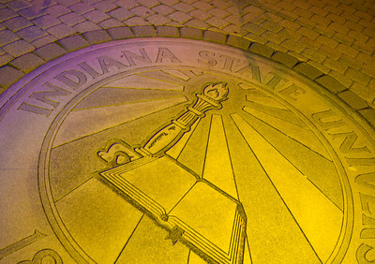
The Pathway to Success
Goal 3 – Initiative 5
Energize Downtown
Notes:
Good morning – thanks
Getting close to lunch
New
Gathering and Using

Slide 2
Accomplishments Since 2013-14 Report
43 Partner Businesses Engaged
Piece Luv Paint, Marketability, Farmer’s Market, Tater & Joes, RUEDI, SBDC, Food Hub, Tech Haute, DTH, Rivers
& Roads Artisan Trail, Art Spaces Inc., Thompson Thrift, Clabber Girl, B. Latskins, Crossroads Café, Fitness
Solutions, YMCA, ISU, Corey’s Fine Footwear, First Fridays, Brown Bunny Delivery Service, Little Lady’s Boutique,
Police Technical, KB Shimmer, ETC….
Downtown Map
Weekly Newsletter (Downtown Terre Haute)
DTH – Mainstreet Grant Collaboration
Farmers Market
Art Spaces

Slide 3
Accomplishments Since 2013-14 Report
Turn to the River – Design Phase
Launch Terre Haute/Verge/Co-Work Space
Broad promotion and marketing of all downtown events

Slide 4
Benchmark Table

Slide 5
Benchmark Progress Detail
The number of students engaged in downtown activities and the number of downtown events supported by ISU has exceeded stated goals
In terms of the experiential learning and community engagement components, Energize Downtown has been successful
The “Choose Downtown” newsletter has an increasing number of subscribers; however, the click/open ratio is 20%
Downtown Terre Haute membership has struggled

Slide 6
Budget Summary
Total funding allocation for 2014-15
$33,000
Expenses as of report date
Expenditures $33,230
Encumbered costs
Anticipated remainder June 30, 2015
$0

Slide 7
Accomplishments Since Plan Inception
Broad scope of student engagement opportunities
Support for Downtown Terre Haute
Promoting downtown Terre Haute as a shopping, dining, and entertainment destination
Support of the Arts District and downtown arts organizations
Collaboration with stakeholders to create a great “college town”

Slide 8
Looking Ahead - Recommendations
Create a well rounded student team
Identify value added projects that engage students in experiential learning while assisting with downtown revitalization efforts.
Introduce a cost share basis for long term partners.
Establish a project management and quality work assurance component for all student projects

Slide 9
Foreseeable Roadblocks
Budget limitations
Downtown Terre Haute leadership and board issues
True “buy-in” from all interested parties

Slide 10
New points of emphasis
Drive economic development of downtown.
A team oriented approach that functions as a “job shop”.
Cost sharing and billing for large or long-term projects.
Emphasize the value that we provide.
Increase campus collaboration on key projects and events.
Increase media recognition.

Slide 11
Missed opportunities
Experiential learning with a true focus and meaningful feedback from mentors.
Partnerships with developers and property owners downtown.
Campus collaboration.

Slide 12
Baseline Recommendation
Continue to provide our students with meaningful engagement and experiential learning opportunities.
Become a driver of economic development and the continued revitalization of downtown Terre Haute.
Build and strengthen the partnerships and engagements that will bring a strong university presence downtown.

Slide 13
Opportunities for Collaborations
RHIT – Downtown Thesis Project
Surveys and Focus Groups
Small Business Development Center
Sycamore Business Advisors
College of Technology
College of Business

Slide 14
Questions?
Energize Downtown
Daniel I. Pigg
daniel.pigg@indstate.edu

