Slide 1
The Pathway to Success
Goal 3 – Initiative 1
Create a Coordinated Community Engagement Program

Slide 2
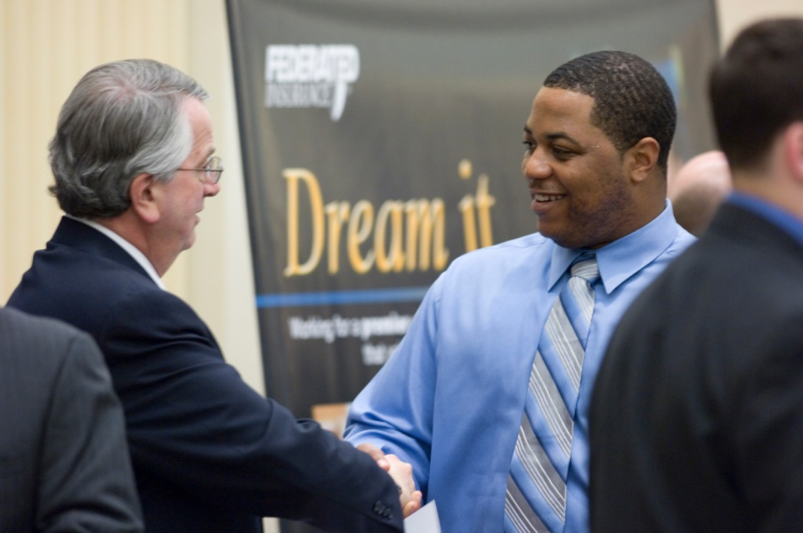
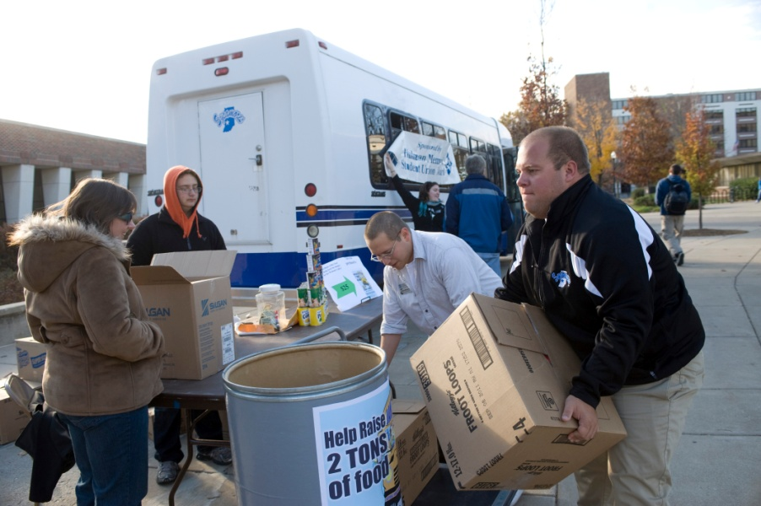
The Pathway to Success
PURPOSE OF INITIATIVE
The goal of this initiative is to improve University-wide coordination of community engagement through creation of new and enhancement of existing curriculum, administrative structures, and co-curricular activities.

Slide 3
The Pathway to Success
METHODS
Improve organizational structure
Economic development
Increase % of courses with community engagement
Connect ISU to the Riverfront
Incorporate alumni into activities
Develop staff policy
Link campus to downtown

Slide 4
The Pathway to Success
BENCHMARKS
Yearly student participation in community engagement activities
Number of students that complete related course
Businesses in the incubator
Jobs created by the incubator

Slide 5
The Pathway to Success
DISCUSSION
Good progress made with development of administrative unit, collection of data, development of community service leave policy.
Progress is currently being made with development of new CE programs.
Progress has not been made with incorporation of alumni into CE activities.

Slide 6
The Pathway to Success
SUMMARY
There has been good progress on the initiative during the past two years. Creating an effective organizational structure has been a top priority. Economic development, downtown development, and curriculum enhancement activities are proceeding as expected. During the next year greater attention should be paid to incorporation of alumni into engagement activities and promoting the community service leave policy. Overall, we are on track to meet the benchmarks for this initiative.

