Slide 1
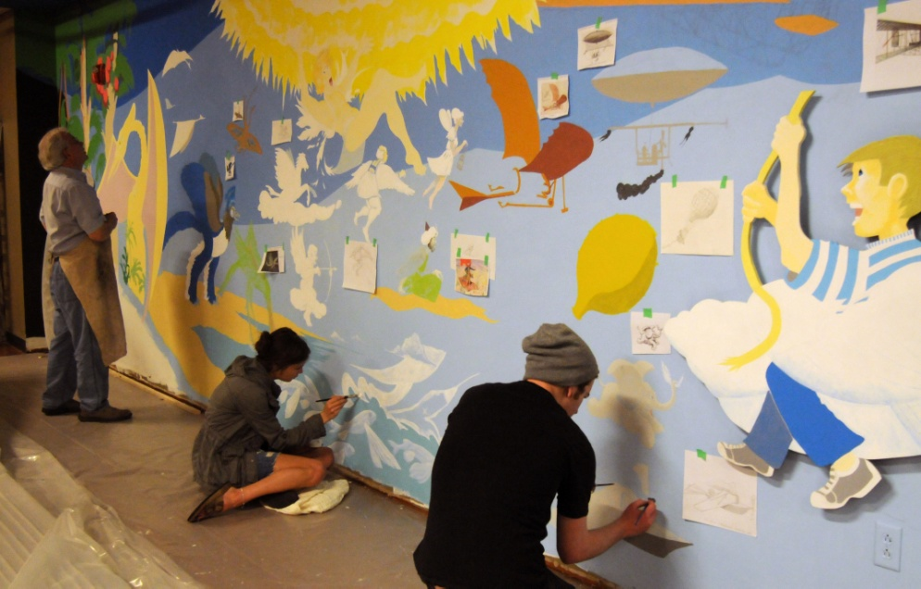
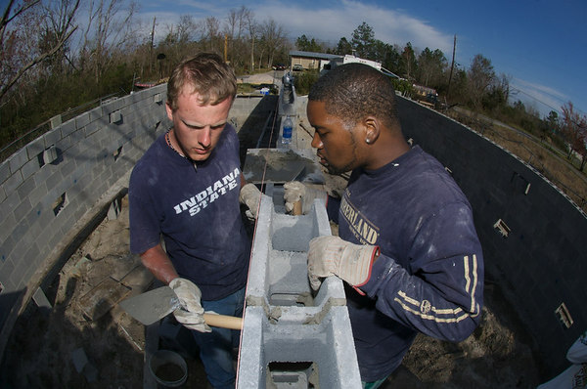
The Pathway to Success
Goal
Three
Enhance Community Engagement
Foster the engagement of students, faculty and staff in the life of our communities and in pursuits improving their economic and social well-being.

Slide 2
The Pathway to Success
Goal
Three
Enhance Community Engagement
Goal Chair: Nancy Brattain Rogers
Audit Chair: John Conant
Initiatives
Create a coordinated community engagement program
Expand distance education offerings to meet the needs of students and to support economic development
Enhance the visibility of ISU in Indianapolis

Slide 3
The Pathway to Success
 | Goal #3 Benchmarks | 2008 | 2010 | 2011 | Long-Term Target
 | Yearly student participation rate in Community Engagement activities | 5400 | 6831 | 6145 | 10,000
 | Leadership positions faculty and staff have in community, social, and economic development groups | TBD |  | 134 | TBD
 | Businesses served by ISU Business Engagement Center |  | 15 | 21 | 40
 | Jobs created by the businesses in the incubator | 11 | 13 | 57 | 125
 | ªNational Survey of Student Engagement Spring 2007 report
Pilot Survey – 4/10

Slide 4
The Pathway to Success
ISU Broad Benchmarks
Student Success
Experiential Learning
Community Engagement
Revenue Generation
Faculty and Staff Success

Slide 5
The Pathway to Success
Student Success
Increase Enrollment
Increased Retention
Increased Graduation
Employment

Slide 6
The Pathway to Success
Experiential Learning
Internship Impacts
Degree Programs
Participation
Field Experiences

Slide 7
The Pathway to Success
Community Engagement
Engagement Impact
Outreach / Job Creation
Leadership
Financial Support (In/Out)

Slide 8
The Pathway to Success
Revenue Generation
Tuition Impact
Contracts and Grants
Foundation Support
Alumni & Donor Engagement
Community and Services

Slide 9
The Pathway to Success
Faculty and Staff Success
Minority / Women Success
Scholarship
Compensation Support
Leadership / Organizations Served

Slide 10
The Pathway to Success
Audit Recommendations
Overall, Goal 3 initiatives have been effective
Action items for removal or reconsideration
Expanded business incubation program
On-line Master’s in Sport Management (completed)
Identification of space for ISU in Indianapolis
Additional information is needed to better audit progress on increasing the number of businesses served by ISU and number of jobs created by the business incubator

Slide 11
The Pathway to Success
Audit Recommendations
Coordinate ISU’s academic involvement in Riverscape
Reconsideration of expanding business incubation program
Increased attention to engagement of ISU alumni
Continue monitoring of development of ISU Business Builders program
Permanent budget support for faculty fellow to coordinate Service Learning scholars program
Increase effort for student mini-grant program
Assess effectiveness of several Indianapolis initiatives, including: SOI partnership, events website and mailer, and Indy Day of Service

Slide 12
The Pathway to Success
Summary – Primary Contributions
Programs are providing increased opportunities for student, faculty, and staff engagement
Distance education efforts to improve degree completion are underway
Efforts to improve ISU’s reputation as an engaged institution have resulted in recognition

Slide 13
The Pathway to Success
Discussion - Questions

