Slide 1
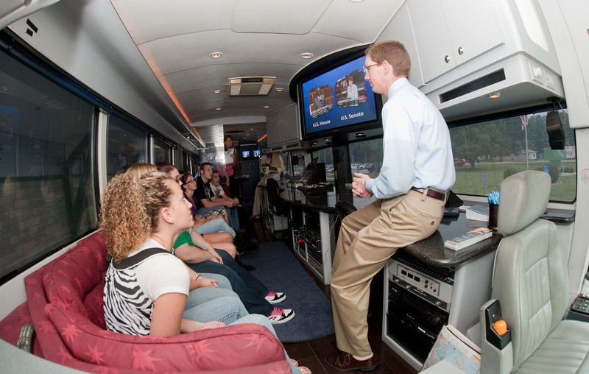
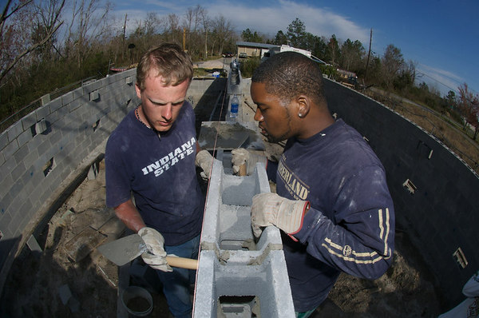
The Pathway to Success
Goal
Three
Enhance Community Engagement
Foster the engagement of students, faculty and staff in the life of our communities and in pursuits improving their economic and social well-being.

Slide 2
The Pathway to Success
Goal
Three
Enhance Community Engagement
Goal Chair: Nancy Brattain Rogers
Audit Chair: John Conant

Slide 3
The Pathway to Success
 | Goal #3 Benchmarks | 2008 | 2010 | 2014 Target | Long-Term Target
 | Yearly student participation rate in Community Engagement activities. | 60%ª | 59% | 100% | 100%
 | Leadership positions faculty and staff have in community, social, and economic development groups. | TBD | TBD | TBD | TBD
 | Businesses served by ISU Business Engagement Center |  | 15 | 25 | 25
 | Jobs created by the businesses in the incubator. | 11 | 13 | 300 | TBD
 | ªNational Survey of Student Engagement Spring 2007 report
Pilot Survey – 4/11
Notes:
You’ll notice the “TBD” by several of the benchmarks.
Our intention is to have baseline data for each of these areas by the end of May.

Slide 4
The Pathway to Success
Initiatives
Create a coordinated community engagement program.
Expand distance education offerings to meet the needs of students and to support economic development.
Enhance the visibility of ISU in Indianapolis.

Slide 5
The Pathway to Success
Initiative 1: Create a coordinated community engagement program.
Implementation Team: Nancy Rogers, Linda Crossett, Steve Stofferahn, Cat Stemmans, Chris Pfaff, Heather Miklozek, Mary Sterling, Jennifer Lewellyn, Terry Dean
This initiative will help achieve all of the Goal Three benchmarks by:
Creating support for faculty, students, and staff to be engaged with the community.
Directly supporting business support and incubation activities.

Slide 6
The Pathway to Success
Initiative 1: Progress
Implementation of Class Legacy Project
Activities related to Wabash River
Community service leave policy
Alumni involvement in engagement
Course inventory
Service-learning scholars program
Incubator feasibility study
Downtown partnerships
Notes:
My position was filled in September.
Center for business Support and Economic Development currently does incubation utilized HUD and SBA grants. Feasibility study will help determine future direction of CBSEI. CBSEI is also working on more close coordination with SBDC.
Inventory of courses with EL/CE component was completed during the spring semester. (Also related to experiential learning).
Faculty from several areas – including Arts & Sciences, Ed, Tech, and NHHS made some recommendations this year for the creation of a Science and Tech center to be located adjacent to the Wabashiki Wetlands area.
Alumni – National Donaghy week – alumni clubs would engage in service project the same week at Donaghy Day.
Community service policy drafted by HR. Implementation next fiscal year.
Service-Learning Scholars program – well-developed timeline, next year planning year; implementation 2011-12
Freshman class legacy service project pilot this year – involved 75 students working on riverfront clean-up

Slide 7
The Pathway to Success
Initiative 2: Expand distance education offerings to meet the needs of students and to support economic development.
Implementation Team: Marcia Miller, Les Lunce, Terry McDaniel, Constance McLaren, Jeff McNabb, Ron Payne, Yancy Phillips, Paul Schikora, Shelley Arvin
This initiative contributes most directly to the benchmark of increasing enrollment.

Slide 8
The Pathway to Success
Initiative 2: Progress
Adult Degree Completion Program
Foundational Studies for Distance Education
M.S. in Sport Management
Notes:
Kenneth Brauchle – Assoc Dean at Boise State – July 1
Proposal for Adult Degree Completion program – revision of a current degree program in COT – start first cohort in fall
ICN assessment – have taken first hard look at ICN data –
White paper – new dean
CEP – 600 target
ACEware implemented this spring

Slide 9
The Pathway to Success
Initiative 3: Enhance Visibility in Indianapolis.
Implementation Team Members: Tara Singer, Kurt Fowler, Joel Harbaugh, Joyce Young, Larry Boulet, Kris Rogers, Chris Pfaff, Cat Stemmans, Dave Taylor
This initiative will help increase enrollment, increase student and faculty participation in community engagement, and, potentially, increase the number of businesses served.
Notes:
Great work – late start!

Slide 10
The Pathway to Success
Initiative 3: Progress
Professional MBA program
ISU presence in Indianapolis media market
Engagement with Indy-based philanthropic organizations
Campus-coordinated events in Indianapolis
Notes:
New office suite same building on Ohio
Study of feasibility is on-going
MBA program – status?
Coordinated events – Music and philanthropy event held earlier this month

Slide 11
The Pathway to Success
Audit Recommendations
Reevaluate objective of increasing the amount of direct and indirect financial support provided by University groups.
Further refine categories of "engagement" for course inventory.
Develop measure of student engagement rather than engagement courses.
Assessment of College Challenge program.
Assessment of possibilities of new program delivery in Hendricks County.
Notes:
New office suite same building on Ohio
Study of feasibility is on-going
MBA program – status?
Coordinated events – Music and philanthropy event held earlier this month

Slide 12
The Pathway to Success
Questions

