Slide 1
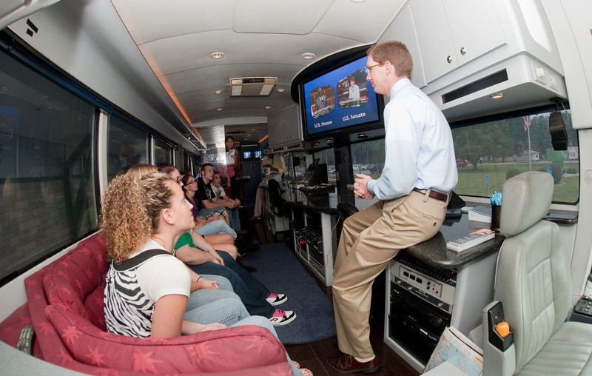
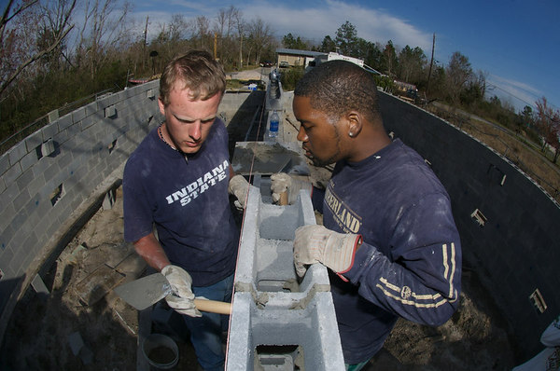
The Pathway to Success
Goal
Three
Enhance Community Engagement
Foster the engagement of students, faculty and staff in the life of our communities and in pursuits improving their economic and social well-being.

Slide 2
The Pathway to Success
Goal
Three
Enhance Community Engagement
Goal Chair: Nancy Brattain Rogers
Audit Chair: Bruce McLaren

Slide 3
The Pathway to Success
 | Goal #3 Benchmarks | 2008 | 2014 Target | Long-Term Target
 | Yearly student participation rate in Community Engagement activities. | 74%ª | 100% | 100%
 | Leadership positions faculty and staff have in community, social, and economic development groups. | TBD | TBD | TBD
 | Direct and indirect financial support provided by the University to community, social, cultural and economic development groups. | TBD | TBD | TBD
 | Businesses served by ISU. | TBD | TBD | TBD
 | Jobs created by the businesses in the incubator. | 11 | 300 | TBD
 | ªNational Survey of Student Engagement Spring 2007 report

Slide 4
The Pathway to Success
Initiatives
Create a coordinated community engagement program.
Expand distance education offerings to meet the needs of students and to support economic development.
Enhance the visibility of ISU in Indianapolis.

Slide 5
The Pathway to Success
Initiative 1: Create a coordinated community engagement program.
Implementation Team: Nancy Rogers, Linda Crossett, Steve Stofferahn, Cat Stemmans, Chris Pfaff, Heather Miklozek, Mary Sterling, Jennifer Lewellyn, Terry Dean
This initiative will help achieve all of the Goal Three benchmarks by:
Creating support for faculty, students, and staff to be engaged with the community.
Directly supporting business support and incubation activities.

Slide 6
The Pathway to Success
Initiative 1: Create a coordinated community engagement program.
Status of the initiative:
Creation of AVP position for community engagement and experiential learning.
Feasibility study for RHIC related business incubator.
Inventory of courses with EL/CE components.
Draft of proposal for Riverfront Science and Technology Center.
Recommendations for incorporating alumni into community engagement activities.
Draft of staff community service policy.
Planning for Service-Learning Scholars Program.
Pilot of Freshman Class Legacy Service Project

Slide 7
The Pathway to Success
Initiative 1: Create a coordinated community engagement program.
Audit team observations:
Place more emphasis on development of faculty, staff, and students.
Development of an in-house journal of website that showcases ISU community engagement activities.
Help everyone understand definitions of community engagement and service-learning.
Development of a referral center in CPSCE.
Recommend accelerating early career experiences and service-learning scholars program.

Slide 8
The Pathway to Success
Initiative 2: Expand distance education offerings to meet the needs of students and to support economic development.
Implementation Team: Marcia Miller, Les Lunce, Terry McDaniel, Constance McLaren, Jeff McNabb, Ron Payne, Yancy Phillips, Paul Schikora, Shelley Arvin
This initiative contributes most directly to the benchmark of increasing enrollment.

Slide 9
The Pathway to Success
Initiative 2: Expand distance education offerings to meet the needs of students and to support economic development.
Status of the initiative:
Selection of Dean of Extended Learning.
Development of proposal for Adult Degree Program.
ICN Assessment.
Online College Credit for High School Students – White paper due in Fall 2010.
Expansion of Corrections Education Program.
Improved coordination of non-credit continuing education through use of ACEware software.

Slide 10
The Pathway to Success
Initiative 2: Expand distance education offerings to meet the needs of students and to support economic development.
Audit team observations:
Establish goals for Dean of Extended Learning.
Need work plan for development of Foundational Studies distance courses.
Need work plan for faculty development.
Need work plan for non-credit continuing education.

Slide 11
The Pathway to Success
Initiative 3: Enhance Visibility in Indianapolis.
Implementation Team Members: Tara Singer, Kurt Fowler, Joel Harbaugh, Joyce Young, Larry Boulet, Kris Rogers, Chris Pfaff, Cat Stemmans, Dave Taylor
This initiative will help increase enrollment, increase student and faculty participation in community engagement, and, potentially, increase the number of businesses served.

Slide 12
The Pathway to Success
Initiative 3: Enhance Visibility in Indianapolis.
Status of the initiative:
Consolidation of Indy-based operations into shared facility.
Evaluation of feasibility of creating a downtown Indianapolis center.
Proposed MBA program in Plainfield.
Expand campus-coordinated events in Indianapolis – Dept. of Music concert, 2010 Philanthropy event, ISU Day at the Statehouse, etc.
Increase ISU’s media presence – Borshoff study.
Identify partner philanthropic organizations.

Slide 13
The Pathway to Success
Initiative 3: Enhance Visibility in Indianapolis.
Audit team observations:
Are there other regions that should be a priority?
Supported consolidation of office in Indianapolis.

Slide 14
The Pathway to Success
Summary
Progress made toward establishing effective organizational structure with appointment of AVP and Dean of Extended Learning.
Several new programs/activities have been proposed through Initiatives One and Three.

