Slide 1
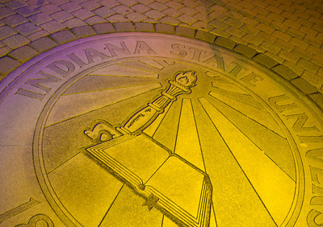
The Pathway to Success
Goal 2 – Initiative 1
Career Center

Slide 2
Accomplishments Since 2013-14 Report
2480 students employed through the Student Employment Program
First Destination Survey Knowledge Rate is 62%
61% of our graduates are employed full time or in graduate school at 6 months post graduation
Employer Relations Team – 304 engagements to date
12 employer field /immersion trips (179 students)
8 faculty/staff professional skills certificates (non-credit)
Notes:
7% increase from last year – still 4 months left to measure
FDS – 47% response rate for the 2012 class and only a 39% last year - result of many partnerships and hard work/phone calls
ERC “engagements” include employer site visits, career fairs, on campus interviews, field trips and significant engagement of recruiters as hosts; still 2 career fairs and 5 scheduled site visits, as well as employer visits.

Slide 3
Benchmark Table

Slide 4
Professional and Skill Certificates
110 completions expected / on co-curricular record
Sycamore Career Ready Certificate – 109 registrations
COE customized for all CDCSEP and EESP students
Customized for Online students , Athletes, and COT
Integrated into Health Sciences curriculum
Integrated into LEAP and UNIV 101 curriculum
Part of Scholar Core Persistence Project / ICHE grant (21st Century / Frank O’Bannon scholars)
Sigma Alpha Pi/Ntl.Soc.Leadership & Success participation
Category #2 UDIE fulfillment
Notes:
110 completions are for the on campus as well as 3rd party certificates that are being

Slide 5
Budget Summary
No strategic funding for 2014-15
Lilly Endowment Focus Indiana support for 4 more years

Slide 6
Accomplishments Since Plan Inception
Increased recognition, visible location, inclusion in University initiatives, and quality faculty partnerships
Increased professionalism and accountability in student employment positions
FWS money spent off campus in quality placements
Increased First Destination Survey response rate
Creation of Professional Skill Certificate Initiative

Slide 7
Looking Ahead - Recommendations
Required/recommended integration of professional skill content and certificate content in curriculum
Required/recommended 1 credit career course
Continue to develop faculty partnerships
Creation of 300 level “College to Career” course
Leverage alumni connections for employer outreach
First Destination Survey to become required part of graduation process

Slide 8
Foreseeable Roadblocks
Incentivizing students to add career and professional events and experiences to their busy schedules
Obstacles to adding any “credit” courses to existing requirements
Career Center has no captive student audience
No formal process for collecting First Destination Survey data as part of graduation

Slide 9
New Points of Emphasis
“College to Career” 300 level course on the transition to the workplace
Integration of Sycamore Career Ready Certificate into co-curricular activities and bridge programs
Develop formalized career process/integration with CAS students, advisors, and faculty

Slide 10
Missed Opportunities
Benchmark initiatives are still new – many positive opportunities

Slide 11
Baseline Recommendation
4 more years of funding from Lilly Endowment
Will need to consider future support for continued employer relations staff, certificate program, and internship scholarships

Slide 12
Opportunities for Collaborations
Partnerships with all academic departments
21st Century Scholars, Frank O’Bannon scholars, LEAP program, UNIV 101 courses, academic advisors, Residential Life, Greek Life, Honors Program, Learning Communities
Integration of soft skill / professional skill learning in Foundational Studies programs

Slide 13
Questions?
Career Center
Nancy Rogers - Nancy.rogers@indstate.edu
Darby Scism - Darby.scism@indstate.edu

