Slide 1
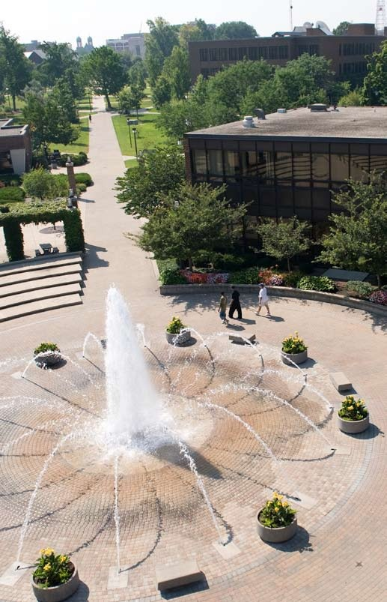
The Pathway to Success
Goal 2 – Initiative 1.B
Center for Student Research & Creativity

Slide 2
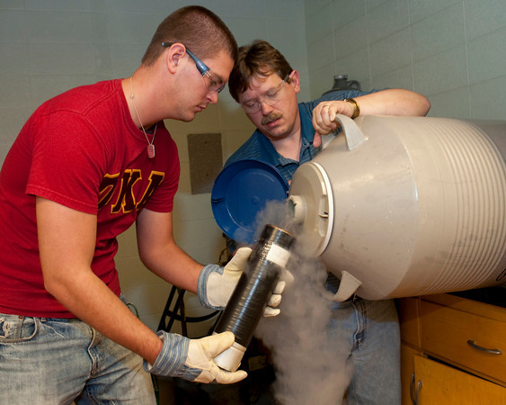
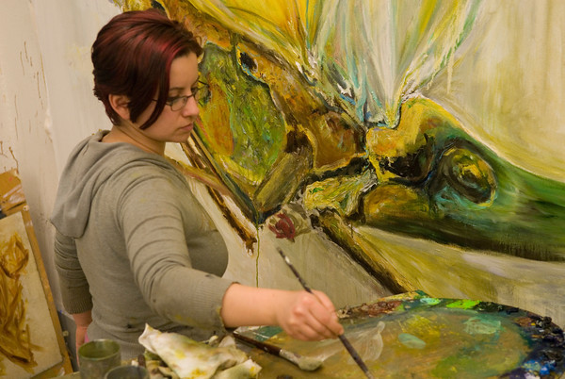
The Pathway to Success
This year’s focus
Continue to institutionalize undergraduate
research and creativity at ISU, consistent
with the strategic initiative. Anticipate
beyond the strategic initiative and develop
a 3-5 years strategic plan.
If original budget request is fully funded,
anticipate no budget constraints. However,
one initiative produced better than expected
results and I have requested supplemental
funding for it. (SUPUR—Summer Unbounded
Possibilities Undergraduate Research)

Slide 3
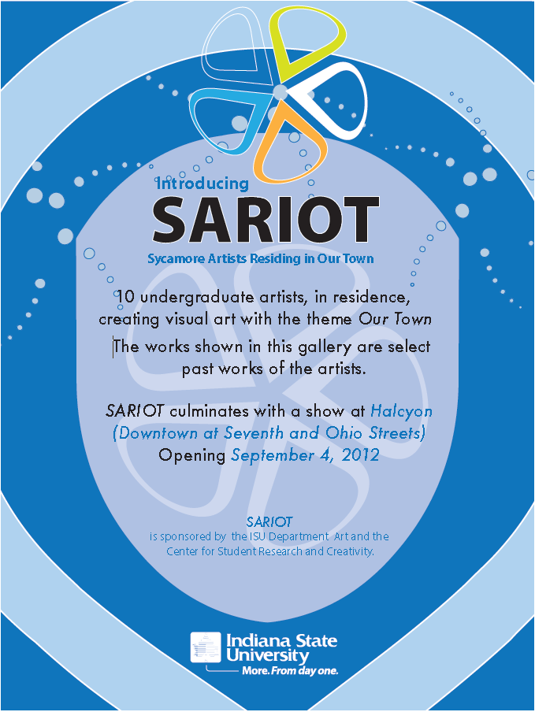
The Pathway to Success
CSRC Highlights
SARIOT—Sycamore Artists Residing in Our Town
10 week art experience modeled
after summer undergraduate research experience, like SURE.

Slide 4
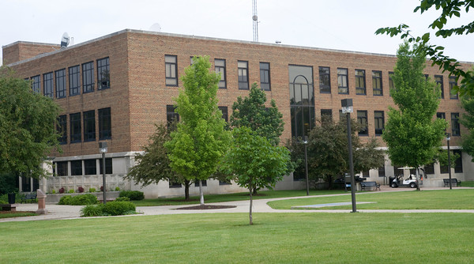
The Pathway to Success
CSRC Highlights
Permanent office space,
Suite 329 Dreiser Hall

Slide 5
The Pathway to Success
CSRC Highlights
Campus wide panel presentation on undergraduate research and creativity/similar panel presentation to New Faculty Orientation

Slide 6
The Pathway to Success
CSRC Highlights
SURF initiative looks like it will be piloted for incoming students Fall 2012. SURF (Sycamore Undergraduate Research Fellows) awards as part of a student’s financial package an undergraduate research fellowship with one of three Unbounded Possibilities initiatives. A day in February is being planned to invite possible SURFers to campus s part of an interview process for these awards. This has recruitment as well as retention impacts.

Slide 7
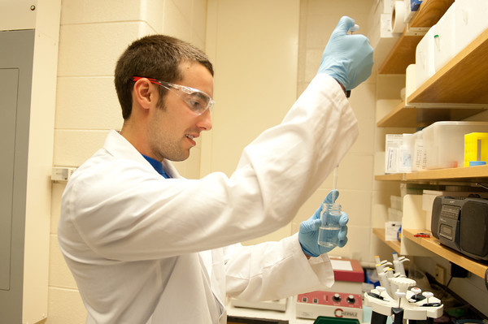
The Pathway to Success
CSRC Highlights
20 requests received and funded involving 36 students.

Slide 8
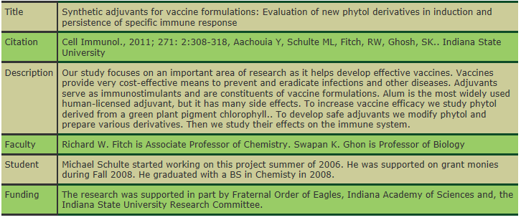
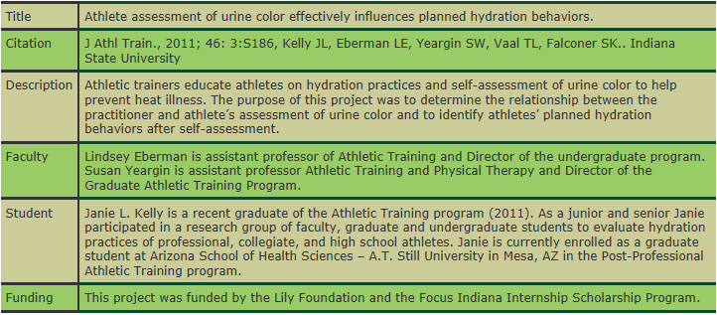
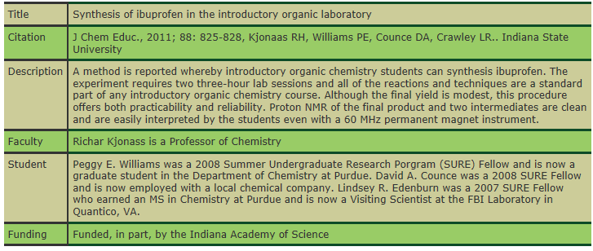
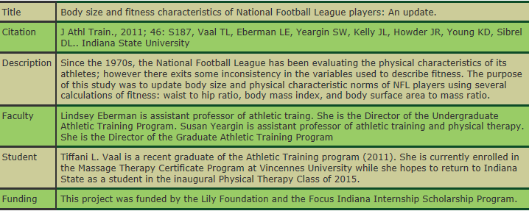
The Pathway to Success
CSRC Highlights
Published research with undergraduates

Slide 9
The Pathway to Success
Upcoming activities and events….
Summer 2013 programs: Creative Writing
Workshop with Prof. Aaron Morales.
SUPUR (Summer Unbounded Possibilities Undergraduate Research). Estimated 30 students involved across both programs.

Slide 10
The Pathway to Success
Upcoming activities and events….
Exposium (formerly Symposium) expands to full week in April to celebrate student research and creativity.

Slide 11
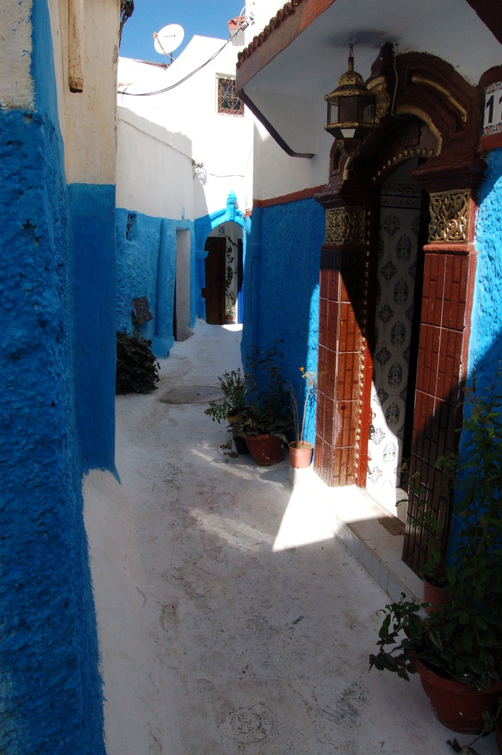
The Pathway to Success
Upcoming activities and events….
May 2013 Faculty lead summer abroad trip to Morocco to (try) integrating undergraduate research experience with study abroad.
Kasbah in Rabat, Morocco

Slide 12
The Pathway to Success
Upcoming activities and events….
“Sycamores at NCUR2013” Agreement with College Deans that any students who are accepted for NCUR2013 that CSRC will pay full expenses for student(s) and that Dean awards $250 in professional development monies to Faculty Sponsor.

Slide 13
The Pathway to Success
Upcoming activities and events….
“Scientia fabricator confjunctum” (scientists and designers together). A poster competition involving SURE2012 students working with graphic designers to produce better science posters.

Slide 14
The Pathway to Success
Questions

