Slide 1
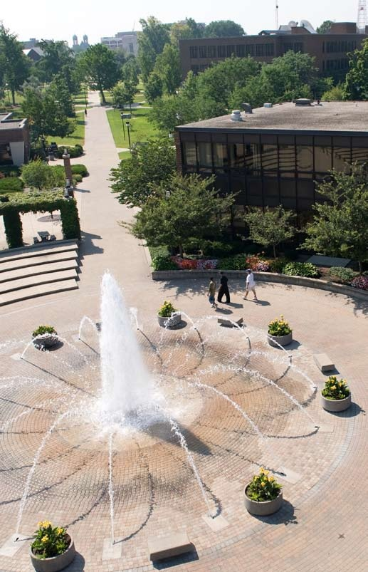
The Pathway to Success
Goal 2 – Initiative 1.B
Center for
Student Research and Creativity
Notes:
Good morning – thanks
Getting close to lunch
New
Gathering and Using

Slide 2
Accomplishments Since 2013-14 Report
Despite the budget cut, all summer REU initiatives are in place though with reduced funding to each (result is either fewer students or reduced stipend)
NCUR2015 , more students, only two colleges represented, some matching funds from one college. Token awards for faculty sponsors from both colleges.
First cohort of SURFers enrolled, second cohort currently being recruited and three SURFers attending NCUR2015. (this is an amazing feat)

Slide 3
Benchmark Table

Slide 4
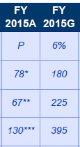
Benchmark Progress Detail
-Expect about 40 students participating in Allusions
-About 75 in summer REU and CEUs
-Have 43 travel requests waiting funding decision
With Spring Exposium, this goal should be met
We are adding a fifth day to the spring Exposium, this goal should be easily met

Slide 5
Budget Summary
Total funding allocation for 2014-15 $134,334 plus one time allocation to reinstate Summer REU and CEU ($50,000) and one time allocation to reinstate NCUR2015 and ISUCCEED ($48,025) plus $6024.37 in recovery of unspent awards. $238,383.37
Expenses as of report date
Expenditures $111,002.88
Encumbered costs $133,191.41
Anticipated remainder June 30, 2015 less than $2000, as of 2/15/15 $4189.08

Slide 6
Accomplishments Since Plan Inception
Four new summer REUs and one CEU in place.
Three straight years of taking increasingly more students to NCUR (25 will attend NCUR2015)
Exposium has grown to include five full days and a one day event in the fall to capture the summer experiences.

Slide 7
Looking Ahead - Recommendations
Base budget so better planning is possible.
High value recognition for faculty mentoring undergraduate researchers, artists and performers.
Need funding streams outside of base budget and one-time ISU dollars. Must get Foundation committed to CSRC
More sharing of expenses with Colleges for student travel related to dissemination and performance.

Slide 8
Foreseeable Roadblocks
Funding. “Undergraduate research” is expensive.
Incentives to faculty to engage in mentoring students. To increase opportunities, some kind of incentive is needed.
Housing. Some kind of affordable housing for summer students engaged in undergraduate research and creative projects. Could be subsidy, or something in-kind. This makes “buying” student time for the experience truly equitable across our student body.

Slide 9
New points of emphasis
More collaboration (with funds):
opportunities for undergraduates to experience research: DR RAP (Dissertation Research Research Assistance Program) CGPS
Undergraduate research in Diversity and Sustainability: ICS and Office of Diversity
Sycamores at NCUR2016: College Deans
SURF: Office of Admissions

Slide 10
Missed opportunities
Funding outside of strategic planning or base budget dollars. Undergraduate research would seem to be an easy “sell” to donors, but there is no relationship with the Foundation despite repeated attempts
Telling the story of undergraduate research and creativity at ISU. Many stories, many visuals, but little production. I will hire it done in the next year, pending funding, through Sycamore Student Media

Slide 11
Baseline Recommendation
The CSRC was formed as a stand alone initiative with the goal of enhancing experiential learning through undergraduate research and creativity. It is doing that and can easily claim that this kind of experiential learning is spreading across and deep into the ISU student experience. Provost Maynard’s charge to me in August 2011 to change the culture shows several tipping points where undergraduate research and creativity is becoming “normal.”

Slide 12
Opportunities for Collaborations
Without the collaboration of individual faculty members undergraduate research and creativity would not exist.
More collaboration with
-Honors Program
-Foundation
-Study Abroad

Slide 13
Questions?
Center for Student Research and Creativity
Tom Steiger
thomas.steiger@indstate.edu

