Slide 1
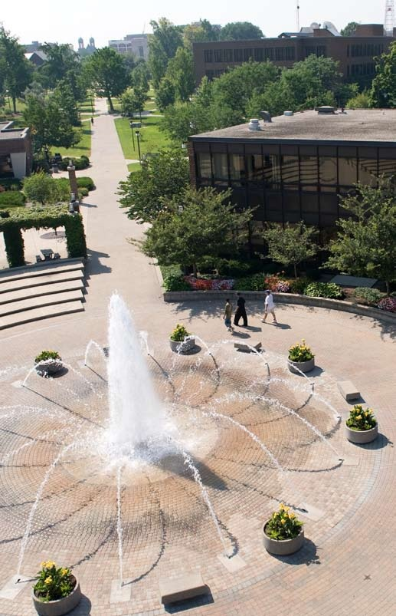
The Pathway to Success
Goal 2 – Initiative 1
Student Travel Study

Slide 2
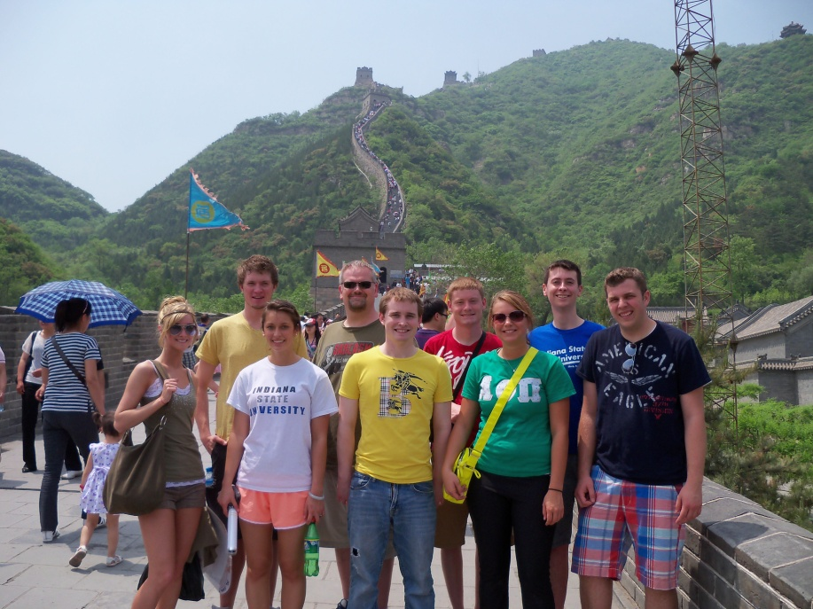
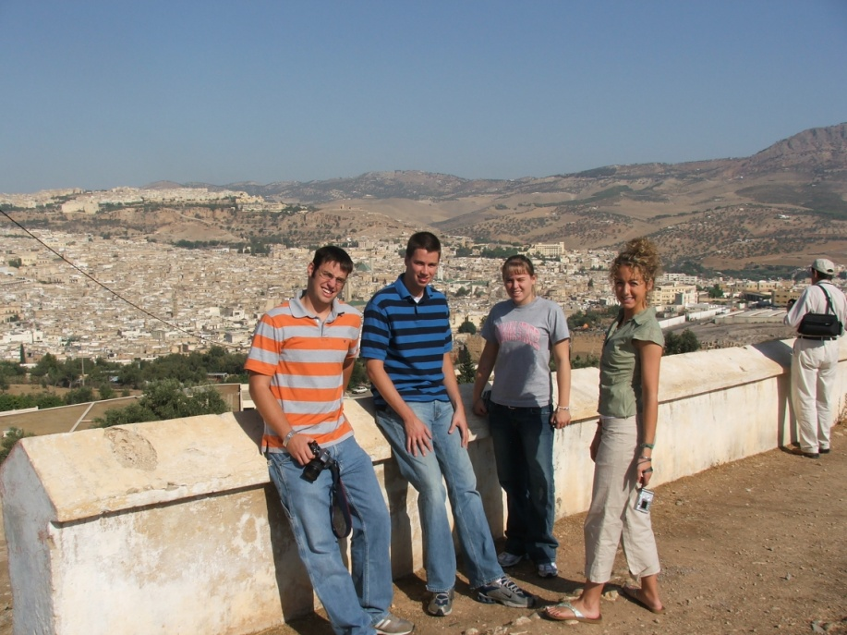
The Pathway to Success
Introduction & Purpose
Domestic and international travel study allows students to visit sites and attend events that enhance their learning beyond the classroom.
Travel to conferences and meetings supports students’ professional development and broadens their horizons
attend a conference or professional meeting
attend a creative performance or view an exhibit or demonstration
gain direct access to information or professional development experience that they would otherwise only encounter second-hand

Slide 3
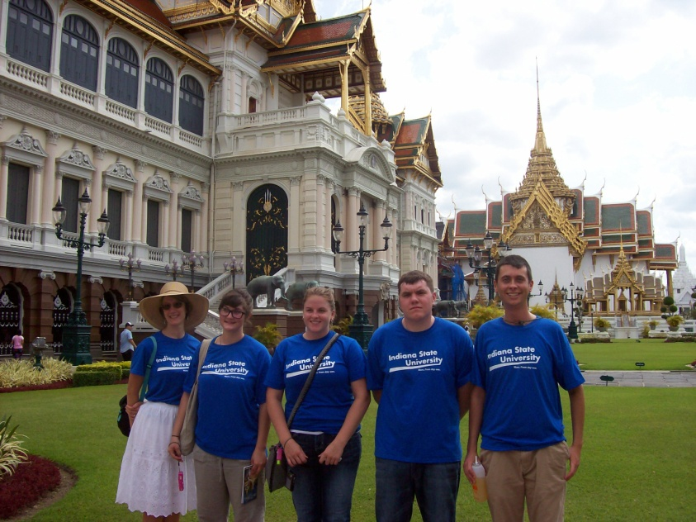
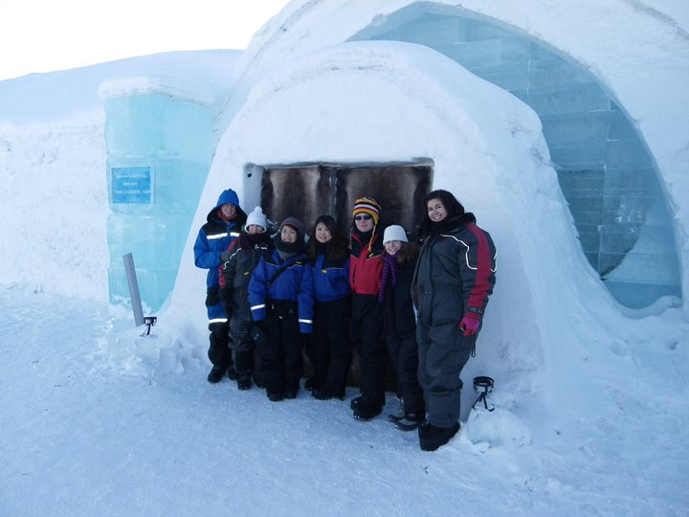
The Pathway to Success
Course based, short term, faculty led international study
Total Faculty Led International Study Experiences:
2009-2010 15 students
2010-2011 92 students (12 courses)
2011-2012 71 students

Slide 4
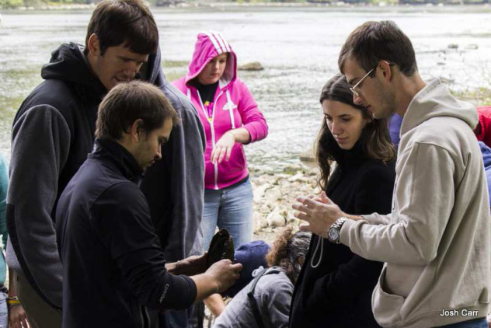
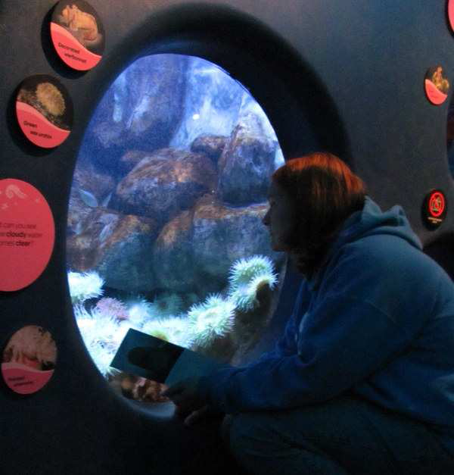
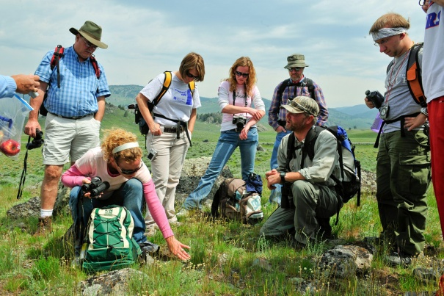
The Pathway to Success
Course based, short term, faculty led domestic travel study
2011-2012 500+ students
2012 (Fall only) 150+ students
Trips funded for courses from all colleges, locations include:
Indianapolis; Chicago; Bloomington; St. Louis; Cincinnati; New York City; San Francisco; Fairfax, VA; Washington, DC; Goshen, IN; Skokie, IL; Cadiz, KY; Atlanta; and Terre Haute.

Slide 5
The Pathway to Success
To quote President Bradley from a recent issue of ISU Magazine, “Studying abroad is a great form of experiential learning … . As part of our strategic goal to advance experiential learning, the university plans to double the percentage of students who participate in international experiences by 2014.”
By helping to make international and domestic travel more affordable, and by providing shorter, faculty led course-related experiences that are more appealing to students unaccustomed to travel, we have significantly increased the number of students traveling to study in the United States and abroad.

Slide 6
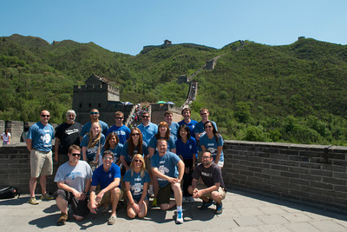
The Pathway to Success
Challenges to Providing More Students the kinds of experiential learning activities that travel provides.
Funding for this initiative is not sufficient to achieve the desired expansion in the number of faculty and students participating in course based travel activities.
Possible solution: Investigate a small fee to create a pool of revenue to subsidize (required?) approved experiential learning activities.

Slide 7
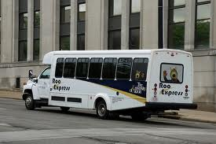
The Pathway to Success
Challenges to Providing More Students the kinds of experiential learning activities that travel provides.
Many grant proposals involve 1 or 2 day regional travel experiences for classes with 20-50 students, making minivan rental difficult (# of required drivers and keeping students together) or utilizing Turner Coaches too expensive on a per student basis.
M
Possible solution: Acquisition of a university mini bus and contract driver. The feasibility of such an option is being investigated.

