Slide 1
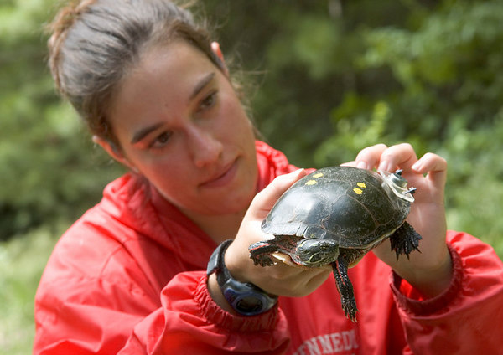
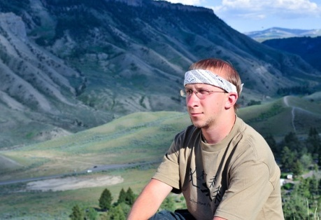
The Pathway to Success
Goal
Two
Advance Experiential Learning
Advance experiential learning to where all ISU students have a significant experiential learning experience within their major.

Slide 2
The Pathway to Success
Goal
Two
Advance Experiential Learning
Goal Chair: Nancy Brattain Rogers
Audit Chair: Yasenka Peterson
Audit Team: Kim Bodey, Lindsey Eberman

Slide 3
The Pathway to Success
 | Goal #2 Benchmarks | 2008 | 2014 Target | Long-Term Target
 | Students who participate in an internship, practicum or field experience before graduation. | 82%ª | 100% | 100%
 | Degree programs with a required significant experiential learning component. | 55% | 100% | 100%
 | New graduates’ participation in experiential learning within their major. | TBD | 100% | 100%
 | Students who participate in an international (non-credit and for-credit) experience. | 12%ª | 25% | 60%
 | ªNational Survey of Student Engagement (NSSE) Spring 2007 report

Slide 4
The Pathway to Success
Initiatives
Infuse experiential learning as a core component in all academic programs.
Apply the science of learning to the learning of science.
Coordinate and elevate leadership studies.

Slide 5
The Pathway to Success
Initiative 1: Infuse experiential learning as a core component in all academic programs.
Implementation Team: Harriet Hudson, Chris Olsen, Chad Becker, Janis Halpern, Debra Israel, Gloria Plascak, David Robinson, Jennifer Ryan, Brad Venable, Rita Worrall, Carole Yaw
This initiative will help ensure that every student participates in experiential learning and every program includes experiential learning by:
Facilitating/supporting the development of EL opportunities in the curriculum.
Strengthening institutional support for EL.

Slide 6
The Pathway to Success
Initiative 1: Infuse experiential learning as a core component in all academic programs.
Current activities of the implementation team include:
Identifying best practices, especially related to study abroad, undergraduate research, internships, and learning communities.
Identifying programs and incentives to promote undergraduate research.
Identifying incentives to increase study abroad participation.
Working with first-year programs to develop opportunities in learning communities.
Provide audit chair comment on this initiative

Slide 7
The Pathway to Success
Initiative 1: Infuse experiential learning as a core component in all academic programs.
Audit Team observations:
Need to consider and articulate strategies for securing necessary faculty participation in recommended activities.
Concern that all study abroad is not experiential learning.
Recommendations regarding improved coordination of undergraduate research must include a strong focus on supporting faculty mentors.

Slide 8
The Pathway to Success
Initiative 2: Applying the Science of Learning to the Learning of Science
Implementation Team: Jim Speer, Sue Berta, Kay Harmless, Liz Metzger, Heather Miklozek, Emily Pugh, Jennifer Sicking, Larry Tinnerman
This initiative will help us reach the benchmark of every program including experiential learning by “SENCERizing” a number of general education courses into a format that challenges students to use the scientific method to address current, often local, unresolved public issues.

Slide 9
The Pathway to Success
Initiative 2: Applying the Science of Learning to the Learning of Science
Status of this Initiative:
ISU SENCER team attended the SENCER Summer Institute 2009 to receive training.
Several faculty workshops held during 2009-10 AY.
SENCER Pilot Courses:
Geol 110: Introduction to Environmental Science
Geol 465/565: Fundamentals of Tree-Ring Research
Geog 490/590: Seminar on the Global Climate Change Debate
Geog 405/505: Fundamentals of Remote Sensing

Slide 10
The Pathway to Success
Initiative 2: Applying the Science of Learning to the Learning of Science.
Status of this Initiative (cont.):
SENCER model proposed in Foundational Studies courses:
Geol 110: Introduction to Environmental Science
Geog 411: Conservation and Sustainability
Visit from Marian Fass, Beloit College.
Another ISU team will attend training during Summer 2010.

Slide 11
The Pathway to Success
Initiative 2: Applying the Science of Learning to the Learning of Science
Audit summary:
Comments related to need for additional detail regarding how faculty and departments participate.

Slide 12
The Pathway to Success
Initiative 3: Coordinate and Elevate Leadership Studies
Implementation Team: Denise Collins, Greg Bierly, Heather Miklozek, Nolan Davis, Les Anne Dant, Linda Maule, Jason Winkle, Amy Naidu, Anna Christensen, Stephanee Squires, Rhonda Impink
This initiative will help us reach the benchmark of ensuring every ISU graduate has participated in experiential learning. The initiative will utilize current and new activities to create a coherent, integrated, and purposeful leadership learning experience.

Slide 13
The Pathway to Success
Initiative 3: Coordinate and Elevate Leadership Studies
Status of this initiative:
Current leadership activities have been inventoried.
Leadership statement for ISU has been drafted.
Plans for creating Leadership Consortium during 2010-11 year.
Proposal to create faculty fellowship focused on leadership.
Audit comments:
Support better coordination of activities.
Would like assessment information for current Civic Leadership Minor.

Slide 14
The Pathway to Success
Summary
Progress has been achieved on all three initiatives. The first initiative is strongly focused on necessary support for experiential learning to thrive. Initiatives 2 and 3 have made substantial progress toward implementation of the Leadership Consortium and SENCER-based curriculum.

