Slide 1
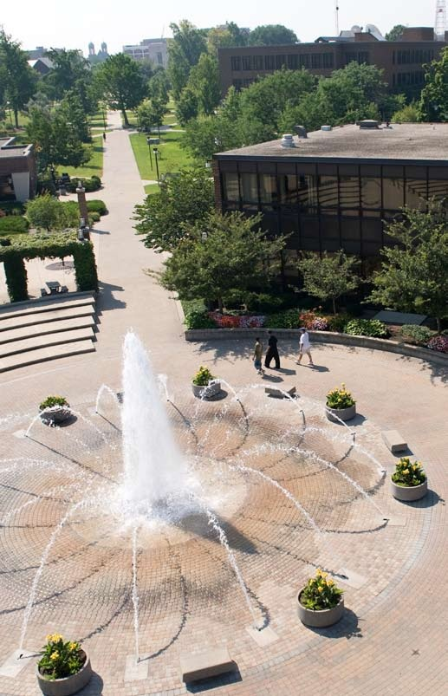
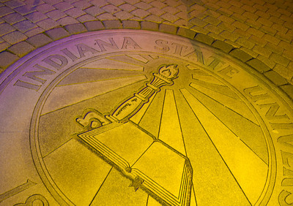
The Pathway to Success
Goal 2 – Initiative 4
Icon and Legacy Programs

Slide 2
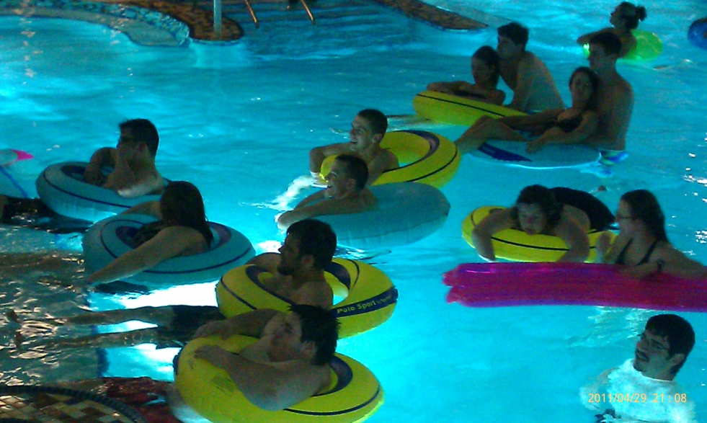
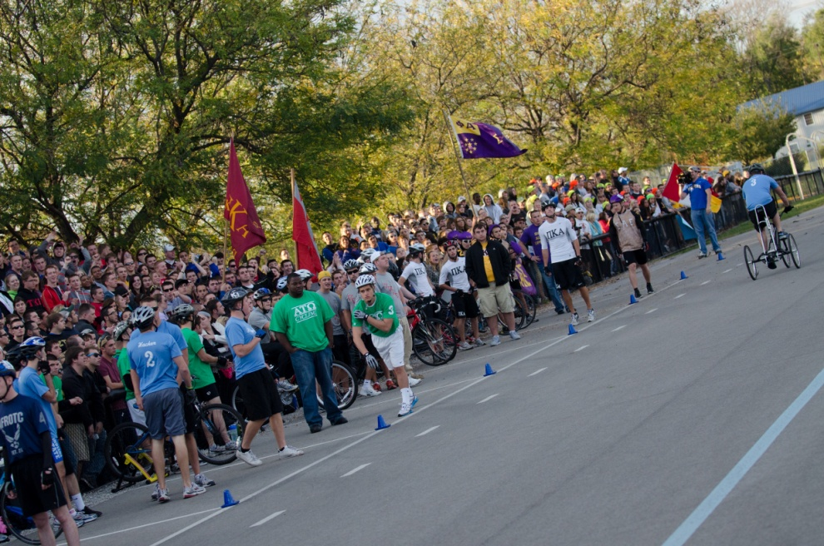
The Pathway to Success
Introduction
To enhance existing (Legacy) programs and to develop new (Icon) programs on campus
Solidify funding and to instill quality in the programming
Re-introduce programs that were eliminated due to funding, but are needed
Keep current with today’s changing students
Purpose
Eliminate “Suitcase” mentality
Provide healthy weekend experiences
Create a sense of belonging
Enhance the University experience

Slide 3
The Pathway to Success
Methods
Defined what was an Icon and what was a Legacy program and service
Icon ideas included programs and services that would help me the needs of today’s changing students and included programs that previously existed but were eliminated.
Legacy ideas included programs and services that currently exist, but needed additional funding or attention to enhance their effectiveness
Identified over 100 Icon and Legacy programs and services
Prioritized list of possible programs and services
Identified one or two programs or services for each of the four years remaining in the plan
Ideas grew in complexity from year to year

Slide 4
The Pathway to Success
Enhancing Legacy Programs and Creating Icon Programs for Students
2
4
7 Prov. Ev. & Act for RH Stud. Pro. Health Wkend Alt & cont to ret. L L L L L
1 9 Gath. Info from Att and Part in events and prog help set ISU St. Pr. M M M M M
Attendance at Rec Fest 834 1200 1300 1400 1500
Attendance at Destress Fest 772 900 1000 1100 1200
Sycamore Tricycle Derby Teams (Men and Women combined) 11/11 15/13 16/14 18/15 20/16
Tandem Race Teams/Organizations involved 9/19 11/21 12/22 14/25 16/28
Sycamore Tricycle Derby Attendance 1400 1600 1900* 1800 1800
Tandem Race Attendance 1100 1200 1300 1400 1500
*50th Anniversary Race – Potential Bump in attendance

Slide 5
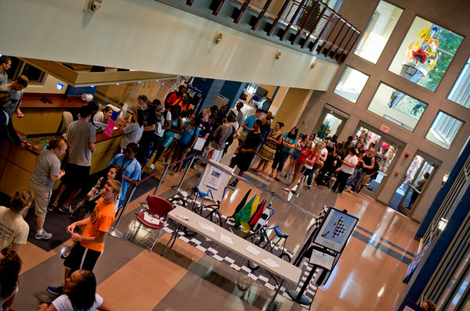
The Pathway to Success
Discussion
RecFest
First weekend of the fall semester
Over 1200 students attended
(366 more than the inaugural year)
Educational, Fun, Safe
Sycamore Tricycle Derby and Tandem Race
New equipment for timing and scoring
Enhancements to the Environment, Awards Ceremony
Purchase of New Tandems
Student Legal Services
Students have no where to turn in today’s litigical society
Requests are currently turned away by the ombudsperson

Slide 6
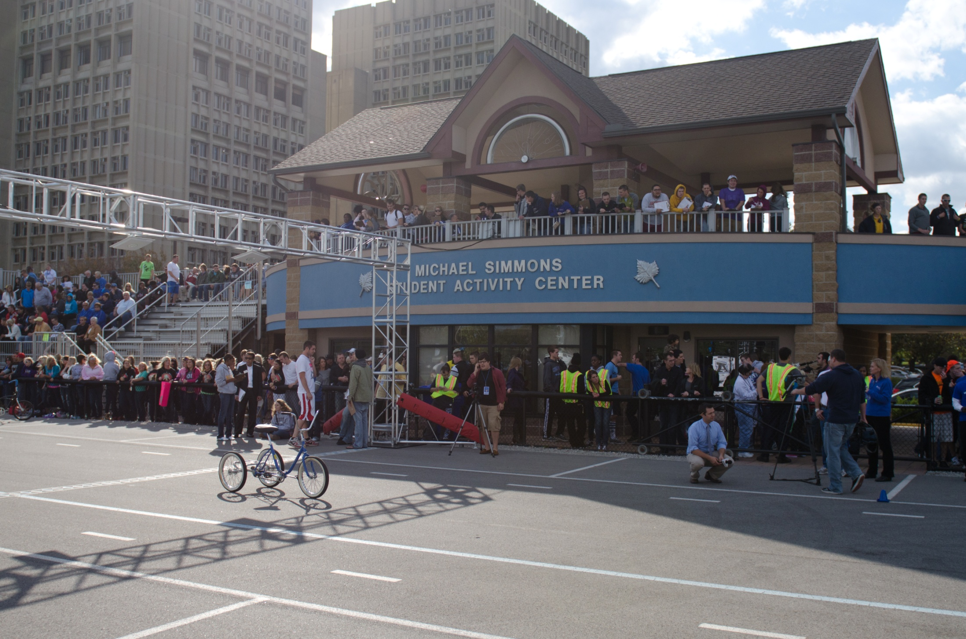
The Pathway to Success
Summary
Initial Projects last spring at the SRC included Cookouts and dive-in movies
This year’s focus is on RecFest (fall) and De-Stress Fest (fall and spring) the weekend before finals
Trike showed an increase in teams, participation and an overall great experience
Funding of Tandems for the spring will provide a similar experience
All of these events enhance the student experience at Indiana State University and impact retention of our students

