Slide 1
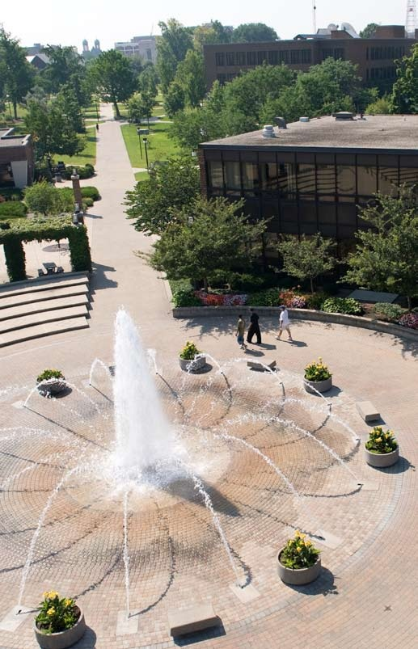
The Pathway to Success
Goal 1 – Initiative 9
Icon and Legacy
Programs
Notes:
Good morning – thanks
Getting close to lunch
New
Gathering and Using

Slide 2
Accomplishments Since 2013-14 Report
The Purchase of Trikes and Tandems to provide a level playing field
A new state of the art timing system
A new storage and workshop facility for Bikes
Tools, work station, bike technicians
Graduate Assistant for Sycamore Athletics

Slide 3
Benchmark Table

Slide 4
Benchmark Progress Detail
Numbers for RecFest included swipes for the entire day
Attendance at Sycamore Tricycle Derby were much larger due to the 50th Running of the event
Tandem goals were met with one exception.

Slide 5
Budget Summary
Total funding allocation for 2014-15
$68,310
Expenses as of report date
Expenditures $51,700
Encumbered costs $12,610
Anticipated remainder June 30, 2015
$4000 for Sycamore Fitness Trail

Slide 6
Accomplishments Since Plan Inception
De-Stressfest and Rec Fest
Two Different Sound Systems (portable and permanent)
Tandem and Trike Purchases & Imrpovements
New Storage Facility for Bikes
New Graduate Assistant for Intercollegiate Athletics

Slide 7
Looking Ahead - Recommendations
Continue to work towards the full integration of the bike shop for the University community for personal bike repairs.
As our fleet of trikes and tandems age, we will need to constantly replace a few of each year so that we can remove the oldest ones and maintain a good fleet of bikes.

Slide 8
Foreseeable Roadblocks
Working with the Sycamore Bike Trail through Facilities Management (too much unknown right now as this is just developing)

Slide 9
New points of emphasis
Banner structure for advertising major campus events
Addition of a new graduate assistant for Trike and Tandem

Slide 10
Missed opportunities
Expansion of Trike and Tandem Teams

Slide 11
Baseline Recommendation
Has this initiative been sufficiently integrated into your operations?
Most of the initiatives with Recreational Sports have been integrated into their department and it is recommended that the funding for Trike, Tandem, The Bike Shop, and Rec Fest be allocated to Recreational Sports annual budget and incorporated into their operation.

Slide 12
Opportunities for Collaborations
Several collaborative efforts are currently underway with Residential Life and across Student Affairs
Developing additional Trike and Tandem Teams from Academic Units
Possible Bike Share program collaboration

Slide 13
Questions?
Icon and Legacy Programs
Initiative Chair – Al Perone
Initiative Chair – al.perone@indstate.edu

