Slide 1
The Pathway to Success
Goal
One
Increase Enrollment
and Student Success
Initiative 10: Create a Comprehensive Wellness Program
Chair: Aimee Janssen-Robinson
Co-Chair: David Stowe
Members: Barbara Barton, Christine Knight, Derek Kingsley, Holly Arnett, Jessica Robinson, Tom Nesser, and Valerie Craig
Initiative 10 began in Fall 2010
Notes:
The vision behind a comprehensive wellness program is to have vibrant healthy students who are ready to learn. This initiative reflects a preventative college health agenda as opposed to a treatment agenda since health is much more than the absence of disease and there are proven strategies for promoting health and preventing disease. The outcomes of this initiative will allow students to participate successfully in the University mission to prepare productive citizens for Indiana and the world in all disciplines, and to prepare them for lifelong learning, leadership and careers in a changing multicultural world. The students will more effectively be educated and motivated with best practices for developing and achieving a healthy lifestyle. The techniques in a comprehensive wellness program are from sources such as the American College Health Association, Healthy Campus 2020, and American College of Sports Medicine.

Slide 2
The Pathway to Success
Initiative 10- Create a Comprehensive Wellness Program
Top 3 health impediments to academic performance
Stress
Alcohol Use
Internet use/computer games
Notes:
According to the National College Health Assessment students report the top three health impediments to academic performance are stress, alcohol use, and internet use/computer games which are responsible for 40% of students' poor academic performance. The comprehensive wellness program will work to address these impediments to academic performance following the Ecological Model.

Slide 3
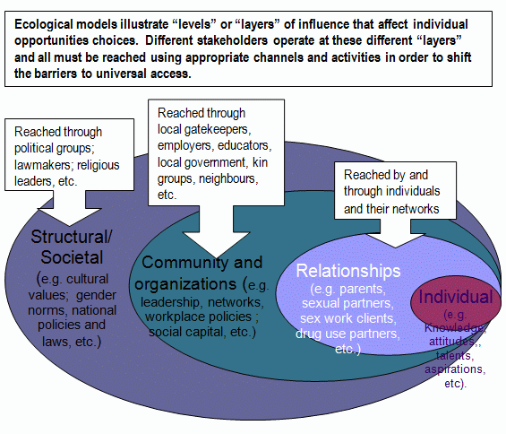
The Pathway to Success
Initiative 10- Create a Comprehensive Wellness Program
Notes:
The Ecological Model is an approach in which multiple strategies are developed to impact determinants of health relevant to the desired health outcomes. This model will allow for greater experiential learning opportunities on campus for students as they will be able to provide health screenings, programs, and other services to their peers.

Slide 4
The Pathway to Success
Initiative 10- Create a Comprehensive Wellness Program
Benchmarks
Benchmark | 2010 | 2011 | 2012
Wellness Bash attendance | 600 | 800 | 1000
SoberRide | 438 | 600 | 600
Student Health Promotion programs/events | 183 | 200 | 210
Nutrition Consultations | 0 | 50 | 60
Exercise is Medicine | 100 | 150 | 200
Notes:
Wellness Bash had record attendance of 800, which is an increase of 200 participants over the past 2 years
• SoberRide provided 600 rides during Homecoming 2011, which is an increase over 438 rides the previous year
• Student Health Promotion has presented 87 programs/events compared to 50 at this point last year
Presented a total of 183 programs we anticipate 200 this year and 210 next year
Programs reached 21678 last year we anticipate reaching 22000 students this year
• Student Health Promotion has provided 20 nutrition consultations compared to 0 at this point last year
We anticipate 50 by the end of the semester
• The Exercise is Medicine Speaker Series will bring in 2 guest speakers for 2011-2012
The first one was Oct. 31st Dr. Craig Broeder – “Why exercise is king and nutrition is queen in the prevention and treatment of obesity.”

Slide 5
The Pathway to Success
Initiative 10- Create a Comprehensive Wellness Program
Goals
Provide financial support for Wellness events to increase participation
Conduct a student health & wellness needs assessment
Implement Exercise is Medicine (speakers & social marketing)
Develop a comprehensive wellness plan
Health risk assessments
Recommendations
Follow-up
Infuse wellness into the curriculum by proving co-curricular activities

Slide 6
The Pathway to Success
Questions/Comments

