Slide 1
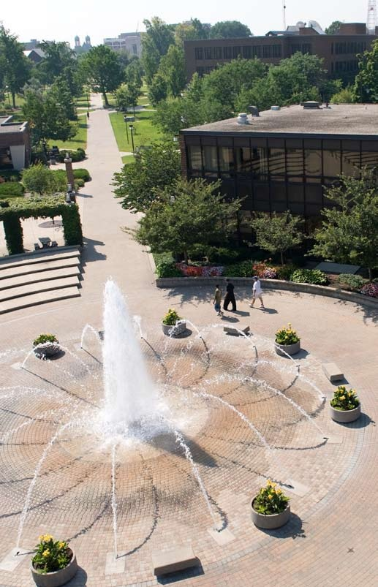
The Pathway to Success
Goal 1 – Initiative 5
Develop Programs for Parents and Families

Slide 2
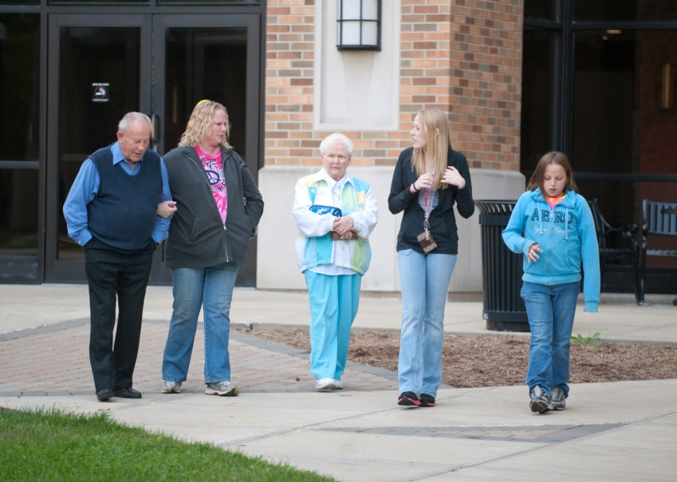
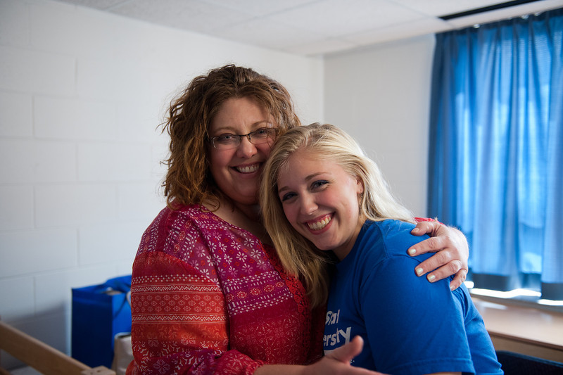
The Pathway to Success
Introduction & Purpose
Centralizes and increases the University’s interaction with parents and siblings, who are an invaluable resource in helping to keep students in college.
Special significance to first-generation college parents.

Slide 3
The Pathway to Success
Methods
• Utilizing a staff member to serve as a Parent Advisor, increasing communication, developing a Parent and Families website and companion Facebook page.
• Conducting an annual Parent Survey exploring expectations, needs and opinions.
• Expanding Family Day to include academic units, student organizations and targeted programming for younger siblings.

Slide 4
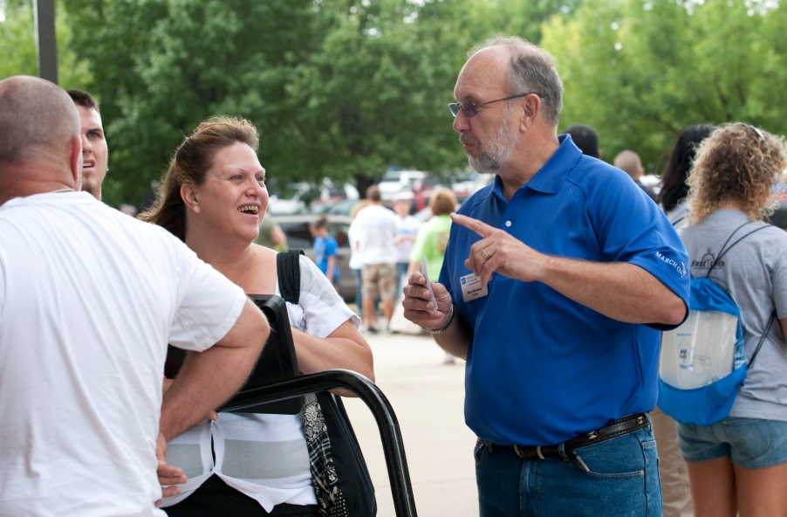
The Pathway to Success
Benchmarks
• Participation in Annual Parent Survey
• Attendance at Family Day (families registered)
• Increased traffic on Parent and Families website
• Members on Parent Facebook page
• Contact at Parent Tent during Move-In
• Reach of ParentLink

Slide 5
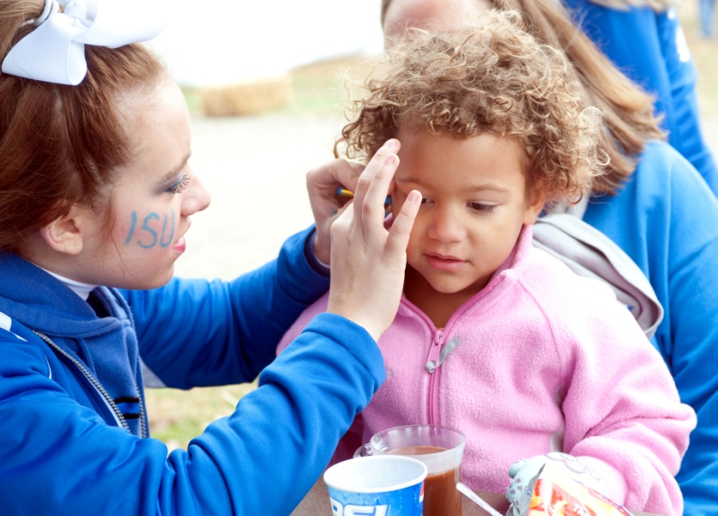
The Pathway to Success
Discussion
Continue what is working (website, social media, e-card series, parent survey, ParentLink, welcome letter, and Family Day)
Additions – Sycamore Hoopla, break transportation and an online Parent and Families Guide to Indiana State

Slide 6
The Pathway to Success
Summary
This initiative has been successful in engaging parents and younger siblings with Indiana State, especially first-generation college families.
While we serve only a small percentage of ISU parents (primarily first-year parents), the impact we have is high.

