Slide 1
The Pathway to Success
Goal 1 – Initiative 2
Math Intervention
Notes:
Good morning – thanks
Getting close to lunch
New
Gathering and Using

Slide 2
Accomplishments Since 2013-14 Report
Results of Math and Mentor programs
for COT transfer students:
Increased 2-year graduation rate to 25%
Increased 2-year retention to 54%
(+ 25% grads = 79% total success)
Maintained 1-year retention of 84%
(+11% early grads = 95% total success)
Reduced the 1-year loss rate to 5%

Slide 3
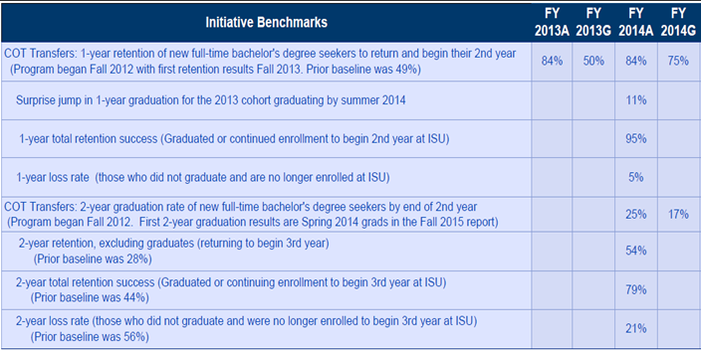
Benchmark Table

Slide 4
Benchmark Progress Detail
1-YEAR BENCHMARKS | FY 2013A | FY 2013G | FY 2014A | FY 2014G
Retention | 84% | 50% | 84% | 75%
Graduation |  |  | 11%
Success |  |  | 95%
Loss rate |  |  | 5%

Slide 5
Benchmark Progress Detail
2-YEAR BENCHMARKS | FY 2014A | FY 2014G
Retention | 54% | 29%
Graduation | 25% | 17%
Success | 79% | 46%
Loss rate | 21% | 54%

Slide 6
Budget Summary
Total funding allocation for 2014-15
$121k
Expenses as of report date
$77k through Feb 2015
+ 8k encumbered costs
Anticipated remainder June 30, 2015
none

Slide 7
Accomplishments Since Plan Inception
Fall 2012-Fall2014 | Prior Avg | Most Recent | Change
1-year retention | 49% | 84% | +35%
2-year retention | 28% | 54% | +26%
2-year graduation | 16% | 25% | +9%

Slide 8
Looking Ahead - Recommendations
The math weakness of incoming students continues at an alarming rate. We must remain vigilant in preparing students for success.

Slide 9
Foreseeable Roadblocks
None

Slide 10
New points of emphasis
Some students need more than the math refresher offered in our 100-level courses.
We have experimented with a couple tech courses which devote more time to math skills. These have been successful.
We could develop a course for weaker students which would strategically prepare them for technology majors.

Slide 11
Missed opportunities
None

Slide 12
Baseline Recommendation
Has this initiative been sufficiently integrated into your operations?
Yes. Both programs have expanded successfully.
The Mentor Team has worked with 530 transfer students in 2 ½ years.
Math Prep has reinforced the skills of over 1,000 COT students.

Slide 13
Opportunities for Collaborations
We’ve learned some important lessons!

Slide 14
Questions?
Math Intervention
Bob English, David Sivley

