Slide 1
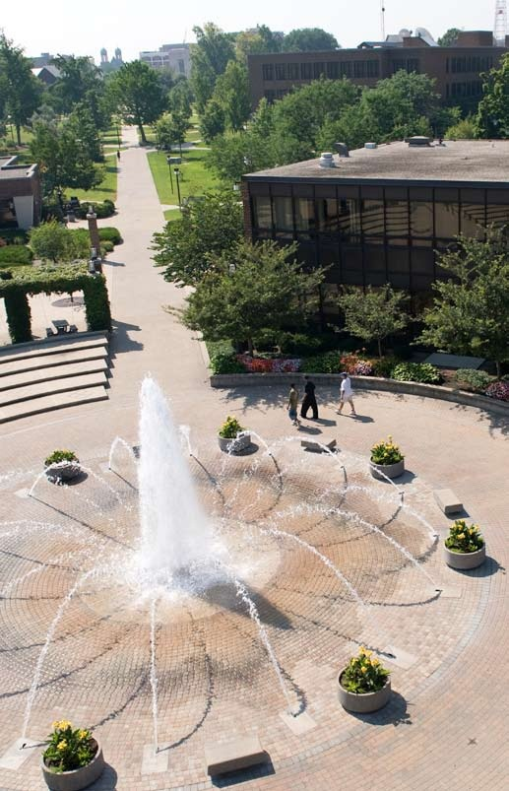
The Pathway to Success
Goal 1 – Initiative 2
Increase Enrollment & Student Success

Slide 2
The Pathway to Success
Introduction & Purpose
Further develop cooperative programs with Ivy Tech in order to increase enrollment and student success

Slide 3
The Pathway to Success
Methods
Competitiveness of Scholarships
Awarded $35,000 in transfer scholarships
Provided laptops for transfer students
Improve Viability of Academic Programs
Improved course and degree articulations
Developed new technology programs (i.e., BSET, BSCET) that articulate with programs at Ivy Tech
Researched B.A.S. program that would articulate with A.A.S. degree(s)

Slide 4
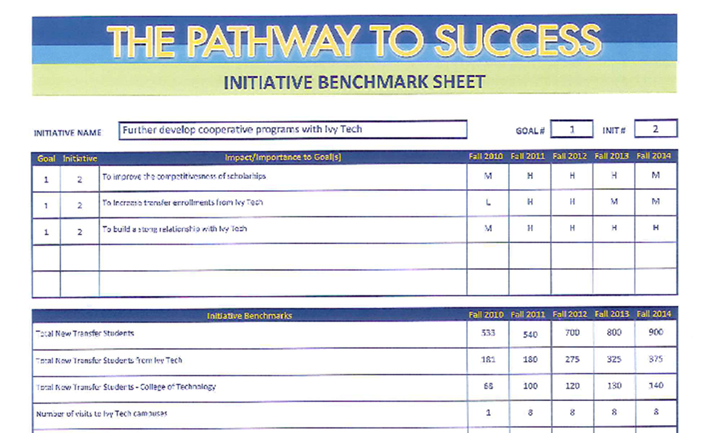
The Pathway to Success
Benchmarks
Goal | Initiative | Impact/Importance to Goal(s) | Fall 2010 | Fall 2011 | Fall 2012 | Fall 2013 | Fall 2014
1 | 2 | To improve the competitiveness of scholarships | M | H | H | H | M
1 | 2 | To increase transfer enrollments from Ivy Tech | L | H | H | M | M
1 | 2 | To build a strong relationship with Ivy Tech | M | H | H | H | H
Initiative Benchmarks |  |  | Fall 2010 | Fall 2011 | Fall 2012 | Fall 2013 | Fall 2014
Total New Transfer Students |  |  | 533 | 540 | 700 | 800 | 900
Total New Transfer Students from Ivy Tech |  |  | 181 | 180 | 275 | 325 | 375
Total New Transfer Students - College of Technology |  |  | 68 | 100 | 120 | 130 | 140
Number of Visits to Ivy Tech Campuses |  |  | 1 | 8 | 8 | 8 | 8

Slide 5
The Pathway to Success
Discussion
Dramatic increase in COT transfer students from Ivy Tech, from 58 (09-10) to 68 (10-11)
Scholarships offset “tuition shock”
New COT programs articulate with Ivy Tech’s engineering program
Plans for 2010-11
Build stronger relationships with Ivy Tech administrators and faculty (visit ITCC and host)
Explore specialized professional degree (B.A.S) to articulate with A.A.S. programs
Assess needs of Ivy Tech students

Slide 6
The Pathway to Success
Summary
Transfer student enrollment steadily increased: 393 (08), 466 (09) 533 (10), and 540 (11)
Expanded services with Ivy Tech
Enhanced relationship with Ivy Tech
Increased scholarship dollars
Improved academic program offerings

