Slide 1
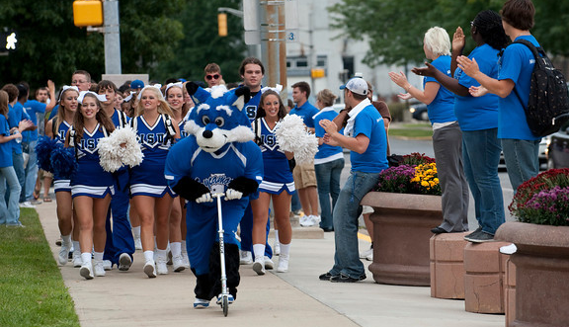
The Pathway to Success
Goal
One
Increase Enrollment
and Student Success
Increase the number of
students taking advantage of
the educational opportunities
at Indiana State University,
and assist all those attending to
realize their educational goals.

Slide 2
The Pathway to Success
Goal
One
Increase Enrollment and
Student Success
Goal Chairs: John Beacon, Jennifer Schriver, & Carmen Tillery
Audit Chair: Liz Brown

Slide 3
The Pathway to Success
Initiatives
Achieve greater impact on student success through the development of a first-year residential village.
Further develop cooperative programs with Ivy Tech to provide multiple points of entry to ISU.
Create a unified undergraduate student success program.
Create “Sycamore Express” one-stop centers.
Develop program for the parents and families of students.
Increase early outreach to students in region.
Enhance graduate education at ISU.
Enhance the gathering and use of information to advance ISU’s strategic priorities.
Create a comprehensive wellness program
Develop a comprehensive retention program for the African American Cultural Center to assist both students and parents.

Slide 4
The Pathway to Success
Benchmark Indicators:
 | Goal #1 | 2010 | 2014 | Long-Term
 | Headcount Enrollment | 11528 | 12000 | ???
 | 1st-Year Retention | 58% | 74% | ???
 | 4-year Graduation Rate | 22% | 26% | 30%
 | 6-year Graduation Rate | 42% | 46% | 55%
 | Total new Transfer Students | 540 | 870 | 21%*
 | New Transfers Students from Ivy Tech | 180 | 322 | 33%**
 | Transfer Student 6-year Graduation Rate | 57% | 60% | 55%
 | Transfer Student 1st-Year Retention | 69% | 74% | 80%
 | *% of new students who are transfer students **% of new transfer students from Ivy Tech

Slide 5
The Pathway to Success
ISU Broad Benchmarks
Student Success
Experiential Learning
Community Engagement
Revenue Generation
Faculty and Staff Success

Slide 6
The Pathway to Success
Experiential Learning
Participation in experiential learning has been promoted and increased thru opportunities in:
Themed housing
Learning communities
Graduate student research program
Comprehensive Wellness Program
African American Cultural Center
The tracking of participation in experiential learning has improved

Slide 7
The Pathway to Success
Community Engagement
Participation in community engagement has been promoted and increased thru opportunities in:
Comprehensive Wellness Program (e.g., Wellness Bash, Sober Ride)
MLK Day of Service
Family Day activities
Partnerships with Ivy Tech has resulted in outreach opportunities
The tracking of participation in community engagement activities has improved

Slide 8
The Pathway to Success
Revenue Generation
Tuition dollars have increased due to:
overall increased enrollment
increased number of transfer students thru partnerships with Ivy tech
increased retention of students living in campus housing
increased recruitment of international students
Alumni & donor engagement has increased thru efforts of African American Cultural Center
ISU’s success at securing grants and contracts may improve due to enrollment successes

Slide 9
The Pathway to Success
Faculty and Staff Success
Theme housing and opportunities for faculty involvement with students outside the classroom are often attractive options for faculty
Attracting more and better prepared students at both the undergraduate and graduate levels may help attract and retain faculty
Development of a Master Teacher Program will offer faculty opportunities for professional development and growth

Slide 10
The Pathway to Success
Audit Recommendations
Excellent progress has been made on these initiatives and they all have the potential to positively impact Goal 1
Several initiatives could be advanced further if faculty expertise and participation were included to a larger extent
Getting the word out to faculty, staff, parents, and families about some of these initiatives is important
Consistent assessment and evaluation are important

Slide 11
The Pathway to Success
Summary – Primary Contributions
Many initiatives promote participation in experiential learning and community engagement opportunities
Tracking of student engagement has improved and allows for analysis of predictors of student success
Increases in enrollment and retention directly impact tuition revenue in positive ways
Efforts to retain faculty and staff are positively influenced by several initiatives

Slide 12
The Pathway to Success
Discussion - Questions

