Slide 1
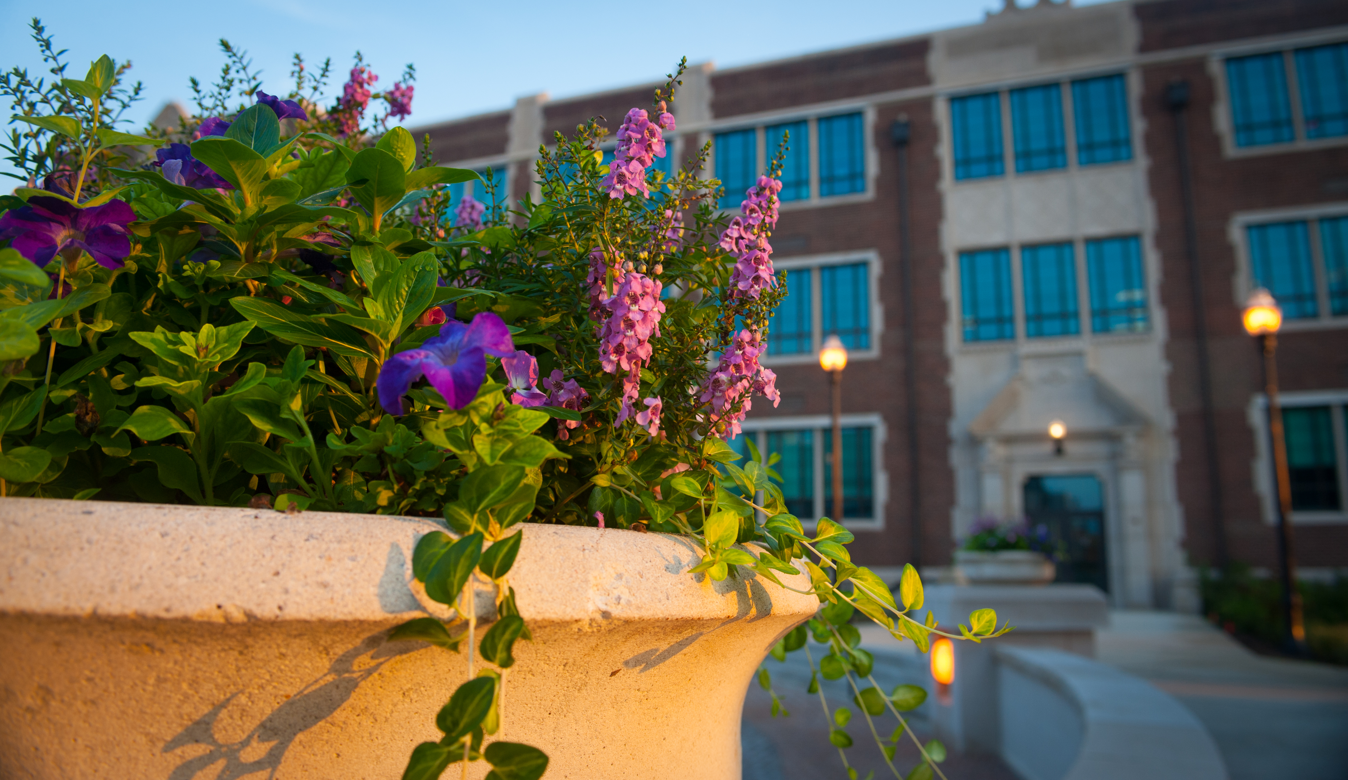
Preparing Leaders Who Transform Lives and Communities
Academic Success in the BCOE
May 15, 2015

Slide 2
Academic Success in the BCOE
Diversity, Inclusion, and Global Engagement: Creating an Environment of Inclusive Excellence in the Bayh College of Education
Elementary, Early, and Special Education Department Success Plan
Communication Disorders and Counseling, School, and Educational Psychology Department Success Plan

Slide 3
Diversity, Inclusion, and Global Engagement: Creating an Environment of Inclusive Excellence in the BCOE
Established Diversity, Inclusion, and Global Engagement (DIGE) Task Force with representation of faculty, staff, and students across departments, centers, and administrative units
Planned year-long calendar of events, training, and awareness activities

Slide 4
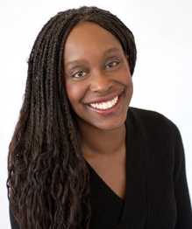
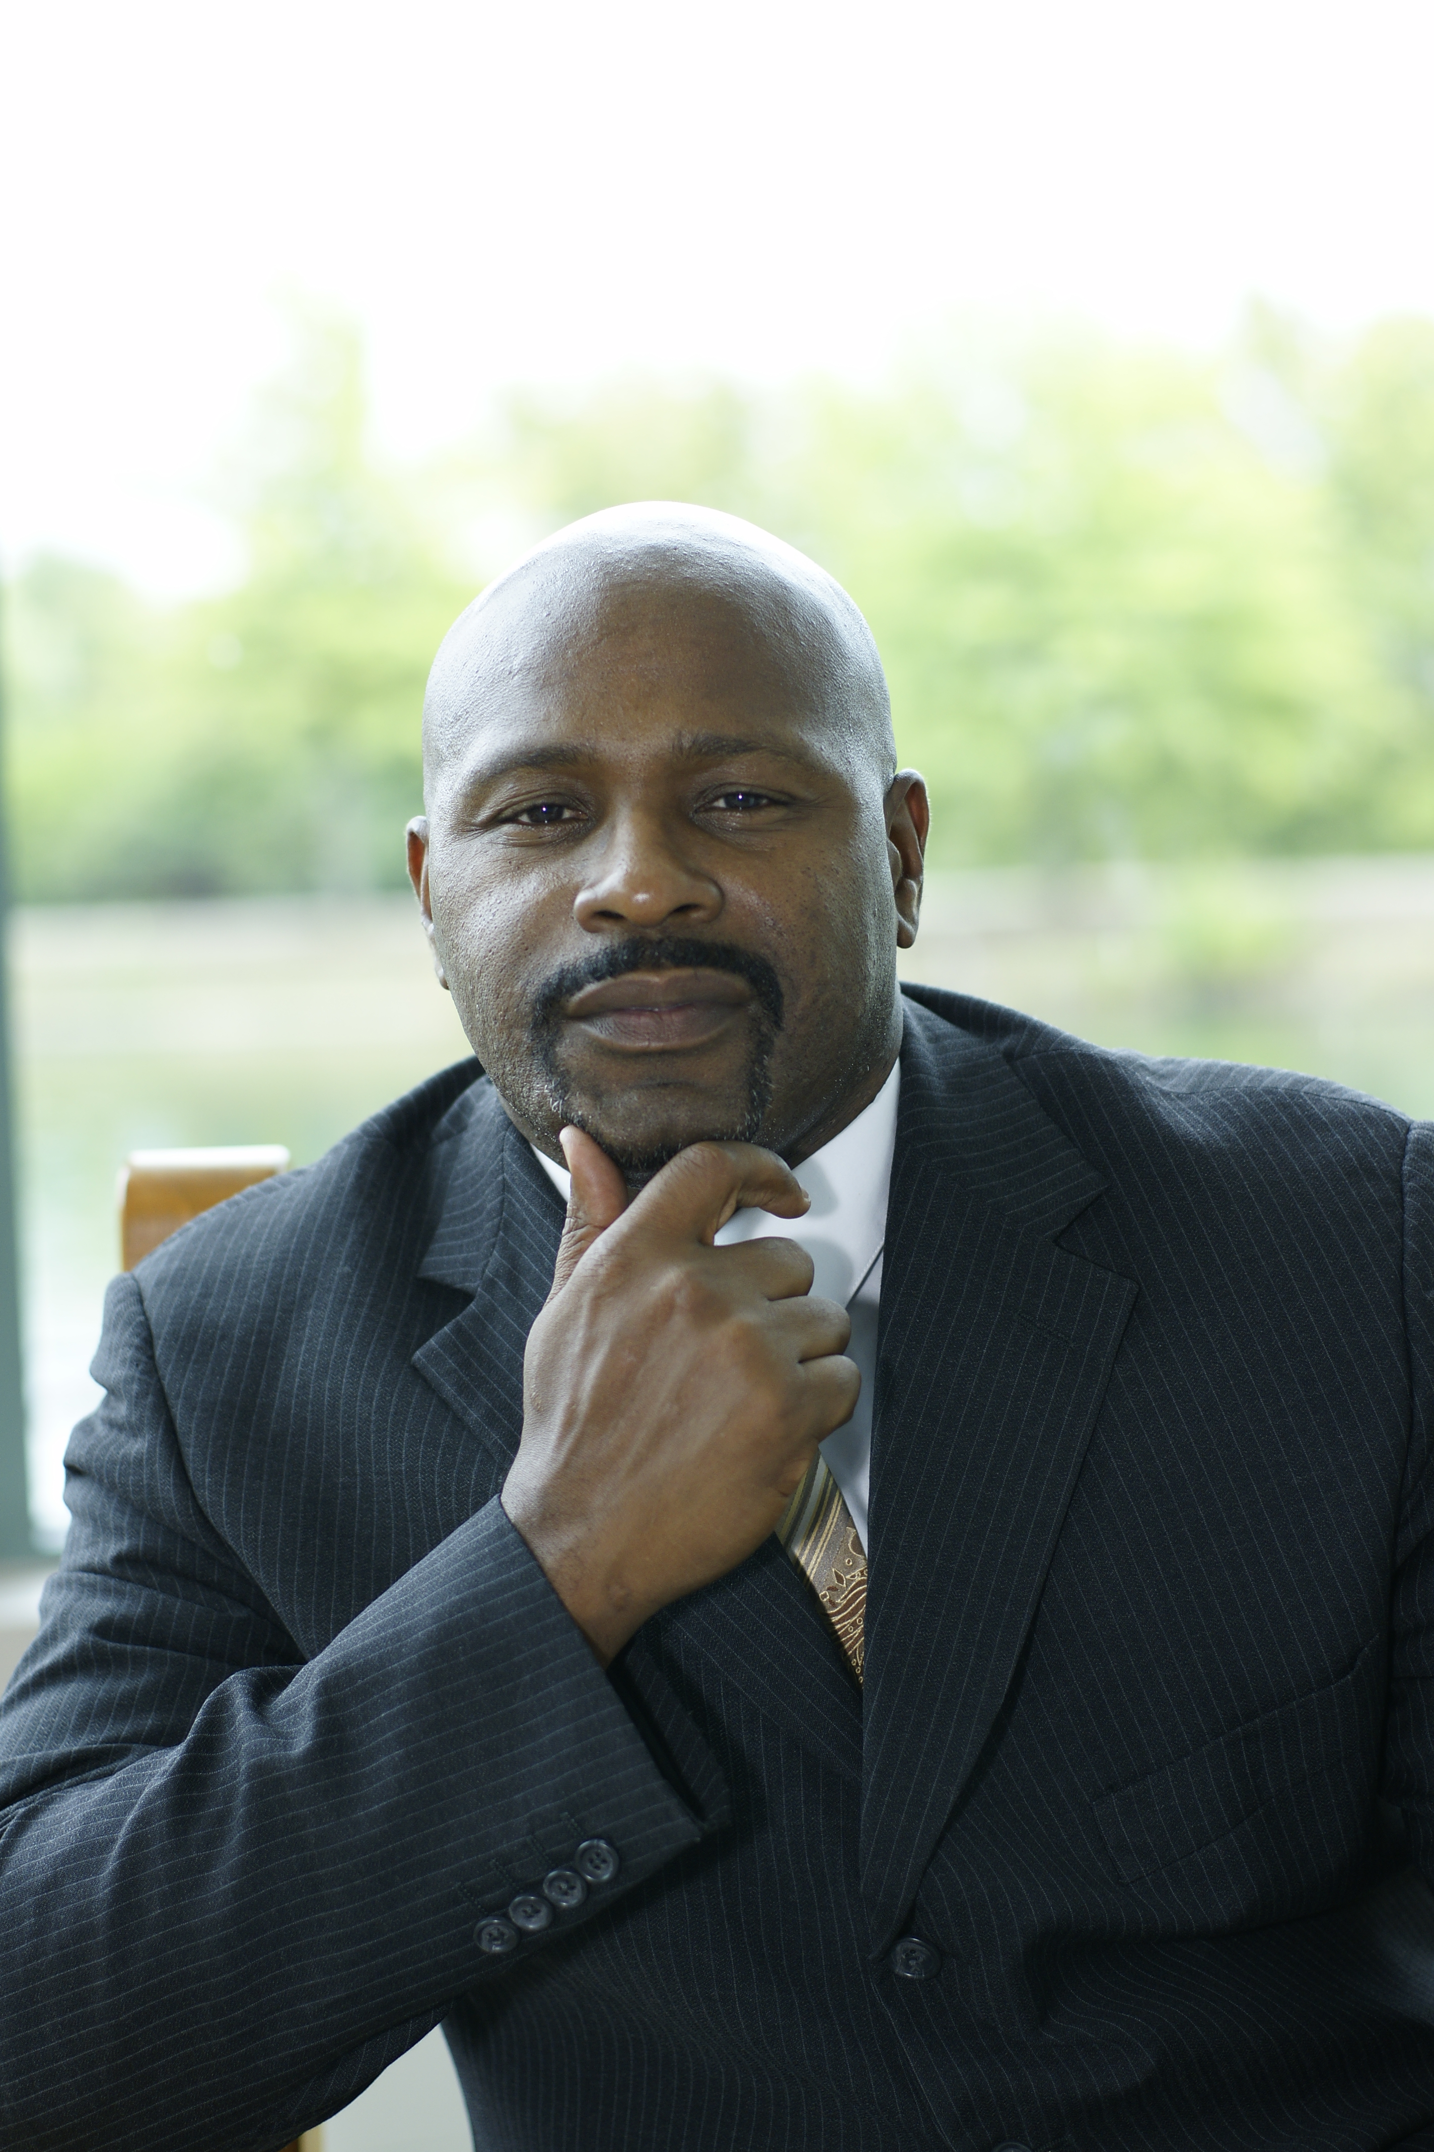
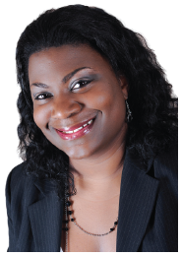
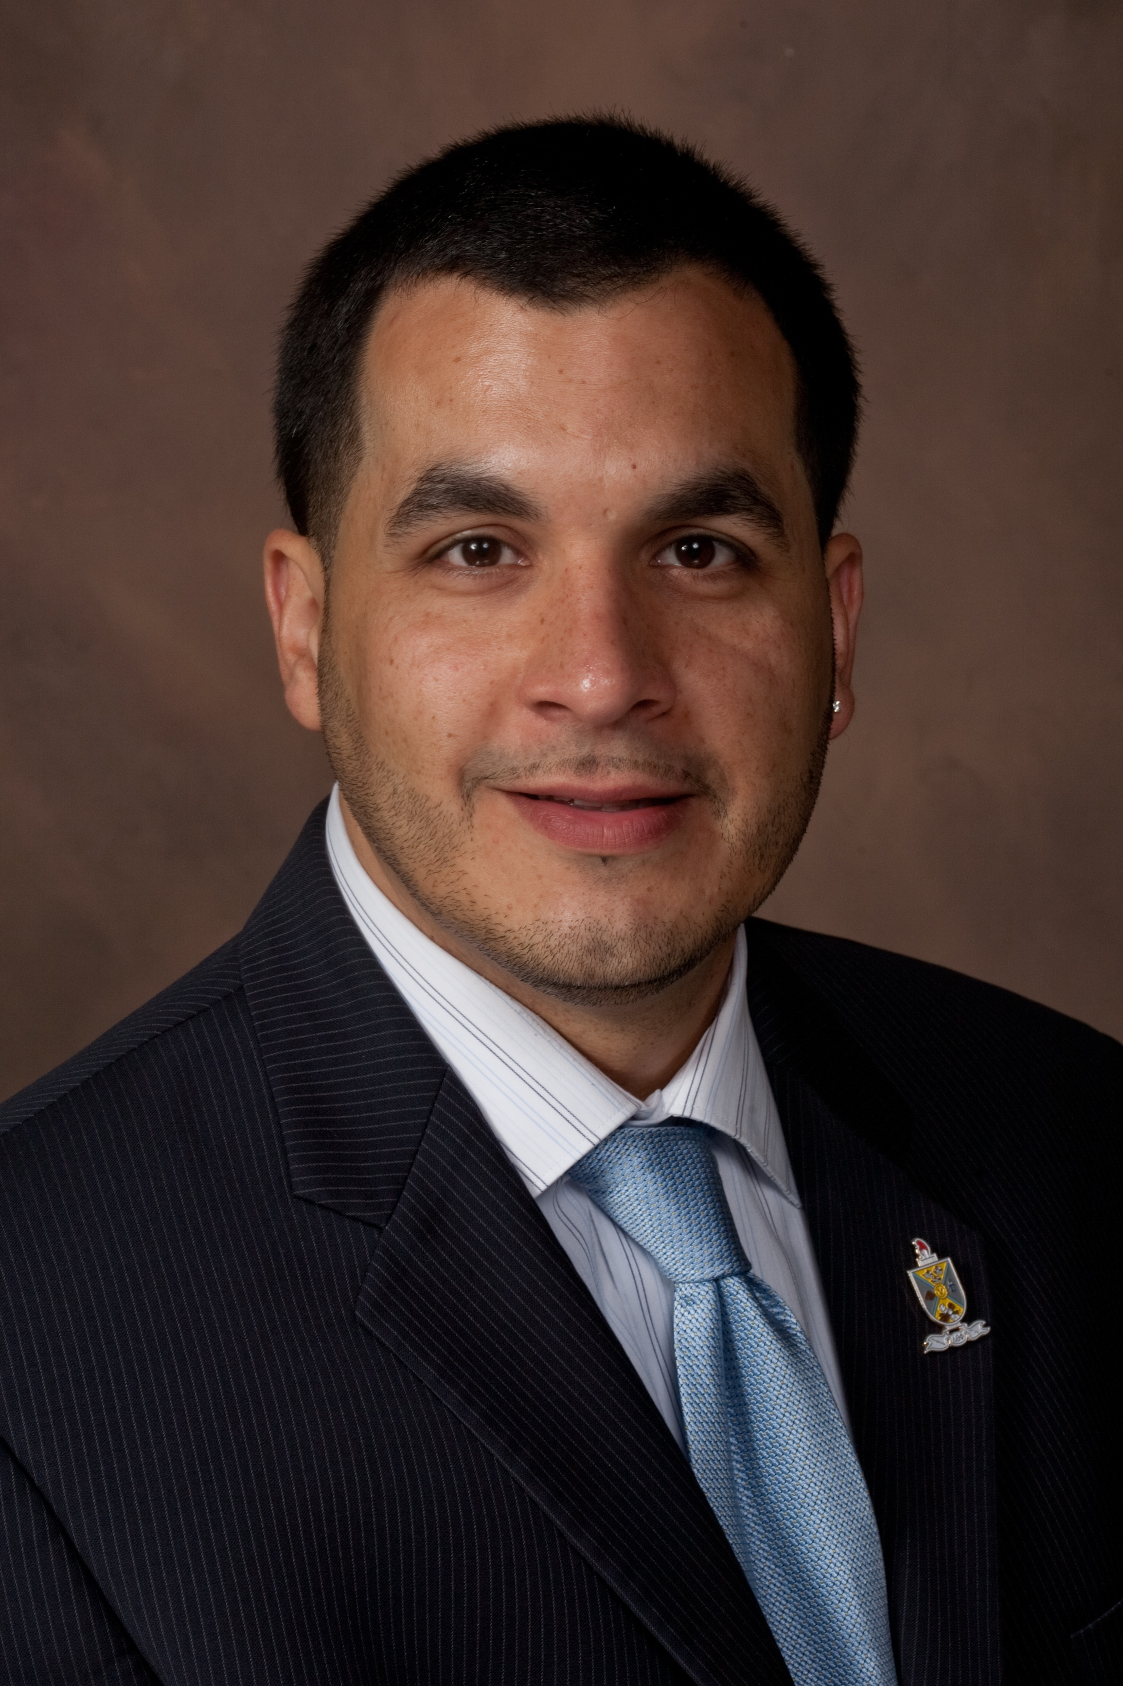
Creating an Environment of Inclusive Excellence in the Bayh College of Education
February 6, 2015
Hulman Memorial Student Union
Schedule
8:00 Continental Breakfast Gallery Lounge
8:30 Keynote Session Dede II
10:00 Concurrent Sessions 307, 321, 407
12:15 Lunch and Table Topics Dede III
1:00 Student Voices Dede III
1:45 Afternoon Workshop Dede III
3:15 Next Step Planning Dede III
Speakers
Dr. Lisa Gunderson
Equity Consultant, One Love Consulting; Clinical Psychologist
Dr. Roger Cleveland
Associate Professor and Director of the Center for Education Equity and Excellence, Eastern Kentucky University
Dr. Catherine Cushinberry
National Executive Director of Parents for Public Schools
Dr. David Pérez II
Assistant Professor, Miami University
Diversity
Inclusion
Global Engagement
Sponsored by the BCOE Diversity, Inclusion, and Global Engagement Task Force with support from the ISU Office of Student Success

Slide 5
Diversity, Inclusion, and Global Engagement: Creating an Environment of Inclusive Excellence in the BCOE
Used conference feedback to continue discussions of relevant topics:
Microaggressions
Inclusive curriculum
Global engagement and the inclusive workplace
Challenges for students from poverty and abuse
Comparing Chinese and American education systems
Social class

Slide 6
Diversity, Inclusion, and Global Engagement: Creating an Environment of Inclusive Excellence in the BCOE
Expanding the impact beyond the funded initiative:
Two faculty members attended AACU Diversity, Learning, and Student Success Conference, March 2015, San Diego
BCOE Support Staff Council has planned professional development day on the topic “Uniquely Gifted”
Cosponsored “Hoosier Successes in the Global Workplace Forum” with Indiana Department of Education and Center for Global Engagement, May 12, 2015

Slide 7
Diversity, Inclusion, and Global Engagement: Creating an Environment of Inclusive Excellence in the BCOE
Planning in place for continued activities:
Faculty learning community on inclusive curriculum
College-wide book read: Seedfolks by Paul Fleischman
On-campus address by the author
Collaboration with Office of Sustainability and community garden
Reading circle discussions
Theatrical presentation
Student advisory board and student DIGE training

Slide 8
Diversity, Inclusion, and Global Engagement: Creating an Environment of Inclusive Excellence in the BCOE
Challenges and Lessons:
Sustaining engagement in the midst of multiple demands for attention
Creating safe space for difficult and sensitive conversations
Ensuring all voices have the opportunity to be heard

Slide 9
Department of Teaching and Learning
Recruitment and Enrollment
33 student/parent visits to campus
47 students participated in math tutoring for assistance with CASA exam. To date, 12 students have passed with average of 4.5 tutoring sessions
Retention and Completion
8 students identified for remediation; all were successful

Slide 10
Department of Teaching and Learning
Post-Graduate Achievement
Collaboration with Career Center
Preparation for employment search
Participation in Education Career Fair
Development of Career-Ready Certificate for elementary and special education majors

Slide 11
CDCSEP Department
Recruitment and Enrollment
Established undergraduate minor in Counseling
Revised marketing materials
Worked with Admissions to arrange meetings with faculty for prospective students

Slide 12
CDCSEP Department
Retention and Completion
Developed faculty/student programming to socialize and support students
Produced Honor Roll for CD students; mailed to parents along with invitation to NSSLHA Banquet. All-time high attendance at banquet.
Offered COUN 135 in 8-week format and cohort format for students on probation

Slide 13
CDCSEP Department
Post-Graduate Achievement
Worked with Career Center to create Career Ready Certificate for speech-language pathology majors

Slide 14
Future Student Success Opportunities
BEST Program
10 high-achieving students received Sycamore Teacher Leader scholarships
Other students will benefit from leadership development and programming in the BEST Program
Ongoing collaboration with Career Center
Career Ready certificate implementation
First destination survey

