Slide 1
The Pathway to Success
Goal 6 – Initiative 2
Programs of Distinction

Slide 2
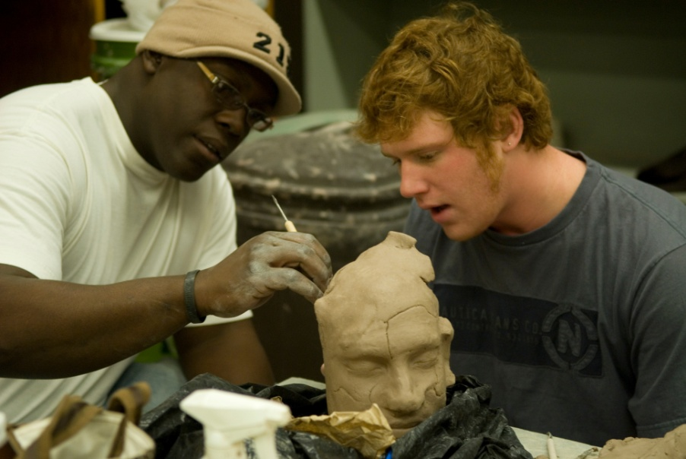
The Pathway to Success
Kelly Wilkinson, Chair
Introduction & Purpose
Faculty Development:
Plays a role in student retention
Plays a role in faculty retention
Requires thinking outside the box for innovative programs
Includes all faculty
Purpose: Develop a broader more comprehensive programs that address the needs for all faculty focusing on student success.

Slide 3
The Pathway to Success
Methods
--Evaluated Mission and Goals of CIRT
--Developed New Faculty Orientation
--Developing Faculty ePortfolios
--Investigating Online Course Evaluations
--Developing a "Veterans" Faculty Orientation (based on request from faculty)
--Developing training offered to each college delivered in each college
--Creating a robust faculty website that addresses the specific needs of all faculty.

Slide 4
The Pathway to Success
Benchmarks
Initiative Benchmarks | Fall 2010 | Fall 2011 | Fall 2012 | Fall 2013 | Fall 2014
New Faculty Orientation (participants) | 12 | 31 | 0 | 0 | 0
ePortfolios for Faculty (participants) | 0 | 0 | 50 | 400+ | 400+
Veteran's Faculty Orientation (participants) | 0 | 0 | 15 | 20 | 20+
Creation of Faculty Web Portal (measured in hits) | 0 | 0 | 100+ | 250+ | 500+
Increase sessions to coordinate with NFO | 2 | 0 | 5 | 10 | 10
Conference "Conversations on Teaching" (in spring 2012) | 0 | 0 | 30 | 50 | 100

Slide 5
The Pathway to Success
Discussion
Faculty development will:
Investigate and enhance the new faculty orientation model
Provide a vehicle to showcase and account for faculty productivity
Focus on the continue development of comprehensive et of support activities for both face to face and online faculty
Focus on the idea of anytime, anywhere learning to help fulfill faculty needs.

Slide 6
The Pathway to Success
Summary
Success begins with the new faculty orientation and will continue with a host of different opportunities that address the needs of ALL faculty. Continued assessment and the use of technology will be used to improve the programs that we have and to develop new programs that will focus on the improvement of teaching and research that will in turn impact student retention and success.

