Slide 1
The Pathway to Success
Goal 6 – Initiative 1
Enhance the Quality of Life of Staff and Faculty

Slide 2
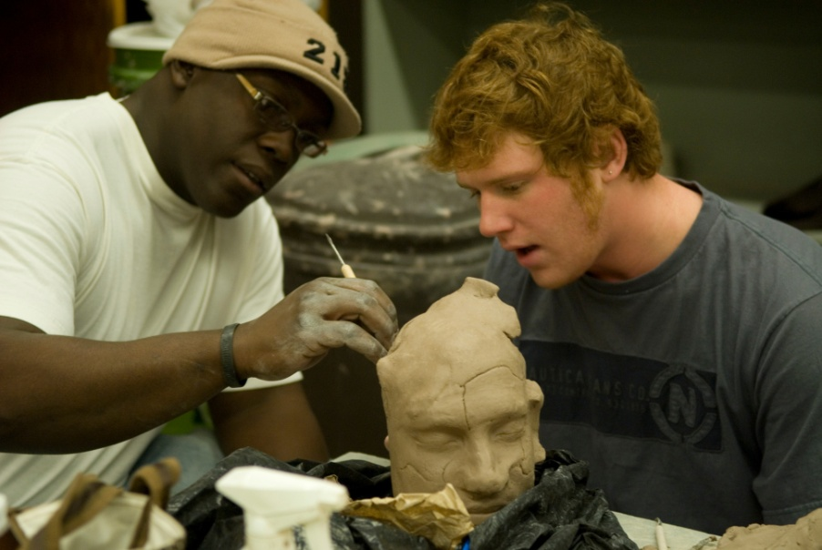
The Pathway to Success
Introduction
This multifaceted initiative focuses on creating a culture that attracts and retains high quality faculty and staff.
The specific purposes of the initiative are to:
a) Increase retention of faculty and staff from year one to year two
b) Develop high quality programming related to work life integration and professional development
c) Demonstrate measurable improvement on key "Great Place to Work for" indicators
d) Through the retention of high quality staff and faculty increase student retention

Slide 3
The Pathway to Success
Methods
a) Programming for new employees
b) High quality child care
c) Improved relocation assistance
d) Quality of life initiatives
e) NSF ADVANCE grant
f) Work-Life integration
g) Great Places to Work For survey

Slide 4
The Pathway to Success
Benchmarks
Attendance at new employee reception and tailgating
Childcare Center Task Force/Needs Assessment/
Child Care Center Renovation
NS Advance Grant/Formation of the Advance Grant Core/
Writing of Grant/Submission of Grant November 7, 2011
Work Life Integration Conference attendance
First Year Faculty not retained from year one until year two
Relocation Assistance, audit, feedback, proposal for outside contract

Slide 5
The Pathway to Success
Discussion
This initiative also is critical to the recruitment of prospective students and the retention and success of our currently enrolled students. High quality, successful faculty and staff, from diverse backgrounds attract and ensure the success of students from diverse backgrounds-- including, but not limited to first generation, under represented minorities, or academically at risk students.

Slide 6
The Pathway to Success
Summary: Accomplishments 2010-2011
1) Increase in the number of new employees participating in programming (reception, tailgating)
2) Increased support for new employees (more contacts via e-mail and in person, sycamore social mentors, parenting network)
3) Five point increase in faculty's satisfaction with teaching and institutional pride (Great Places to Work for Survey 2009, 2011)
5) Completion of child care center needs assessment and commitment to remodel the existing child care center
6) Submission of an NSF ADVANCE grant to increase to the number of women and underrepresented minorities in the STEM disciplines
7) Foundational Studies Certificate Program to assist new adjuncts, instructors, and tenure track faculty teaching foundational studies courses.

