Slide 1
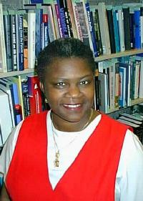
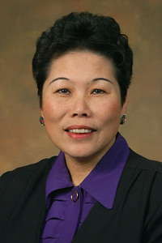
The Pathway to Success
Goal
Six
Recruit and Retain Great Faculty
and Staff
Take measures to enhance the University’s ability to recruit and retain great faculty and staff in order to realize its goals and fulfill its mission.

Slide 2
The Pathway to Success
Goal
Six
Recruit and Retain Great Faculty and Staff
Goal Chair: Dan Bradley, Diann McKee
Audit Chair: Dorothy Carole Yaw
Initiatives
Enhance the quality of life for faculty and staff.
Enhance the development of faculty.
Enhance the development of staff.
Expand the diversity found in the composition of the faculty and staff at Indiana State University.

Slide 3
The Pathway to Success
 | Goal #6 Benchmarks | 2008 | 2010 | 2014 Target | Long-Term Target
 | Six year retention rate for staff. | 35% | 37% | 60% | TBD
 | New faculty hires retained – six years. | 43% | 50% | 70% | TBD
 | Diversity – African American faculty. | 10 | 9 | 31 | TBD
 | Diversity – Hispanic faculty. | 11 | 14 | 27 | TBD
 | Diversity – Women faculty. | 207 | 205 | 260 | TBD
 | Faculty salaries as % of peers. |  | 101.95% | 100% | 100%

Slide 4
The Pathway to Success
ISU Broad Benchmarks
Student Success
Experiential Learning
Community Engagement
Revenue Generation
Faculty and Staff Success

Slide 5
The Pathway to Success
Student Success
Recruitment and retention of great faculty and staff has a direct impact on student enrollment and retention.
Faculty development supports teaching and scholarship that enhances student learning and academic success.
Diversity of faculty and staff contributes to creating a welcoming and rich environment for students and encourages openness and critical thinking.

Slide 6
The Pathway to Success
Experiential Learning
Faculty development activities that support faculty in utilizing experiential learning and community engagement in their courses.
CIRT sponsored workshops for faculty that include strategies appropriate to the content areas involving experiential learning.

Slide 7
The Pathway to Success
Community Engagement
Staff training and development initiatives create a more engaged employee thereby increased employee interest in community engagement.
Implementation of a community service leave policy allows employees the ability to take a more active role in community volunteerism.

Slide 8
The Pathway to Success
Revenue Generation
Recruitment and retention of great faculty increases student satisfaction and success thereby increasing enrollment and retention resulting in increased tuition revenue.
Potential grant and contracts:
Submitted NSF Advance grant to increase the number of women and underrepresented minorities in STEM disciplines.

Slide 9
The Pathway to Success
Audit Recommendations
Audit of Goal 6 validated the goal and initiative efforts. Progress has been made for each of the initiatives during Year 3 with a large volume of work completed.
No specific recommendations noted.

Slide 10
The Pathway to Success
Summary – Primary Contributions
Faculty Development
Expanded CIRT Workshops
Extended New Faculty Orientation
Staff Development
Expanded Staff Training
New Employee Orientation
Sycamore Service Customer Training
Diversifying Faculty through Opportunity Hires
Addressing work/life balance issues for faculty and staff.

Slide 11
The Pathway to Success
Discussion - Questions

