Slide 1
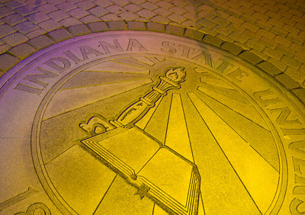
The Pathway to Success
Goal 5 – Initiative 1
Enhance Contract and Grant Activity

Slide 2
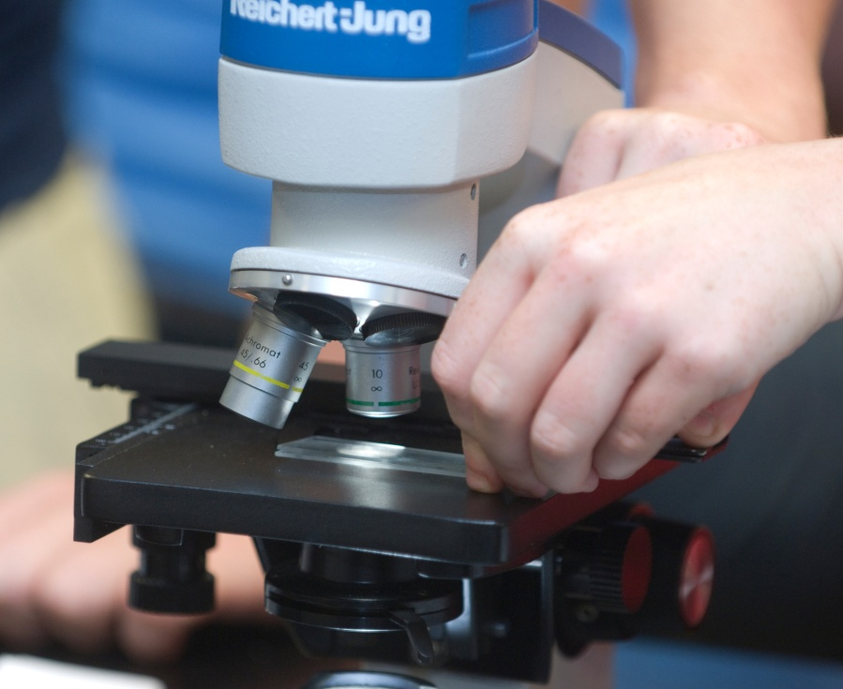
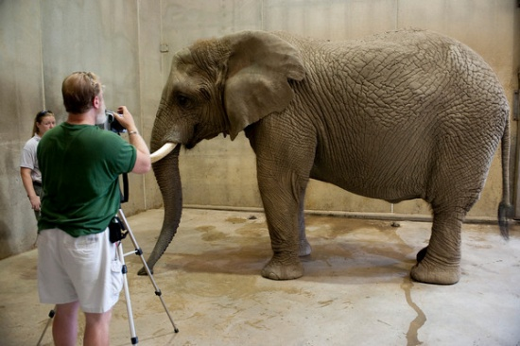
The Pathway to Success
Introduction & Purpose
Grants hold the potential to positively affect everything we do at ISU.
Notes:
Grant and contract revenues hold the potential to positively affect everything we do at ISU. I would like to give you a few examples to prove this point. Consider Dr. Eric Glendening’s $1.5 million award from the National Science Foundation which provided funds to renovate 7 science laboratories. This single grant award will improve the lab experiences for thousands of ISU students. Consider Dr. Kurt Fowler’s generous support from Arts Illiana for the 44th Contemporary Music Festival. Think about the health education and promotion programming of the West Central Indiana Area Health Education Center, headed by Louise Anderson, and funded through Indiana University and the state of Indiana. This center provides professional development and health career promotion to hundreds of people in the Wabash Valley. Dr. Affan Badar’s $460K grant from NSF will provide scholarships to 54 students in Computer and Mechanical Engineering Technology. In the Bayh College of Education, Dr. Lisa Cutter heads up a team who, with grant support from the Indiana Commission for Higher Education, provide professional development for teachers in the areas of literacy and reading. These are only a few examples of the 114 awards made to Indiana State this past year. External funding makes a difference.

Slide 3
The Pathway to Success
2011 Awards by Activity Type:
43% Public Service
32% Research,
13% Academic Support
8% instruction
4% institutional support
65% included Community Engagement activities
67% included Experiential Learning

Slide 4
The Pathway to Success
Benchmarks
Goal #5, Initiative 1 | 2008 | 2011 | 2012 | 2013 | 2014
Grants and Contracts Awards – Per OSP | $9,868,158 | $10,248,265 | $12,297,918 | $14,757,502 | $17,709,002
Indirect Costs Received – Per OSP | $541,561 | $651,207 | $700,000 | $800,000 | $900,000
Number of Proposals Submitted | 175 | 172 | 200 | 220 | 245
Number of awards | 135 | 114 | 130 | 150 | 160
Grant /Compliance Workshops (# of ISU attendees) | 390 | 369 | 400 | 425 | 450
Notes:
Despite these efforts, progress toward the overarching goal of increasing grant revenues by 50% has been slow. Funding in 2011 totaled $10.2 million, down from $13.7 million in 2010. This is due to several factors including increased teaching loads due to record enrollments, anticipated and real reductions in federal grant appropriations, and reduced funding from foundation sources due to the economic slowdown. Fiscal year 2011 also saw the end of grants from the American Recovery and Reinvestment Act (ARRA), commonly known as the stimulus bill. It should be noted that indirect cost recovery was up slightly over the previous year.

Slide 5
The Pathway to Success
Methods
Funding for grant meetings/workshops
Support for external reviewers (grants > $100K)
Stipend of $500/yr for grants > $25K
Resources for colleges grant planning
Develop culture – visibility, awareness, increased support
Notes:
Intentions with this initiative:
Reward major grant recipients
• Support departmental and college-level grant efforts
• Develop new collaborations and models to address societal needs
• Increase the competitiveness of ISU grant proposals
• Increase grants and contracts awarded to ISU

Slide 6
The Pathway to Success
Discussion
Faculty contact with program officers
Explore new approaches to encouraging grant writing
New metrics- increasing # of proposals submitted and # of faculty involved, tracking OSP activities
Notes:
Increased teaching loads, anticipated and real reductions in federal grant appropriations, and reduced foundation funding due to the faltering economy will make growing grants difficult in the short-term future. However, investing in faculty and student scholarship is a crucial part of ISU’s growth. The Office of Sponsored Programs is committed to working with faculty as well as department and college leaders to make ISU grant seekers competitive and successful.

