Slide 1
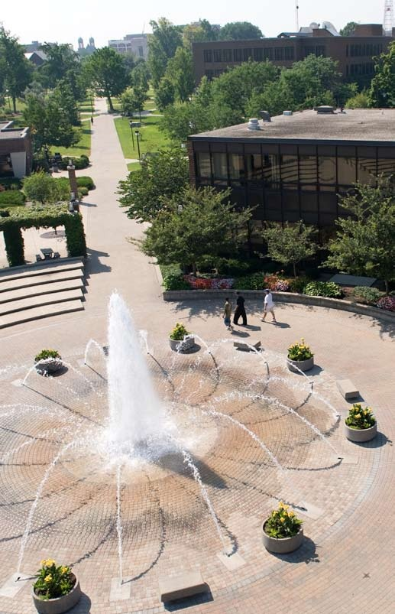
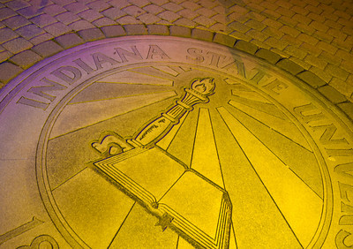
The Pathway to Success
Goal 2 – Initiative 2
Applying the Science of Learning to the Learning of Science (SENCER)

Slide 2
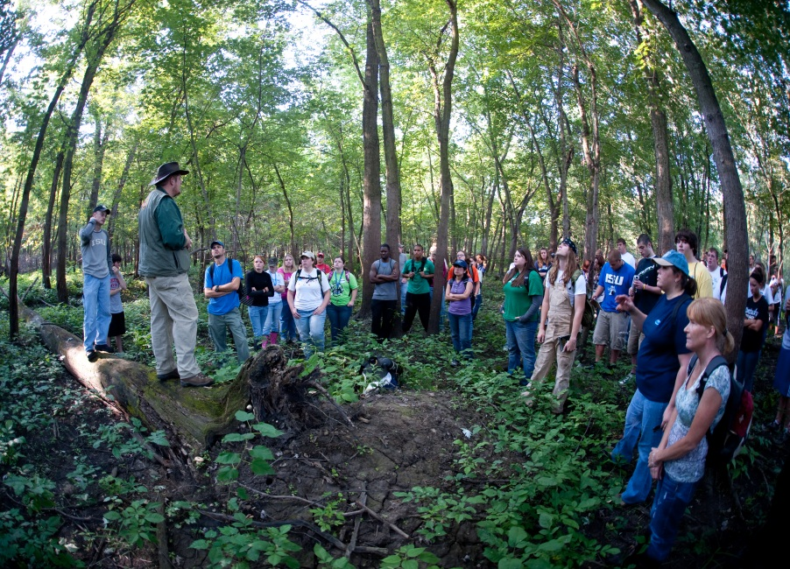
The Pathway to Success
Introduction & Purpose
Science Education for New Civic Engagements and Responsibilities (SENCER)
Applying the Science of Learning to the Learning of Science
Purpose: To engage more students in STEM education and practice 21st Century Skills

Slide 3
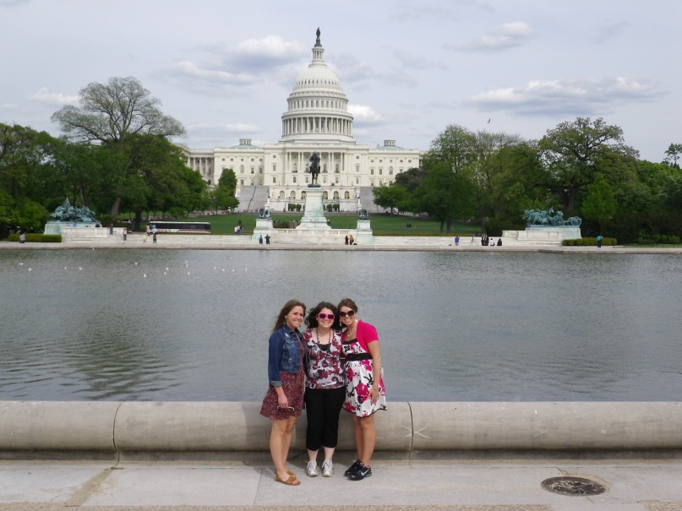
The Pathway to Success
Methods
Professional Development Workshops
Course Development Funds
SIR and SALG Assessment of Courses
Rubric 2.0 Assessment of Courses
Experiential Learning and Community Engagement in Classes
Student Presentation at National Conferences

Slide 4
The Pathway to Success

Slide 5
The Pathway to Success
Discussion
Retention up 6.6% in the first year and 7.7% in the second year for students taking SENCERized ENVI 110.
Provided 700 field experiences each year in ENVI 110
Presented 8 talks on SENCER at national venues in the last 2 years
Presented 10 poster presentations on SENCER at national venues in the past 2 years
Hosted a regional SENCER conference at ISU
Submitted two papers for publication assessing our SENCER program
Sent 22 students to national conferences through SENCER
50 Faculty participated in workshops
30 SENCER-like classes at ISU
Received the national William E. Bennett Award for Extraordinary Contributions to Citizen Science.

Slide 6
The Pathway to Success
Summary
SENCER Teaching Model at ISU for two years
National Recognition for the SENCER Student Leadership Team
Many faculty incorporating these concepts in classes
Working to involve more Foundational Studies classes
Expanding into Department of Applied Health Sciences (Dr. Kruger) and Sport Management (Dr. Strigas) through interested faculty

