Slide 1
The Pathway to Success
Goal 2 – Initiative 1.B
Center for Student Research & Creativity

Slide 2
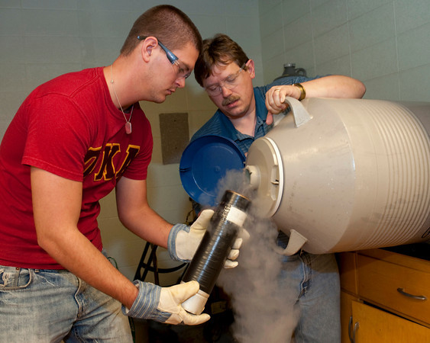
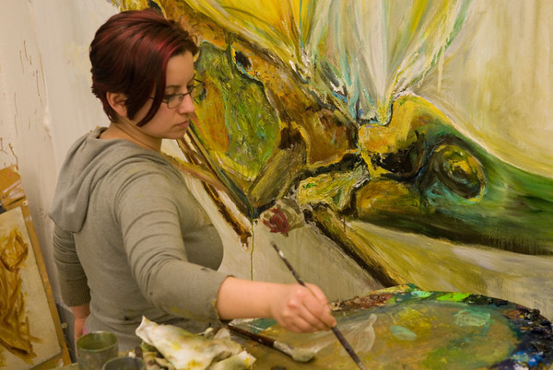
The Pathway to Success
Introduction & Purpose
Research and creativity are widely recognized as a key component of experiential learning. The mission of Indiana State University's Center for Student Research and Creativity is to institutionalize student research and creativity, focusing primarily on the undergraduate experience. The Center will serve as a clearinghouse for information, support, coordination, and communication for all student research and creative activities.
ISU’s incubator for student research and creativity at ISU

Slide 3
The Pathway to Success
Methods
Mini-grants to students for research/creative projects; travel
Student wage dollars for faculty to hire students to work on research/creative projects
Summer stipends to pursue independent research/creative projects
Support for faculty to travel with students to conference presentations and performances
Faculty development
Support faculty research coordinators
Celebrating student research and creative accomplishments

Slide 4
The Pathway to Success
Benchmarks
F11 F12 F13 F14
Hard # of Seniors that have had an Experiential
Learning Component (undergraduate research) 23 50 100 200
% of degree programs with a required significant
experiential learning component (research) 10 12 25 50
Hard # of Programs with an Experiential Learning
Component (research.) 25 40 55 70
% of Graduates who participate in research within
their major 10 20 30 40
Hard # of students participating in research
"showcases"/professional presentations 51 100 150 250
Hard # of students participating in research at lower
division level 100 500 1000 2000
Hard # of creative projects 2 4 8 16

Slide 5
The Pathway to Success
Discussion
Director appointed, August 2011
Office space identified, 721/723 SCOB
Admin Asst hired
Website online
Poster on Thailand project presented at CUR conference, October 2011
Support for research/travel announced November 2011
Research/Creative Project Showcase with invited guests and friends of ISU (partnered with Foundation) Nov 30, 2011.

Slide 6
The Pathway to Success
Summary
On Aug 1, 2011 there was no CSRC. Today the CSRC has a growing presence on the campus, it is supporting undergraduate research and creative projects, it is celebrating these activities, it is beginning to tell the story of undergraduate research and creativity at ISU

