Slide 1
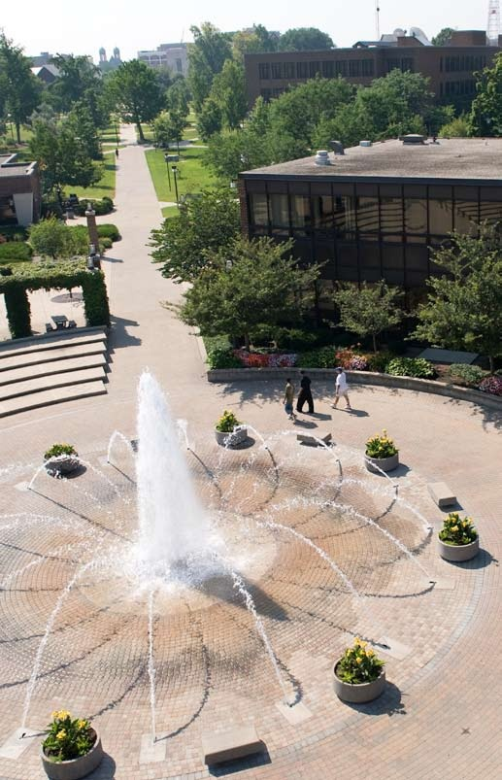
The Pathway to Success
Goal 2 – Initiative 1
Student Travel Study

Slide 2
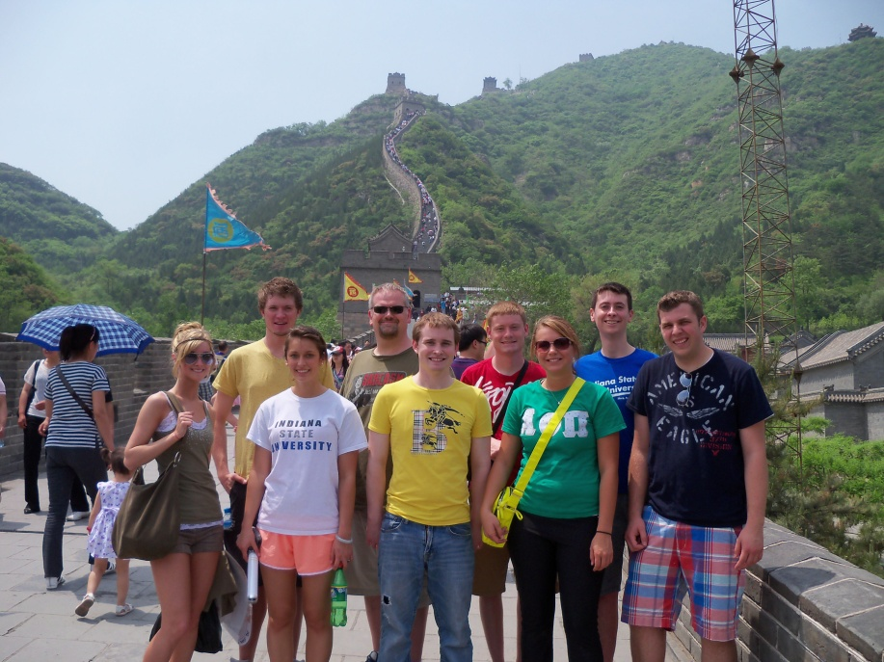
The Pathway to Success
Introduction & Purpose
Domestic and international travel study allows students to visit sites and attend events that enhance their learning beyond the classroom.
Travel to conferences and meetings supports students’ professional development and broadens their horizons
attend a conference or professional meeting
attend a creative performance or view an exhibit or demonstration
gain direct access to information or professional development experience that they would otherwise only encounter second-hand

Slide 3
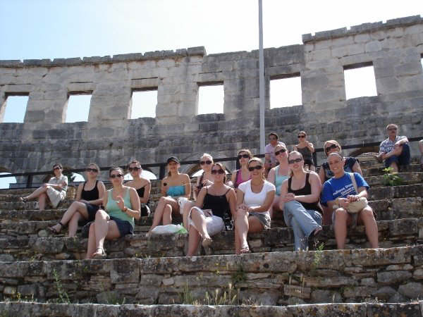
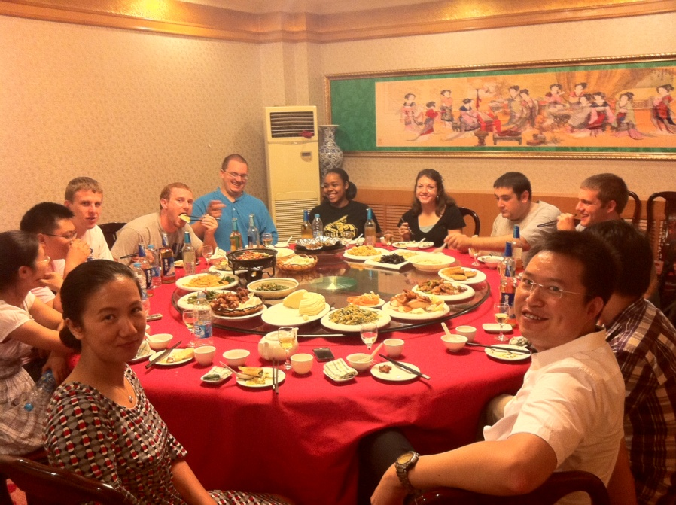
The Pathway to Success
Traditional Semester or Summer Study Abroad Experiences
2009-2010 53 students
2010-2011 69 students
Includes students from all Colleges studying in 18 different countries.
Liaoning University Exchange Program
8 ISU Students - fall 2011 at LNU
Includes students with 6 different majors in 3 different Colleges.
5 LNU Students - AY 2011-12 at ISU

Slide 4
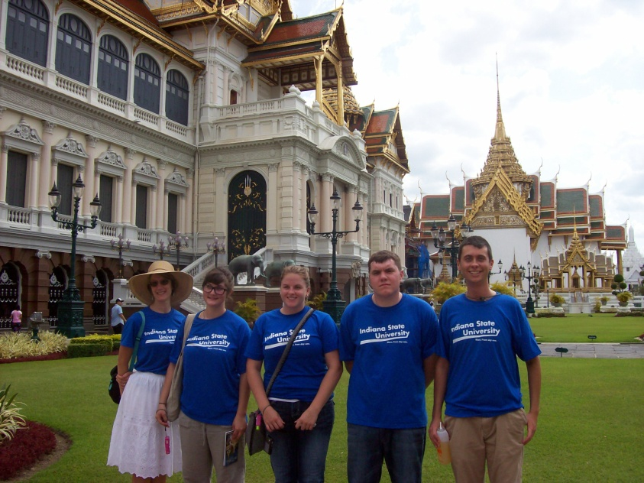
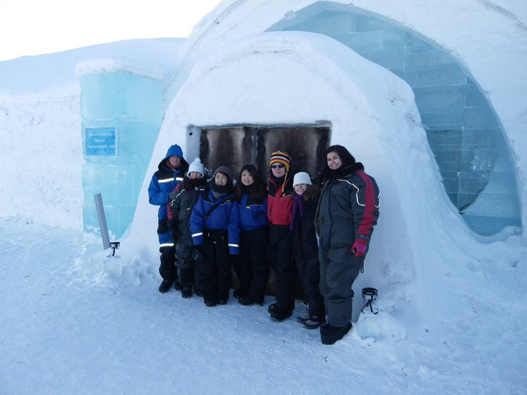
The Pathway to Success
Course based, short term, faculty led international study
Total Faculty Led International Study Experiences:
2009-2010 15 students
2010-2011 92 students (12 courses)

Slide 5
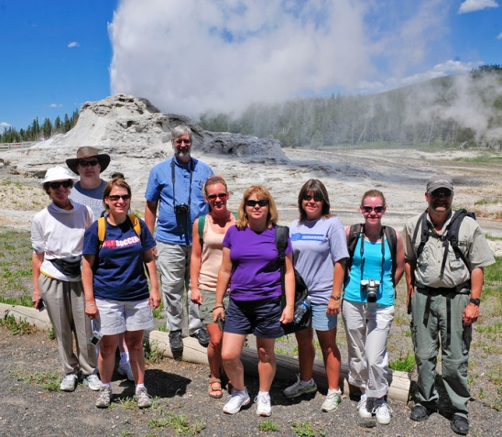
The Pathway to Success
Course based, short term, faculty led domestic travel study
2010-2011 269 students
2011 (Fall only) 400+ students
Trips funded for courses from all colleges, locations include:
Indianapolis; Chicago; North Carolina; New York City; Bloomington; Kansas City; the Rocky Mountains; St. Louis; New Orleans; Lansing, Michigan; and Tampa, Florida

Slide 6
The Pathway to Success
To quote President Bradley from a recent issue of ISU Magazine, “Studying abroad is a great form of experiential learning … . As part of our strategic goal to advance experiential learning, the university plans to double the percentage of students who participate in international experiences by 2014.”
By helping to make international and domestic travel more affordable, and by providing shorter, faculty led course-related experiences that are more appealing to students unaccustomed to travel, we have significantly increased the number of students traveling to study in the United States and abroad.

