Slide 1
The Pathway to Success
Goal
Two
Advance Experiential Learning
Advance experiential learning to ensure all ISU students complete a significant experiential learning requirement within their major.

Slide 2
The Pathway to Success
Goal
Two
Advance Experiential Learning
Goal Chairs: Carmen Tillery, Nancy Rogers
Audit Chair: Yasenka Peterson
Audit Team: Kim Bodey, Lindsey Eberman

Slide 3
The Pathway to Success
 | Goal #2 Benchmarks | 2008 | 2010 | 2011 | 2014 Target
 | Total international student experiences | 64 | 68 | 161 | 270
 | Degree programs with a required significant experiential learning component. | 52% | 52% | 68% | 100%
 | New graduates’ participation in experiential learning within their major. | 75% | 76% | 77% | 100%
 | Students who participate in international (non-credit and for-credit) experience. |  | 1.8%ª | 1.4% | 25%

Slide 4
The Pathway to Success
Initiatives
Infuse experiential learning as a core component in all academic programs.
Apply the science of learning to the learning of science.
Develop a climate action plan.
Coordinate and elevate leadership studies.
Enhance legacy programs and create icon services and programs that reflect the changing needs and interests of today’s students.
Enhance the co-curricular experience and value of participation.
Student Government Association

Slide 5
The Pathway to Success
ISU Broad Goals
Student Success
Experiential Learning
Community Engagement
Revenue Generation
Faculty and Staff Success

Slide 6
The Pathway to Success
Student Success
Legacy & Icon Programs - Nearly every study has shown that students engaged in positive experiences in campus life are retained all the way through to graduation at a higher level than are their peers. In fact, they often have higher GPA. Increasing the size of existing programs and matching the interests of our students is the purpose of this initiative.
Tandem Race
Rec Fest
DeStress Fest

Slide 7
The Pathway to Success
Student Success
Enhance the Co-Curricular Experience – Another way to promote student engagement and to increase retention is to reward students for their engagement and document their experiences.

Slide 8
The Pathway to Success
Student Success
SENCER Courses – Preliminary data indicates learning is improved in SENCER courses.
The Sustainability Institute
Earth Day
Spring Week

Slide 9
The Pathway to Success
Student Success
The SGA Initiative - combats feelings of loneliness and isolation by creating numerous experiences for student involvement.
Blue Fridays
Theme Nights – Blue Crew

Slide 10
The Pathway to Success
Experiential Learning
Legacy & Icon Programs - The newly created Cycling Council, tandem and trike races.
The SGA Initiative
Provided over 150 grants to student organizations. Student Leaders will gain experience by running programs throughout the year.
Emerging Leaders Program – First Year Students.

Slide 11
The Pathway to Success
Experiential Learning
Study Abroad – The international Study Program is providing increased opportunities for students to choose from a variety of formats of study abroad experiences.
Research Opportunities – The Center for Student Research and Creativity is supporting a variety of opportunities, such as undergraduate art majors participating in field experiences this summer in Terre Haute.

Slide 12
The Pathway to Success
Community Engagement
The Institute for Community Sustainability is contributing to an improved physical environment in the Wabash Valley.
Students, faculty, and staff have participated in clean-up efforts and conducted environmental research in the Wabashiki Fish and Wildlife area.
Students, faculty, and staff have participated in the removal of invasive plant species at Dobbs Park.

Slide 13
The Pathway to Success
Community Engagement
Enhance the Co-Curricular Experience – The next state of projects for the initiative includes a comprehensive tracking and reporting system for student involvement on and off campus. We will be able to connect with community organizations easier by receiving and recording their information online.

Slide 14
The Pathway to Success
Community Engagement
The SGA Initiative - Developed a statewide association, the Indiana Coalition of Student Leaders.
InShape - Partner with the ISU Wellness Initiative and the Governor’s InShape Indiana Program.

Slide 15
The Pathway to Success
Audit Recommendations
Significant progress in assessment and measurement
More effectively measuring outcomes
95% response rate on Community Engagement Inventory
66% of students were exposed to community engagement
Over 1.4 million hours of engagement in 2010-2011
Almost 29% of UG sections resulted in referred publication

Slide 16
The Pathway to Success
Center for Community Engagement
Center for Undergraduate Research and Creativity
Dissemination of SENCER research
National recognition
Climate Action Plan
Cost Savings and Carbon Footprint
Student Government Association
Improving student organization presence

Slide 17
The Pathway to Success
Redefine success to incorporate student participation, satisfaction, and relationship of programming to graduation/retention
Study Abroad
Involvement of more faculty and programs in SENCER
Successful search for Director of Leadership Consortium
Co-Curricular Record Implementation

Slide 18
The Pathway to Success
Summary
Significant progress has been made toward incorporating experiential learning into every academic program.
Data collection has improved – but cooperation is still needed.
Many initiative activities have been institutionalized.
Leadership Consortium needs to be revisited.

Slide 19
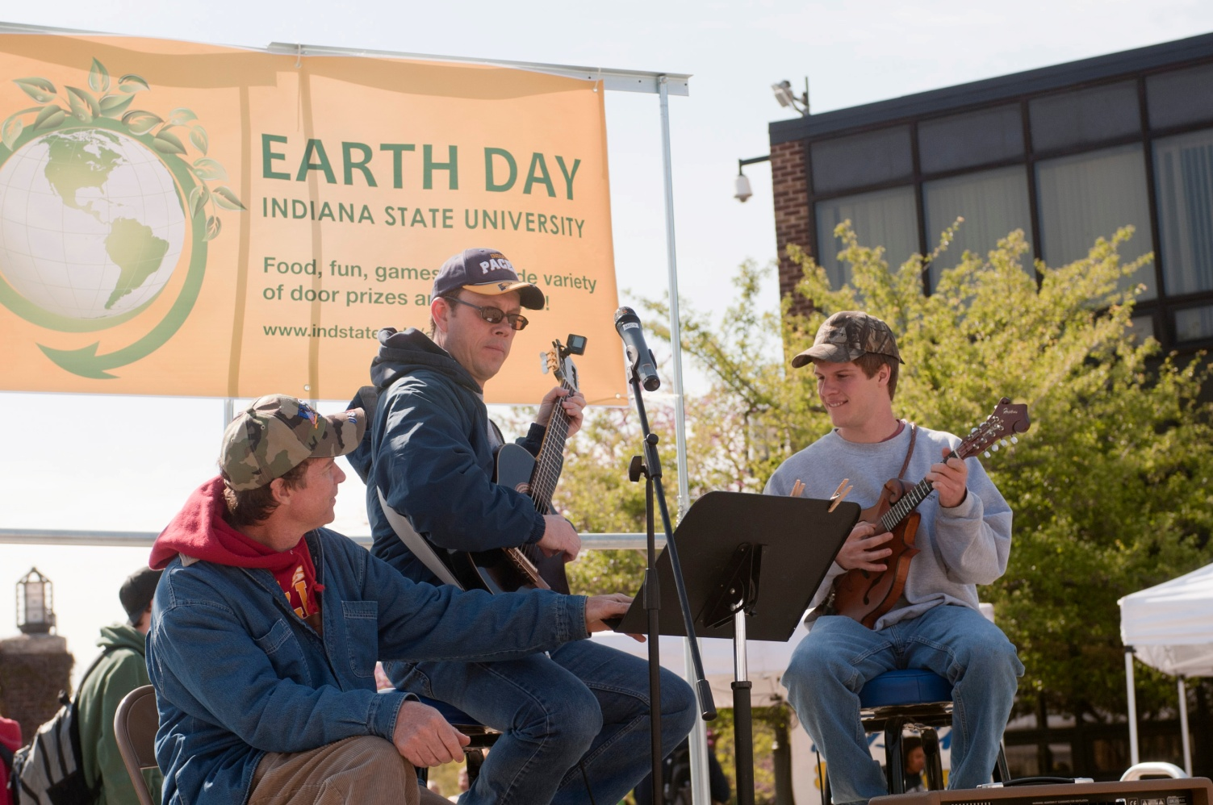
The Pathway to Success
Discussion - Questions

