Slide 1
The Pathway to Success
2011 Stakeholders Conference
March 31, 2011

Slide 2
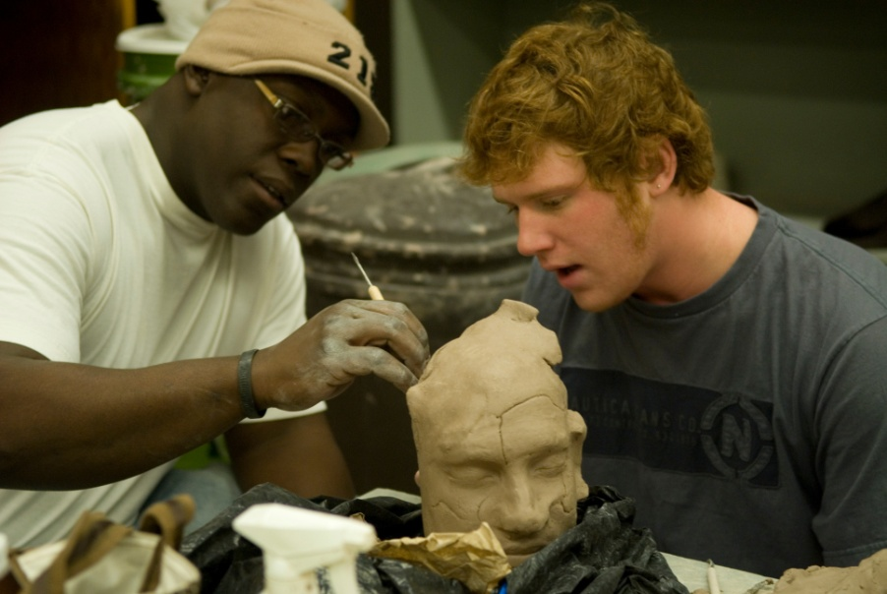
The Pathway to Success
Goal
Two
Advance Experiential Learning
Advance experiential learning to ensure all ISU students complete a significant experiential learning requirement within their major.

Slide 3
The Pathway to Success
 | Goal #2 Benchmarks | 2008 | 2010 | 2014 Target | Long-Term Target
 | Students who participate in an internship, practicum or field experience before graduation | 82%ª | - | 100% | 100%
 | Degree programs with a required significant experiential learning component. | 52% | 52% | 100% | 100%
 | New graduates’ participation in experiential learning within their major. | 75% | 76% | 100% | 100%
 | Students who participate in international (non-credit and for-credit) experience. | 7%ª | 10% | 25% | 60%
 | ªNational Survey of Student Engagement (NSSE) Spring 2007 report

Slide 4
The Pathway to Success
Goal
Two
Advance Experiential Learning
Goal Chairs: Nancy Brattain Rogers, Carmen Tillery
Audit Chair: Yasenka Peterson
Audit Team: Kim Bodey, Lindsey Eberman

Slide 5
The Pathway to Success
Initiatives
Infuse experiential learning as a core component in all academic programs.
Apply the science of learning to the learning of science.
Develop a climate action plan.
Coordinate and elevate leadership studies.
Enhance legacy programs and create icon services and programs that reflect the changing needs and interests of today’s students.
Enhance the co-curricular experience and value of participation.
Student Government Association

Slide 6
The Pathway to Success
Initiative 1: Infuse Experiential Learning as a Core Component in All Academic Programs
Implementation Team – Harriet Hudson, Chris Olsen, Debra Israel, Gloria Plascak, Carole Yaw, Chad Becker, Janis Halpern, Jennifer Ryan, Brad Venable, David Robinson
Contribution to Benchmarks:
Development of experiential learning opportunities in curriculum and co-curricular activities
Strengthening institutional support for experiential learning

Slide 7
The Pathway to Success
Initiative 1: Progress
Grants to students for study abroad and faculty for course-based domestic and international travel.
Drafted proposal for Student Research Center.
Faculty director
Identifying space for permanent display of student research and creative work.
Undergraduate Research Fellows
Notes:
Faculty director appointed by end of semester
Student research fellows this summer – coordinated by Deb Israel
Summer workshops this summer or next
Sycamore Scholars?

Slide 8
The Pathway to Success
Initiative 2: Apply the Learning of Science to the Science of Learning
Jim Speer, Sue Berta, Liz Metzger, Heather Miklozek, Jennifer Sicking, Larry Tinnerman, Ross Alexander, Dorothy Rosene, Adri Lehman, Peter Rosene, Lauren Adams, Chase DuPont
Contribution to Benchmarks:
Development of curricular experiential learning
Strengthening institutional support for experiential learning

Slide 9
The Pathway to Success
Initiative 2: Progress
SENCER team attended Summer 2010 institute.
Sustainability Speaker Series funded through SENCER grant.
SENCER Regional Workshop held at ISU.
On-going implementation of SENCER courses using Student Assessment of Learning Gains.
D.C. Symposium presentation
William Bennett Award for Extraordinary Contributions to Citizen Science
Notes:
20-40 people attended 8 sustainability series talks this semester
Team of 6 – including 4 students presenting in DC

Slide 10
The Pathway to Success
Initiative 2a: Climate Action Plan
Jim Speer, Dustin Blaszczyk, Julie Whitaker
Contribution to Benchmarks:
Development of experiential learning opportunities in curriculum and co-curricular activities
Community engagement opportunities for students

Slide 11
The Pathway to Success
Initiative 2a: Progress
Baseline survey administered to faculty, staff, and students
Completing 2nd round analysis of ISU’s carbon footprint
Energy Conservation Competition
Recyclemania

Slide 12
The Pathway to Success
Initiative 3: Coordinate and Elevate Leadership Studies
Denise Collins, Greg Bierly, Les Anne Dant, Nolan Davis, Heather Miklozek, Amy Naidu, Jason Winkle, Rhonda Impink, Shawn Phillips, Kent Waggoner, Kasie Weina, Linda Maule, Scott Walden, Anita Gabbard
Contribution to benchmarks:
Development of experiential learning opportunities in curriculum and co-curricular activities
Strengthening institutional support for experiential learning

Slide 13
The Pathway to Success
Initiative 3: Progress
Inventory of current leadership activities completed.
Site visits
Proposed structure for Leadership Consortium
Campus workshops in August and January

Slide 14
The Pathway to Success
Initiative 4: Enhance Legacy Programs and Create Icon Programs that Reflect the Changing Needs and Interests of Today’s Students
Al Perone, Corey Guyton, Gary Ballinger, Joe Thomas, Judy Conner, Lindsey Eberman, Michelle Landis, Steven Flowers, Eloise Pitts
Contribution to benchmarks:
Development of experiential learning opportunities in co-curricular activities
Promotes student retention

Slide 15
The Pathway to Success
Initiative 4: Progress
ICON and Legacy Programs selected for FY 2011-FY 2014.
ICON Programs
2011 – Community Resource Guide, SRC Weekend Event Series
2012 – Commuter Programs
2013 – Arts Programs
2014 – Main Quad Development
Legacy Programs
2011 – Performing Arts Series
2012 – Tandem, Student Legal Services, Athletics
2013 – Commencement
2014 – Field Campus
Notes:
3 SRC weekend events – impact will be evaluated this summer – prior to requesting funding for 2011-12

Slide 16
The Pathway to Success
Initiative 6: Student Government
List implementation team members
Steven Flowers (Student Chair), Adam Novotney (Staff Co-Chair), Jaden Brown, Taylor Schaffer, Jenna Hazelbaker, Derek Lex, and Chelsea Tarquini
Contribution to benchmarks:
Development of experiential learning opportunities in co-curricular activities
Promotes student retention

Slide 17
The Pathway to Success
Initiative 6: Progress
Five programs designed to promote ISU Spirit and enhance campus life.
Up and running since Fall 2010
Blue Crew: created and conducted 21 athletic theme nights
SGA Awareness Campaign: explains the role of SGA to students
Blue Fridays: school spirit campaign with fun prizes
SGA Marketing Service: advertising assistance for student events
Set for an April 2011 launch
InShapeISU: promotional campaign on “getting fit” (Wellness Initiative)

Slide 18
The Pathway to Success
Initiative 5: Enhance the Co-Curricular Experience and the Value of Participation
Nolan Davis (Chair), April Hay, Cat Stemmans, Elonda Ervin, Kent Waggoner, Kevin Smith, Marcy Shonk, Mike Snyder, Ray Buechler, Suellyn Mahan, Mark Frederick, Carole Brassie
Contribution to benchmarks:
Development of experiential learning opportunities in co-curricular activities
Promotes student retention

Slide 19
The Pathway to Success
Initiative 5: Progress
Student Organization Database and Management
OrgSync service has been purchased and set-up
Names the “ISU TreeHouse”: 500 users in 45 days
Similar to Outlook and Banner for 160 organizations
Co-Curricular Record Pilot
Will provide a list of all co-curricular information in the system
Document content and visual layout design is underway
Working to match OrgSync and Banner for data transfers
Student Passport System
Electronic system of recording and rewarding participation
Defining the potential users and relationships with other systems
Developing a set of measures of success for the system

Slide 20
The Pathway to Success
Audit Recommendations
Recommendation 1 – More faculty support to integrate experiential learning in the classroom
Recommendation 2 – Better description of assessment results
Recommendation 3 – Expand the SENCER model to incorporate more courses from other disciplines
Recommendation 4 – Revisit the need for the creation of leadership consortium

Slide 21
The Pathway to Success
Next Steps
Address audit concerns
Full implementation of new initiatives
Institutionalization of initiatives

Slide 22
The Pathway to Success
2011 Stakeholders Conference
March 31, 2011

