Slide 1
The Pathway to Success
Goal 1 – Initiative 11
ISUcceed
A Comprehensive Retention Program in the African American Cultural Center

Slide 2
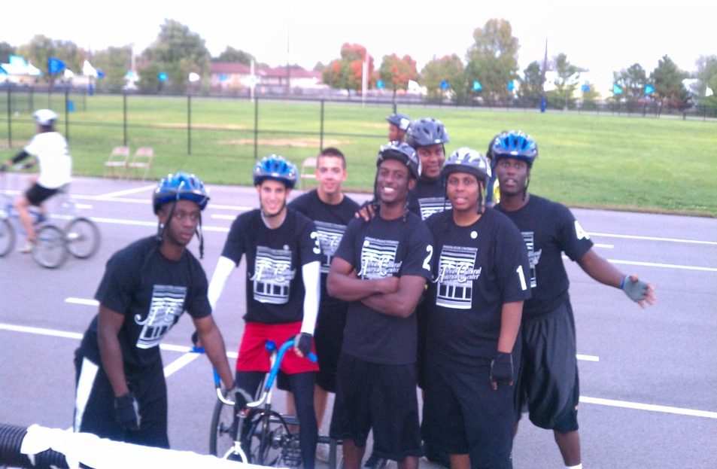
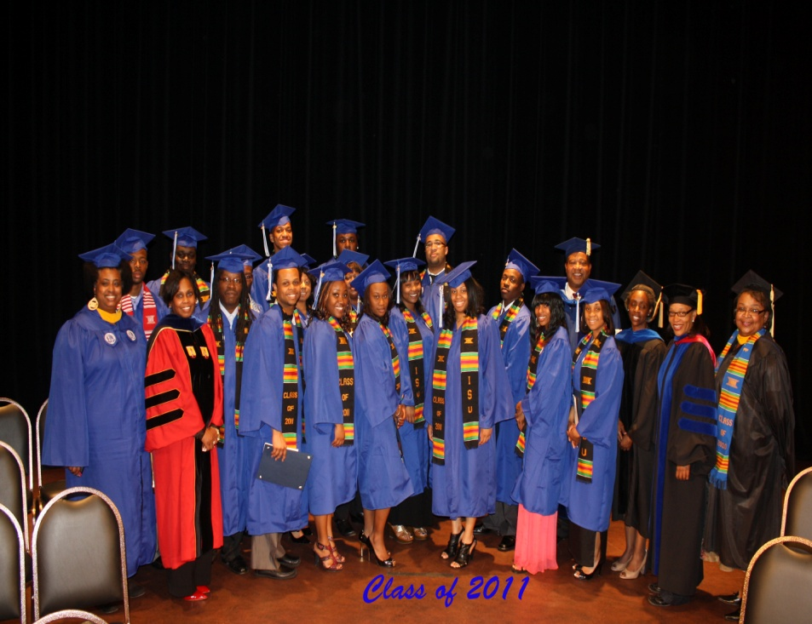
The Pathway to Success
Introduction & Purpose
ISUcceed
Purpose:
Involve & assist parents in process of preparing their student for college
Help students transition from H.S to college & adjust to academic/social rigors of college life
Guide/support students as they learn to navigate university & develop positive academic strategies
Help students build leadership and professional skills
Assist students facing academic and personal difficulties.
Notes:
Purpose of Goal 1 – Initiative 11 is to: develop a comprehensive retention program within the African American Cultural Center.
ISUcceed supports the retention initiative of ISU with a focus geared toward increasing AA student’s rate of retention, sense of academic capability, and persistence to graduation.

Slide 3
The Pathway to Success
Methods
ISUcceed has 4 components:
Summer Orientation Parent Sessions (Summer 2011)
ISUcceed Prep – Fall Orientation
ISUcceed Scholars
ISUcceed Academic Probation
Notes:
ISUcceed SOPS- educated parents on how to assist their student, introduced ISU support resources & discussed the ISUcceed program. June 3-July 1st ; 80 parents participated. Received 70 students. Joined by Career Center; Student Conduct & Integrity; SASC; Counseling Center.
ISUcceed Prep-Fall Orientation – Day and a half orientation, held prior to classes. Aug. 19th & 20th . 70 Freshmen (regular & conditional admits). Helped new students to transition to ISU by introducing them to support services, small group sessions with graduate counselors & upper classmen.
ISUcceed Scholars – Academic year program. Provides on-going social and academic support to students through bi-weekly meetings with GC, academic seminars and leadership development and social activities. 1st week of classes/ 10 graduate counselors/ bi-weekly meetings & academic seminars
ISUcceed Academic Probation – helps students get back on track through bi-weekly or weekly GC meetings and academic seminars. AACC staff goes out to home areas (Gary, Indianapolis, etc…) to meet and talk with students & parents during break and prior to start of Spring semester.

Slide 4
The Pathway to Success
Benchmarks
Initiative Benchmarks
2010 2011 2012 2013 2014
Increased retention rates of African American students to second year NA 43.2% 48% 52% 58%
Increased numbers of regularly participating students in ISUcceed NA 62 100 125 150
Increased rates of ISUcceed first year students w/ at least 2.5 GPA
At mid-semester NA 65% 75% 80% 85%
Increased retention rates of AA students to graduation * (4 year) 5.6% 7.9% 11.0% 12% 15%
Increased 6 year graduation rates of AA students **(6 year) 23.1% 26.5% 28% 29.5% 30.8%
Fall 2010 = Fall 2004 cohort entry*
Fall 2010 = Fall 2002 cohort entry**

Slide 5
The Pathway to Success
Discussion
Year 1: ISUcceed – Academic Probation Program (January 2011)
Year 2 (Summer 2011-2012) Implement full year ISUcceed Program for all African American students regardless of admission status (regular, conditional and transfer admits and continuing students)
90% parents felt very positive about ISUcceed
Program started with 70 students and increased to 92. Ten graduate counselors.
Currently, 62 students regularly attend bi-weekly meetings & academic seminars.
Students from Spring asked to continue in the program
Notes:
Year 1 – ISUcceed started with AA AOP freshmen who were placed on academic probation. Mixed but expected results: students who participated fully (attended bi-weekly meetings & weekly academic seminars & took program seriously) met probation gpa. Students who did not, did not fare as well.
Year 2 – ISUcceed full year. SOPS-very successful. June 3rd-July 1st, 2011; 80 parents participated. 70 students.
ISUcceed Prep Fall Orientation – Aug. 19th –Aug. 20th . 70 Freshmen (regular & conditional admits). Voluntary program.
ISUcceed Scholars Component – started first week of classes. 10 Graduate Counselors. Bi-weekly meetings w/ GC; weekly academic seminar taught by graduate counselors. 91 students in program 1st week of classes. Currently, 62 regularly attend bi-weekly meetings.
ISUcceed Academic Probation Component – for all levels of students on AP; students will work with GC and attend weekly academic seminars. Will begin January 2012 and operate throughout the academic year.

Slide 6
The Pathway to Success
Summary
Strengths:
Focus on all AA students regardless of admission status
Participating in Summer Orientation
Promoting early & regular use of support resources
Early student engagement using resources & activities in AACC
Weekly academic seminars
Minority graduate counselors as examples of success
Challenges:
Lack of tutoring in key courses esp. beyond 1st year level
Student financial support
Inability to obtain current student information

