Slide 1
The Pathway to Success
Goal 1 – Initiative 9
Enhance the Gathering and Use of Information to Advance ISU’s Strategic Priorities

Slide 2
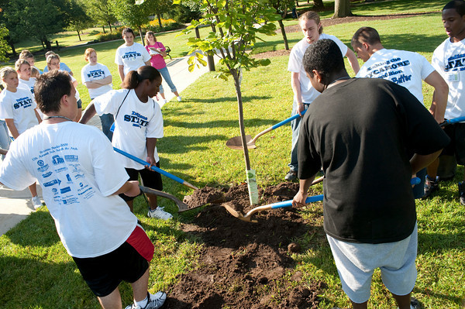
The Pathway to Success
Goal 1 Initiative 9
Better use of information
Find and Collect the Data
Report and Measure the Data
Disseminate the Data
Apply to Decision Making
Notes:
Lack of leverage
Difficulty collecting
Strategic Plan requires better information
Retention
Program Utilization
Model the students

Slide 3
The Pathway to Success
Methods
Capturing and consolidating key non-academic student data (co-curricular data)
Funnel data into Data Warehouse
Understand the data, measure the data, leverage the data
Model Students, measure program success
Disseminating useful and needed information to students and employees

Slide 4
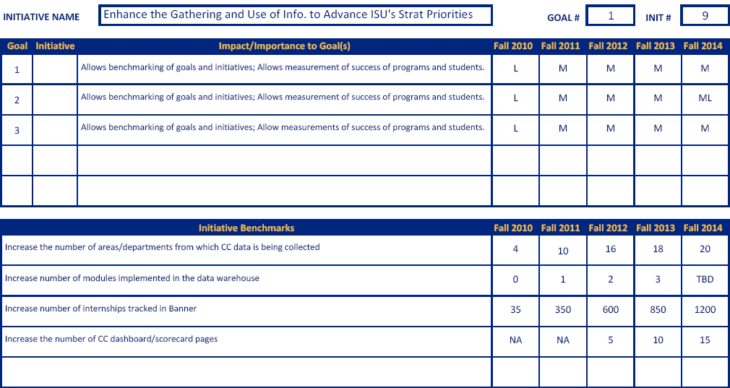
The Pathway to Success
Benchmarks

Slide 5
The Pathway to Success
Discussion
Co-Curricular Data Project
Current
Future
Data Warehouse Project
Current
Future
Data Modeling
Portal Improvements
Mobile App

Slide 6
The Pathway to Success
Summary
Much work has been completed, still much to do
Baseline is possible for many areas
Time to start leveraging that work
Set some goals around the use of information
Questions?

