Slide 1
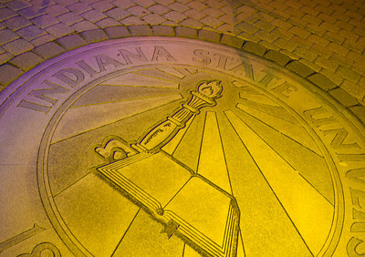
The Pathway to Success
Goal 1 – Initiative 9
Enhance the Gathering
and Use of Information
Notes:
Good morning – thanks
Getting close to lunch
New
Gathering and Using

Slide 2
Accomplishments Since 2013-14 Report
Blue Reports Phase 1 Release
Large CRM effort to support Distance Marketing Effort
Areas working to increase availability and variety of CC Data in Banner

Slide 3
Benchmark Table

Slide 4
Benchmark Progress Detail
CC Data areas still being added
CC Dashboards – Fall 2015
Academic Dashboards – Fall 2015
Internships – Tracked internally at CCE
Departments Using CRM – Full Speed Ahead
Colleges Tracking and Using Attendance – Great Progress

Slide 5
Budget Summary
Total funding allocation for 2014-15: $90,000
Expenses as of report date
Expenditures: $36,000
Encumbered costs: $51,000
Anticipated remainder June 30, 2015
$30,000

Slide 6
Accomplishments Since Plan Inception
Campus culture much more data oriented
28 Areas now tracking CC Data
Data Warehouse implemented
Data Warehouse rebooted
CRM going Enterprise Wide
Attendance tracking being aggressively investigated/piloted

Slide 7
Baseline Recommendation
Tightly integrated with IT and IR
Some budget has been integrated
Initiative should remain active
Nature of technology
State of internal knowledge
President Bradley

Slide 8
Looking Ahead - Recommendations
CRM
Must keep our project resources focused on expanding adoption of Blue Reports and CRM
Blue Reports
Enrollment Data/Retention Data/Graduation Data is available
Must continue improving collection and report of CC Data/Career Data
Attendance
Tracked and available as part of student profile
Blue Reports? MapWorks? Banner?

Slide 9
New points of emphasis
Blue Reports – Get the word out
Required usage:
Blackboard
Attendance taking
CRM
Graduate and Professional Studies
Sycamore Express

Slide 10
Foreseeable Roadblocks
Adoption
Competing Priorities
Technology
Cost

Slide 11
Missed opportunities
Timing?
Knowledge?

Slide 12
Questions?
Enhance the Gathering and Use of Information
Mike Snyder
mike.snyder@indstate.edu

