Slide 1
The Pathway to Success
Goal 1 – Initiative 8
Advancing Graduate Education

Slide 2
The Pathway to Success
Introduction & Purpose
To increase the viability of programs through enhanced enrollment
To improve the student experience through technology and process improvements
To increase the total number of international students enrolled in graduate programs.
To improve the competitiveness of assistantships

Slide 3
The Pathway to Success
Methods
New program development and alternate delivery
Expanded use of web and e-infrastructures; as well as improved processing systems
New graduate assistantship policies, increase stipends, and fix building fee
Targeted international recruitment

Slide 4
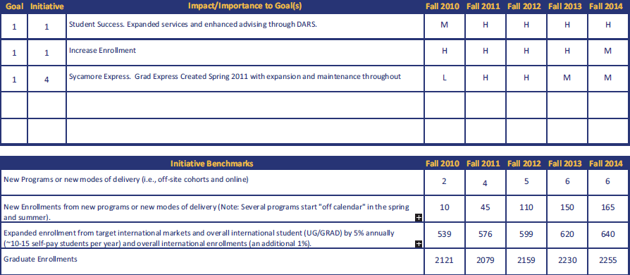
The Pathway to Success
Benchmarks

Slide 5
The Pathway to Success
Discussion
PROGRAMS: New program development will slow—and approved programs will begin enrolling. Programs should be fully enrolled by spring/summer 2014.
SERVICES: Electronic Theses/Dissertations, DARS, New Processing, GradExpress (one-stop)
ASSISTANTSHIPS: Indexed stipend floor, eliminated building fee (40% savings to students), revised more program centered GA guidelines
ENROLLMENT: 21% increase in international graduate students, new cohorts in CNHHS

Slide 6
The Pathway to Success
Summary
1. Significant progress has been made in expanding the number of new self sustaining high demand programs
2. Expanded electronic services and technology-driven processes yield results
3. International recruitment has been increased vis-à-vis strategic investments across campus. The result has been a significant increase in tuition revenue (ROI conservatively estimated at 12:1 since 2008)
4. New programs will continue to enhance graduate enrollment through at least spring/summer 2014

