Slide 1
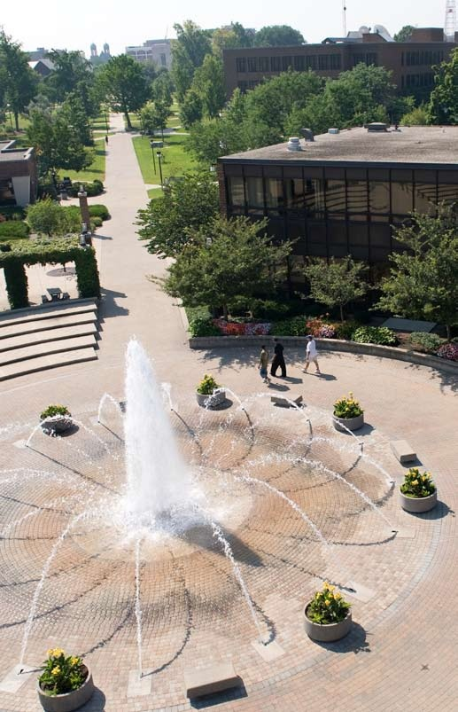
The Pathway to Success
Goal 1 – Initiative 11D
Persistence to Completion
Initiative Chair:
Joshua Powers
Notes:
Good morning – thanks
Getting close to lunch
New
Gathering and Using

Slide 2
Accomplishments Since 2013-14 Report
Advancement of Your Success is Our Story campaign
2nd Annual Student Success Conference (90+ attendees)
Launch of SUCCESSx for students (150+ attendees)
MAP-Works usage up 460%
21st Century Scholar retention up 3.0%
SophoMORE Success Program.

Slide 3
Additional Accomplishments
FITW Grant – U.S. DOE “Accelerating College Completion Through Math Mindset” $1.63 million.
ICHE Contract Project - “21st Century and O’Bannon Scholar Corps” $127,264.
Lumina Foundation Grant – “College Students and Poverty” $10,000
College Transition Collaborative – Stanford University – “Social Belonging and Historically Marginalized Students”

Slide 4
Benchmark Table
Initiative Benchmarks | FY 2013 | FY 2014A | FY 2014G | FY 2015 | FY 2016 | FY 2017
Increase 4-year completion rate. | 22.7% | 21.5% | 25% | 26% | 28% | 30%
Increase 6-year completion rate. | 41.8% | 39.6% | 46% | 48% | 49% | 50%
Increase # faculty/staff using MAP-Works. | 174 | 644 | 200 | 225 | 240 | 250
Commitment to ISU Score – MAP-Works. | 5.74 | 6.11 | 5.8 | 5.85 | 5.87 | 5.9
1-year retention of first generation mentees. |  | 64.3% | TBD | +2% | +2% | +1.5%
1-year retention of 21st Century Scholars. | 61.2% | 64.2% | 62% | 64% | 66% | 68%
Retention of sophomores in LC at UA. |  |  |  | TBD | +2% | +2%
D/F/Drop rate in MATH 115 & ENG 105 with wrap-around tutoring. |  |  |  | TBD | -15% | -10%

Slide 5
Benchmark Progress Detail
4-year and 6-year completion still stuck roughly where it has been for at least 15 years.
MAP-Works engagement up 370%.
Freshmen commitment to institution trending up.
First generation mentoring moving to a LC model.
21st Century Scholar retention up 3%.
Sophomore Learning Community at UA well received.
MATH 115 with wrap-around tutoring: Avg. drops Spr. 2014: 27%; Avg. drops Spr. 2015 : 17%.

Slide 6
A Window into MAP-Works
Stephanie Pearcy, Director of First Year Student Outreach & Success

Slide 7
A Window into the Sophomore Learning Community
Amanda Knerr, Executive Director, Residential Life

Slide 8
Budget Summary
Total funding allocation for 2014-15: $150,000
Expenses as of report date
Expenditures ($45,558)
Encumbered costs ($102,815) – after various transfers for past activities and activities still to happen
Anticipated remainder June 30, 2015
$1,627

Slide 9
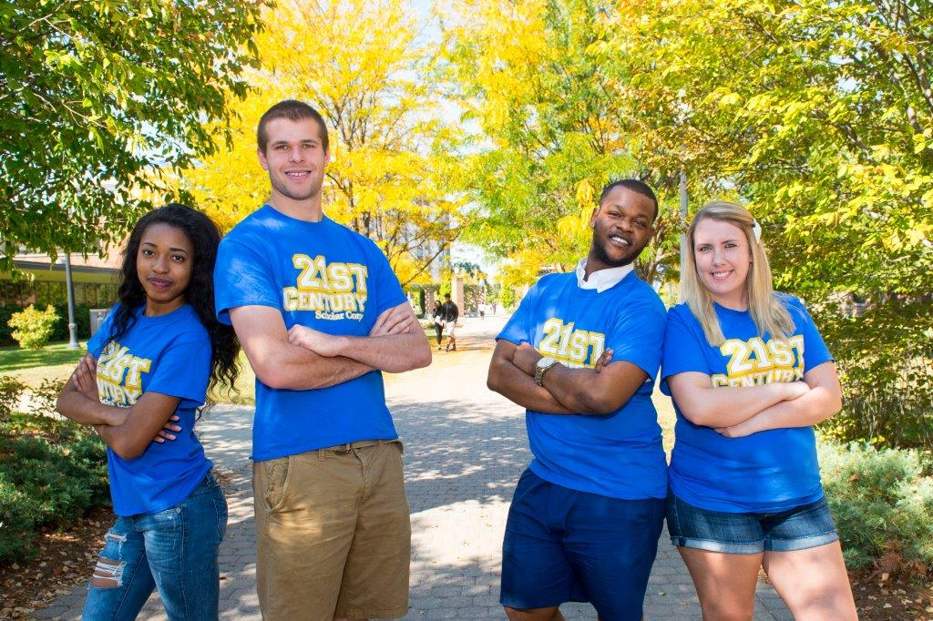
Accomplishments Since Plan Inception
MAP-Works usage exploded.
21st Century Scholars – Shift from something to be hidden to a point of pride.
1st year retention up 6.4% since 2011.
SEM Planning Process: New Goal initiatives and culture of data to inform decisions.

Slide 10
Looking Ahead - Recommendations
Advising Task Force
21st Century Scholar & Frank O’Bannon Aid recipients & CH targets

Slide 11
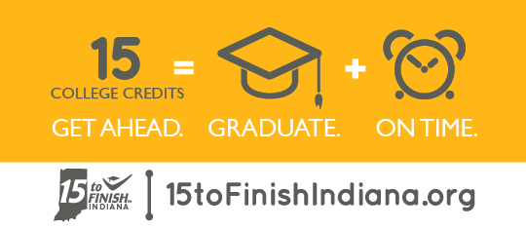
Foreseeable Roadblocks
What emerges from the Advising Task Force, especially around costs, if we move to a larger professional advising model for sophomores and higher. Can we afford it?
Interest alignment challenges.

Slide 12
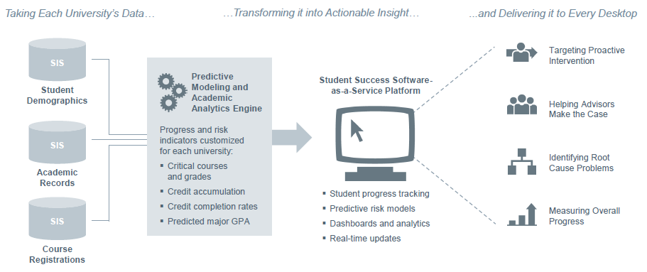
(Possible) New point of emphasis
Descriptive Analytics (what we have now)
Versus
Predictive Analytics (what others are adopting)

Slide 13
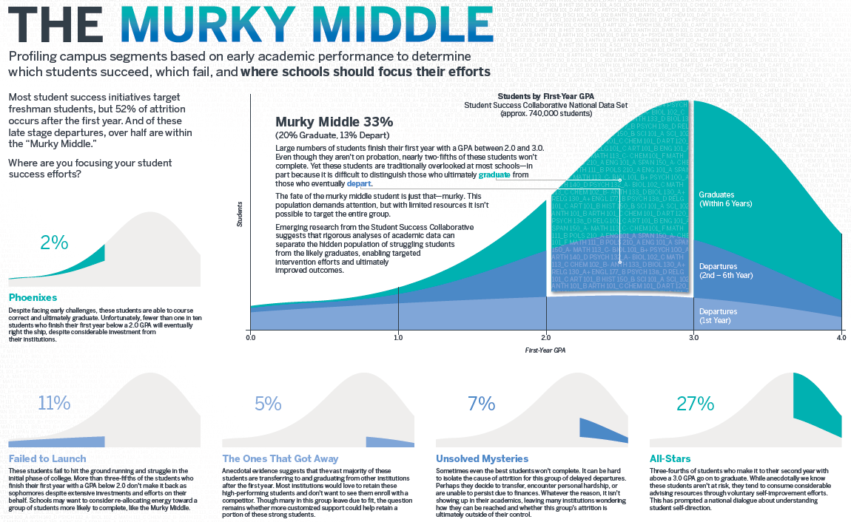
Missed opportunities
No lack of opportunities to “do” things. But are they the right things? Difficult to isolate the impact of a program/activity.
Missed opportunities, but catching up…
Attention to our murky middle: 2.5-3.0 HS GPA.
Expand summer
bridging/pre-fall start.
Making summer more
accessible.

Slide 14
Baseline Recommendation
Has this initiative been sufficiently integrated into your operations?
Some are mature and already weaved into the fabric of a unit’s work.
Opportunity to baseline some, but not all.

Slide 15
Opportunities for Collaborations
Associate Deans
The Library

Slide 16
Questions?
Persistence to Completion
Josh Powers
jopowers@indstate.edu

