Slide 1
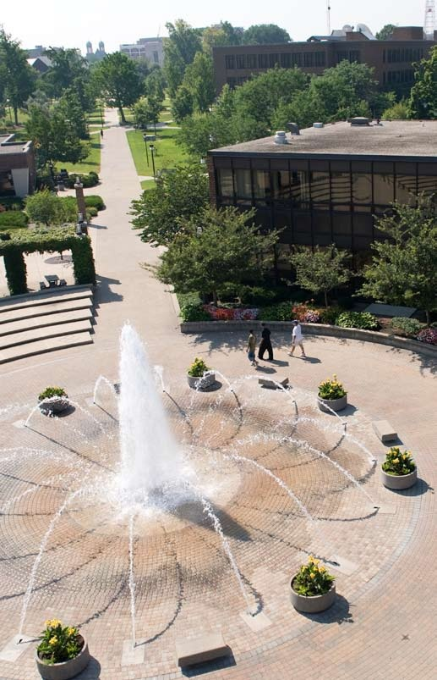
The Pathway to Success
Goal 1 – Initiative 11B
Financial Literacy
Crystal Baker
Notes:
Good morning – thanks
Getting close to lunch
New
Gathering and Using

Slide 2
Accomplishments Since 2013-14 Report
SEM Initiative 1
To enhance what is done to better educate and prepare new students and their families prior to the student enrolling in the fall.
Strategy 1: Develop college preparation web content for the ISU website and to enhance early outreach.
Strategy 2: Enhance the financial literacy of students and their families.
Strategy 3: Augment college going education for admits and families via the use of a multimedia seminar entitled Sycamoreology.
Strategy 4: Re-vision the conditional admission process, enhance the summer bridge program as a component of the conditional admit experience, and redefine in-college experience for conditional admits.

Slide 3
“Enhance the financial literacy of students and their families.”
Investing
Employment benefits
Risk analysis
Venture capital
Stocks
Budgets

Slide 4
Labor Day, 2014:
13,160 enrolled students
8,810 met disbursement requirements
8,112 have an account balance
832 have a balance, FAFSA on file, and have not met disbursement requirements
2,295 have a balance and no FAFSA on file.
Aug 20, 2014:
12,672 enrolled students, 11,272 filed a FAFSA
8,530 have met disbursement requirements (76% of filers)
8,222 have an account balance
2,742 have a balance, FAFSA on file, and have not met disbursement requirements
1,711 have a balance and no FAFSA on file

Slide 5
“Enhance the financial literacy of students and their families.”
Filing a complete FAFSA
Meeting deadlines
Making smart choices
How to spend your refund
Loan repayment
Budgets
Investing
Employment benefits
Risk analysis
Venture capital
Stocks

Slide 6
What we did in 2014
Indstate.edu/moneymatters
Curricular integration into Personal Financial Planning courses and Univ 101, LEAP, Project Success, ISUcceed, Res Life, Parent & Family Programs, and Commuter Services
15 events
NSO coach, personalized worksheet
Outbound peer calls
Financial Wellness Committee
Publications: mailbox stuffers, postcard, posters
MyISU Portal revision

Slide 7
Benchmark Table

Slide 8
Proposal
Fund a new, customizable, Banner-integrated, turnkey/delivered software solution to launch in the next 12 months;
Lend consulting support to OIT to enhance financially-related reports via an enterprise-wide reporting solution; and
Give the Financial Aid Office $5,000 to continue with printed publications and events related to college financial outreach
Notes:
Everfi

Slide 9
Everfi
Notes:
Everfi

Slide 10
iStrategy
Link: http://www.blackboard.com/Platforms/Analytics/Products/Enrollment-Management-Suite.aspx
Notes:
Everfi

Slide 11
iStrategy
EFC | 0-500 | 501-1000 | 1001-1500 | 1501-2000
Gift Aid | ? | ? | ? | ?
Merit Aid | ? | ? | ? | ?
Loans | ? | ? | ? | ?
Net price | ? | ? | ? | ?
Notes:
Everfi

Slide 12
iStrategy
HS GPA | 1.0 | 1.5 | 2.0 | 2.5
Gift Aid | ? | ? | ? | ?
Merit Aid | ? | ? | ? | ?
Loans | ? | ? | ? | ?
Net price | ? | ? | ? | ?
Notes:
Everfi

Slide 13
iStrategy
Parent Income | 15,000 | 20,000 | 25,000 | 30,000
Verification % | ? | ? | ? | ?
# of missing items | ? | ? | ? | ?
Gift aid | ? | ? | ? | ?
Unpaid balance | ? | ? | ? | ?
Notes:
Everfi

Slide 14
Publications
Notes:
Yearly allocation is about $10,000 which I blow through in a heartbeat sending FANs.

Slide 15
Proposal
Everfi -$10,000
iStrategy consultant (40 hours) -$8,000
Give me Money -$5,000
SPIT Remainder as of June 30: $15,000
Total needed for FY16: $8,000
Notes:
Everfi

Slide 16
Foreseeable Roadblocks
New benchmarks
Performance indicators for the financial aid office
Claim rate of self-help aid
Unpaid balance
“Escalation”
Loan default rates
Refund activity

Slide 17
Missed opportunities
Parents
Distance
Portal phase 2: Cascade

Slide 18
Discussion

